Slide 1

Reducing the uncertainty of projected climate change
    Francis Zwiers, Pacific Climate Impacts Consortium, University of Victoria
    Chao Li, Tong Li, Xuebin Zhang, Qiaohong Sun, Yongxiao Liang, Jianyu Wang
    Photo: L’estive de Paloumère, France

Slide 2

Introduction
What is a climate model?
  Intro based on circa 2010 slides … basic notions remain the same today
Sources of projection uncertainty
  Hawkins and Sutton, 2009, BAMS, Fig. 4
  Li et al, 2021, Fig. 1
  Deser et al, 2012, Fig.1
Extreme precip a key concern
  Model fidelity (Li et al, 2021, Fig 3)
  Projections (Li et al, 2021, Fig 5)
  Uncertainty as characterized by scaling rates (Li et al., 2021, Fig 7)
In the face of this large uncertainty, how do we narrow projections to make them more useful for adaptation planning and implementation?
Smokey summer sunset over the Strait of Juan de Fuca, Shirley, BC, Canada

Slide 3
Climate model hierarchy
EBMs (Energy Balance Models)
  Simulate balance between incoming shortwave radiation (sunlight) and outgoing infrared radiation (heat)
  Deterministic (no chaotic variability)
AOGCMs (Coupled Atmosphere-Ocean General Circulation Models)
  Include general circulation models of atmosphere and ocean, together with sea ice, land surface models and sometimes land ice
ESMs (Earth System Models)
  AOGCM plus additional earth-system components (terrestrial and oceanic ecosystems, carbon and nitrogen cycles, ozone chemistry, perhaps large ice sheets…)
EMICs (Earth system Models of Intermediate Complexity)
  May include some dynamical components (e.g., energy balance atmosphere coupled to dynamical ocean and ice sheets)
RCMs (Regional Climate Models)
  Limited area, atmosphere and land surface only, can be very high resolution

Slide 4
Primitive equations for atmospheric general circulation
Newton’s second law (simplified)
acceleration in the zonal, meridional and vertical directions (functions of longitude, latitude, height, and time) is given by:
pressure
gradient
acceleration
Coriolis term
gravity
friction

Slide 5
Continuity equation (conservation of mass)
First law of thermodynamics for a gas
adiabatic term
diabatic term
net heat gain or loss
from external sources
Equation of state

Slide 6

What is a climate model?
Courtesy CCCma

Slide 7
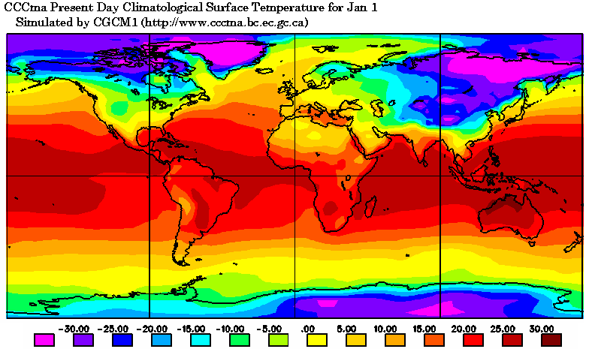
Annual cycle of surface temperature
Courtesy CCCma
Notes:
Figure 1:
24 hour precipitation as observed at the Toronto Airport during a 2-year period and as simulated by two generations of the CCCma atmospheric general circulation model at a grid point near Toronto. The diagram demonstrates that these GCMs simulate precipitation variability that is similar to that which is observed. The more recent version of the model (AGCM3) appears to produce smaller precipitation extremes at this particular location that the earlier version of the model. Scale considerations suggest that models should simulate smaller precipitation extremes than observed, and that there should be increasing agreement as the resolution of the model increases.

Slide 8
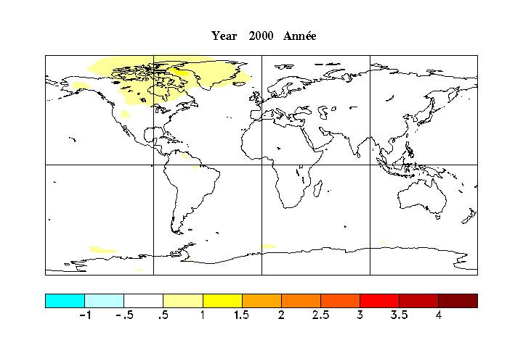
CGCM3
A surface temperature change projection (SRES-A1B)
Courtesy CCCma
°C

Slide 9
CGCM3
A surface temperature change projection (SRES-A1B)
Courtesy CCCma
°C

Slide 10
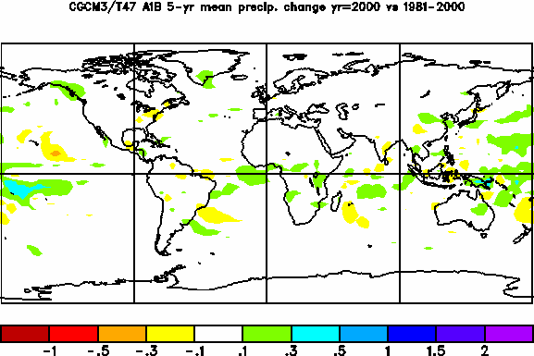
A precipitation change projection (SRES-A1B)
Courtesy CCCma
CGCM3
mm/day

Slide 11
Transfer of C and nutrients through rivers
Mineral Dust
Mineral Dust
Chemistry
CHEMICAL LAND
CO₂, CH₄
CHEMICAL
ATMOSPHERE
CO₂
CHEMICAL OCEAN
ESMs go beyond the physical climate system by including feedbacks between climate and biosphere (via carbon cycle), and representing important chemical processes related to sulfur, ozone and nitrogen.
C and N contents of terrestrial vegetation and soil organic matter
Inorganic soil C content
Inorganic soil N content (NH₄+, NO₃−)
[CO₂]
[CH₄]
[N₂O]
CFCs
[O₃]
[SO₄]
[BC]
[OC]
[Mineral Dust]
[Sea salt]
Ocean carbonate system state (pH, alkalinity, nutrients (N, P, Si, Fe))
Dissolved organic matter
N₂, N₂O, VOCs,
SO₂, BC, OC
CH₄, N₂O,
DMS
N₂, NH₄+, NO₃−
NH₄+, NO₃−, Fe
BIOLOGICAL LAND
BIOLOGICAL OCEAN
Vegetation attributes including
Leaf biomass
Vegetation height
Root biomass
Fractional vegetation coverage
Anthropogenic
emissions
CO₂, CH₄, SO₂, N₂O,
BC, OC
Abundance and composition of key plankton functional groups
Biology
Anthropogenic fire &
land use change
Humans
PHYSICAL LAND
PHYSICAL
ATMOSPHERE
PHYSICAL OCEAN
Leaf area index
Roughness length
Rooting depth and distribution
Land surface albedo
Soil moisture
Soil temperature
Snow
Land ice/Glaciers
Temperature
Humidity
Pressure
Winds
Clouds (Liquid and frozen water contents and fraction)
Sea surface albedo
Temperature
Salinity
Sea ice fractional coverage and thickness
Surface and planetary waves
Physics
Energy, water, and momentum fluxes
Energy, water, and momentum fluxes
River discharge

Slide 12
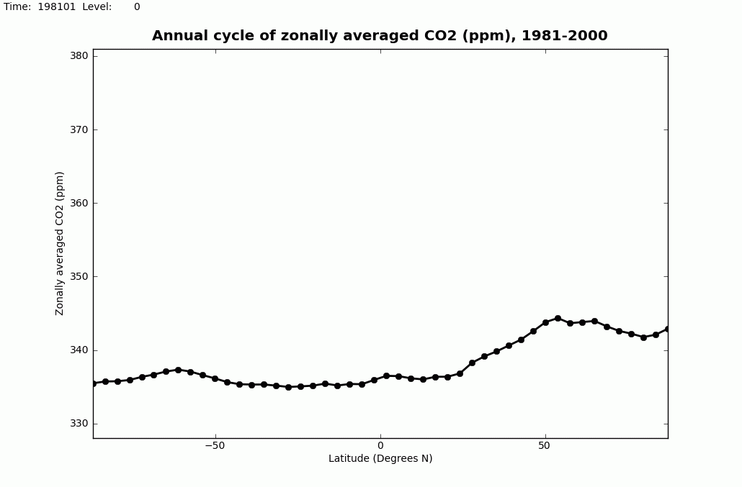

Transient response of CanESM to historical emissions
Annual Cycle of CO2 (1981-2000)
Southern hemisphere
Northern hemisphere
South Pole
Equator
North Pole
Courtesy V. Arora, CCCma

Slide 13
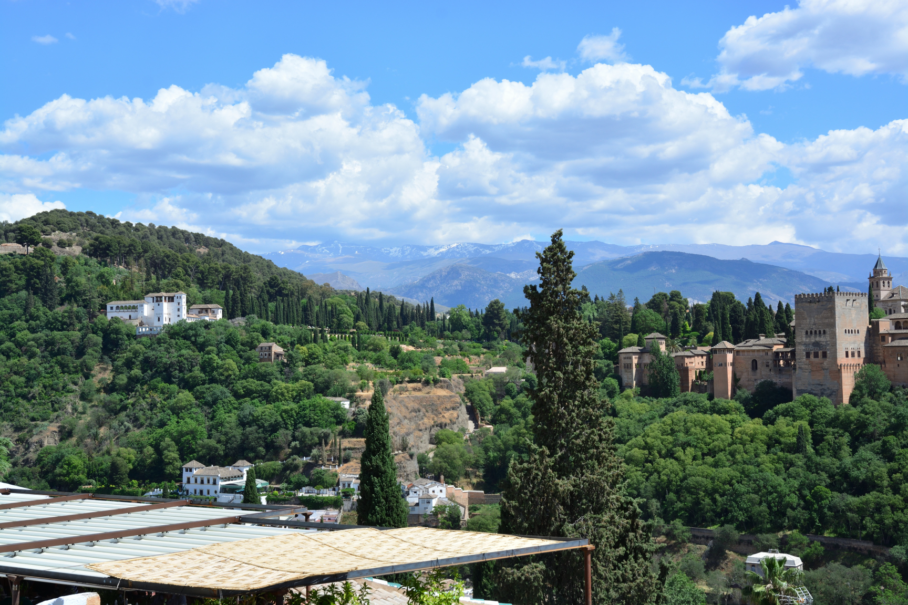
Sources of climate modelling uncertainty
Alhambra Palace Complex, Granada, Spain (Sierra Nevada’s in the distance)

Slide 14
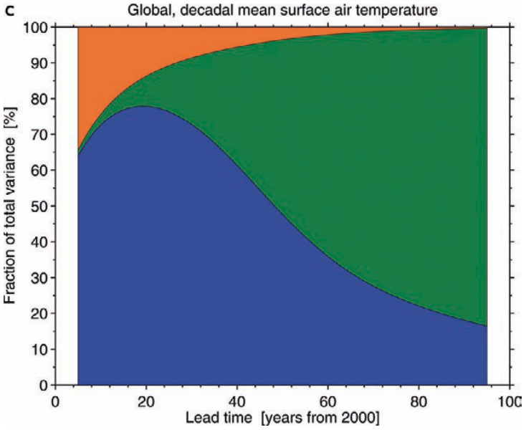
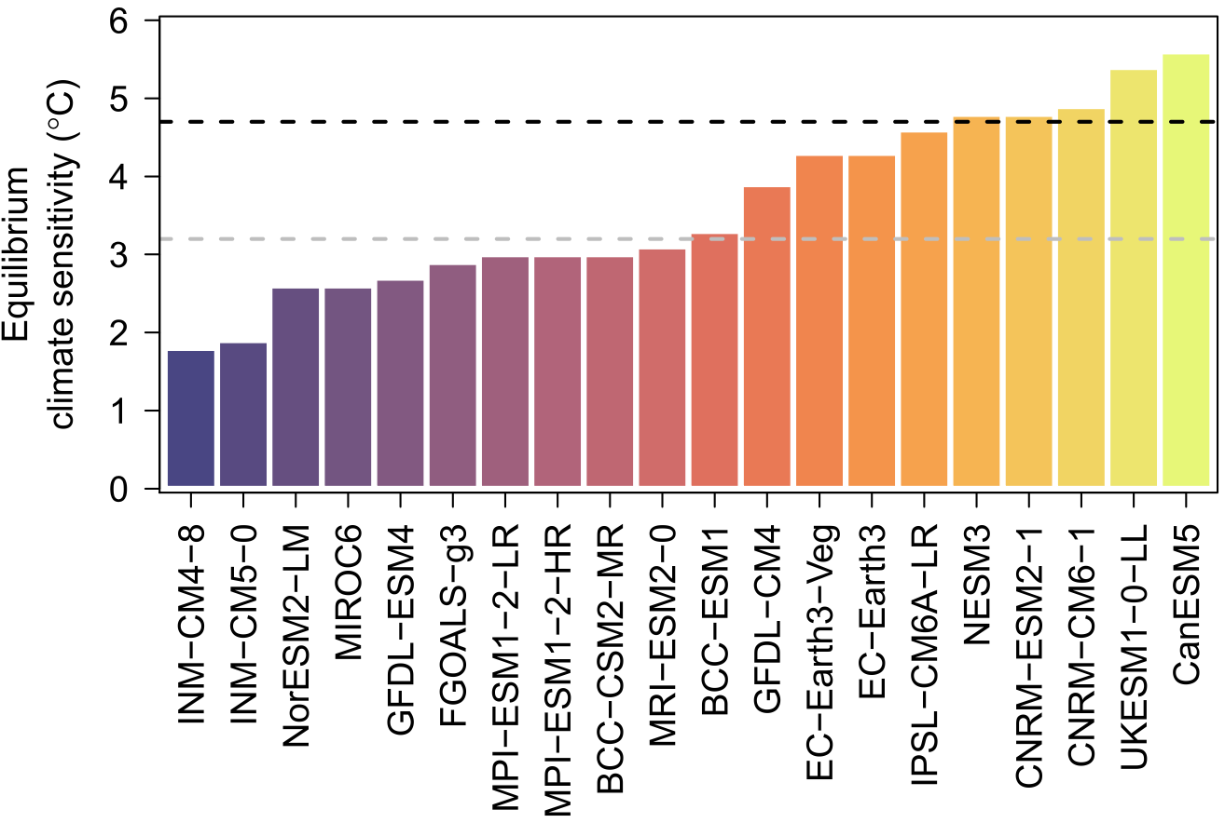
Sources of projection uncertainty
Relative importance of sources of uncertainty in global surface temperature projections
Equilibrium climate sensitivity of a selection of models participating in CMIP6
Internal variability
  Li et al, 2021, J. Climate, Fig. 4
Forcing scenario
Model
  Hawkins and Sutton, 2009, BAMS, Fig. 4
Notes:
Left: Hawkins and Sutton, 2009, Fig 4c: Fig. 4. The relative importance of each source of uncertainty in decadal mean surface temperature projections is shown by the fractional uncertainty (the 90% confidence level divided by the mean prediction) for (a) the global mean, relative to the warming from the 1971–2000 mean, and (b) the British Isles mean, relative to the warming from the 1971–2000 mean. The importance of model uncertainty is clearly visible for all policy- relevant timescales. Internal variability grows in importance for the smaller region. Scenario uncertainty only becomes important at multidecadal lead times. The dashed lines in (a) indicate reductions in internal variability, and hence total uncertainty, that may be possible through proper initialization of the predictions through assimilation of ocean observations (Smith et al. 2007). The fraction of total variance in decadal mean surface air temperature predictions explained by the three components of total uncertainty is shown for (c) a global mean and (d) a British Isles mean. Green regions represent scenario uncertainty, blue regions represent model uncertainty, and orange regions represent the internal variability component. As the size of the region is reduced, the relative importance of internal variability increases.
Right: Li et al, 2021, Fig 1b: Equilibrium climate sensitivities of the climate models, with the black and gray horizontal lines marking respectively the highest and mean value in the prior generation CMIP5 models. [These estimates are acquired from a Carbon Brief report ‘‘CMIP6: the next generation climate models explained’’ available from https://www.carbonbrief.org/cmip6-the-next-generation-of- climate-models-explained. Estimation is based on the method used in IPCC AR5 as described in Gregory et al. (2004)].

Slide 15
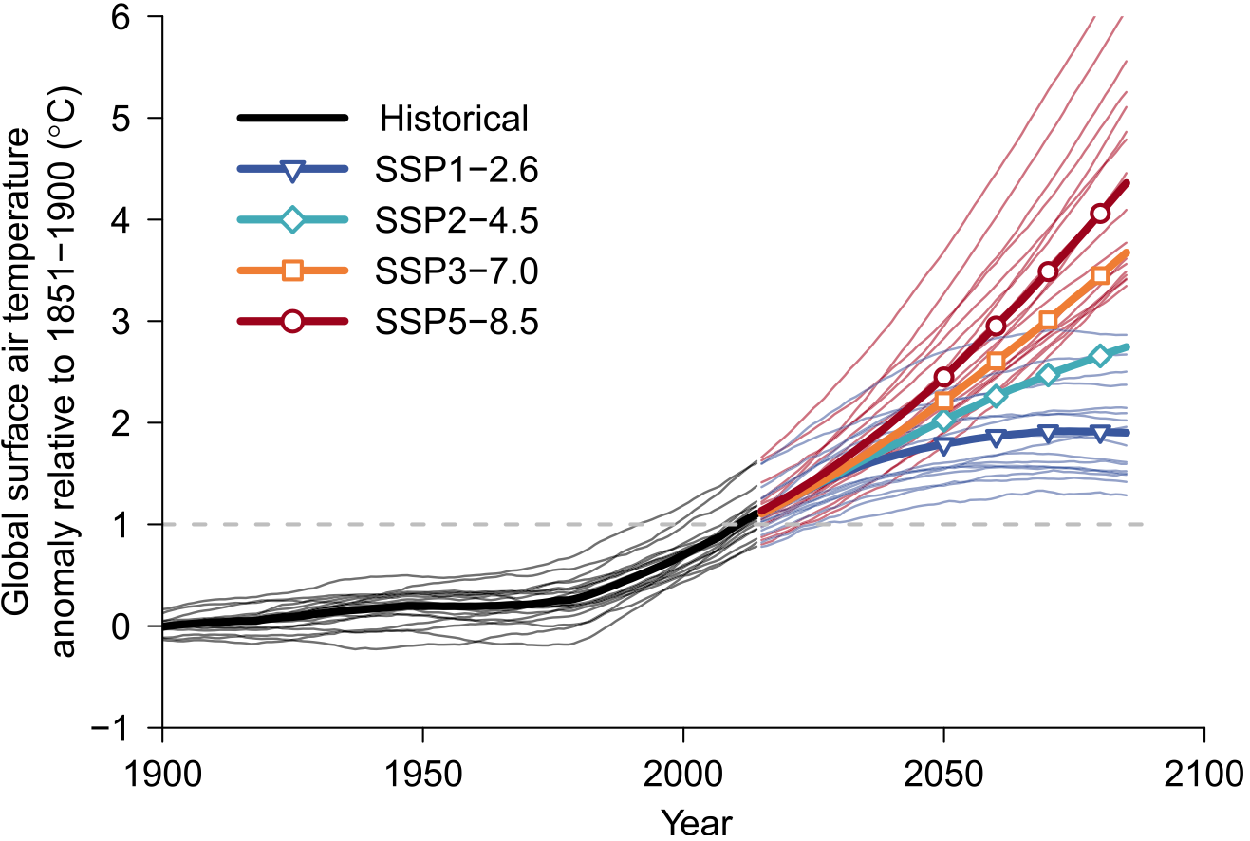
Simulated evolution of global surface air temperature
relative to 1851-1900 illustrating model and scenario uncertainty
  Li et al, 2021, J. Climate, Fig. 1
Notes:
Li et al., 2021, Fig 1c: Global annual mean surface air temperature anomalies relative to the 1851–1900 average simulated by the climate models. The thick lines (with symbols marked for future projections) show the multimodel median anomalies, and the thin lines show anomalies from indi- vidual models. Only anomalies under SSP1–2.6 and SSP5–8.5 are shown for individual models for clarity. The anomalies are smoothed by applying a 31-yr moving average. The horizontal line marks the 1.08C anomaly line.

Slide 16
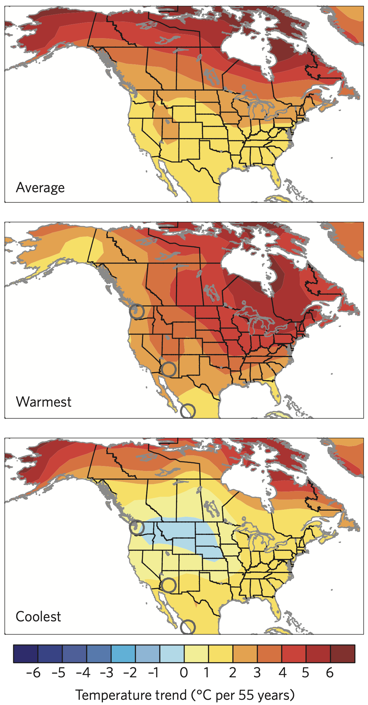
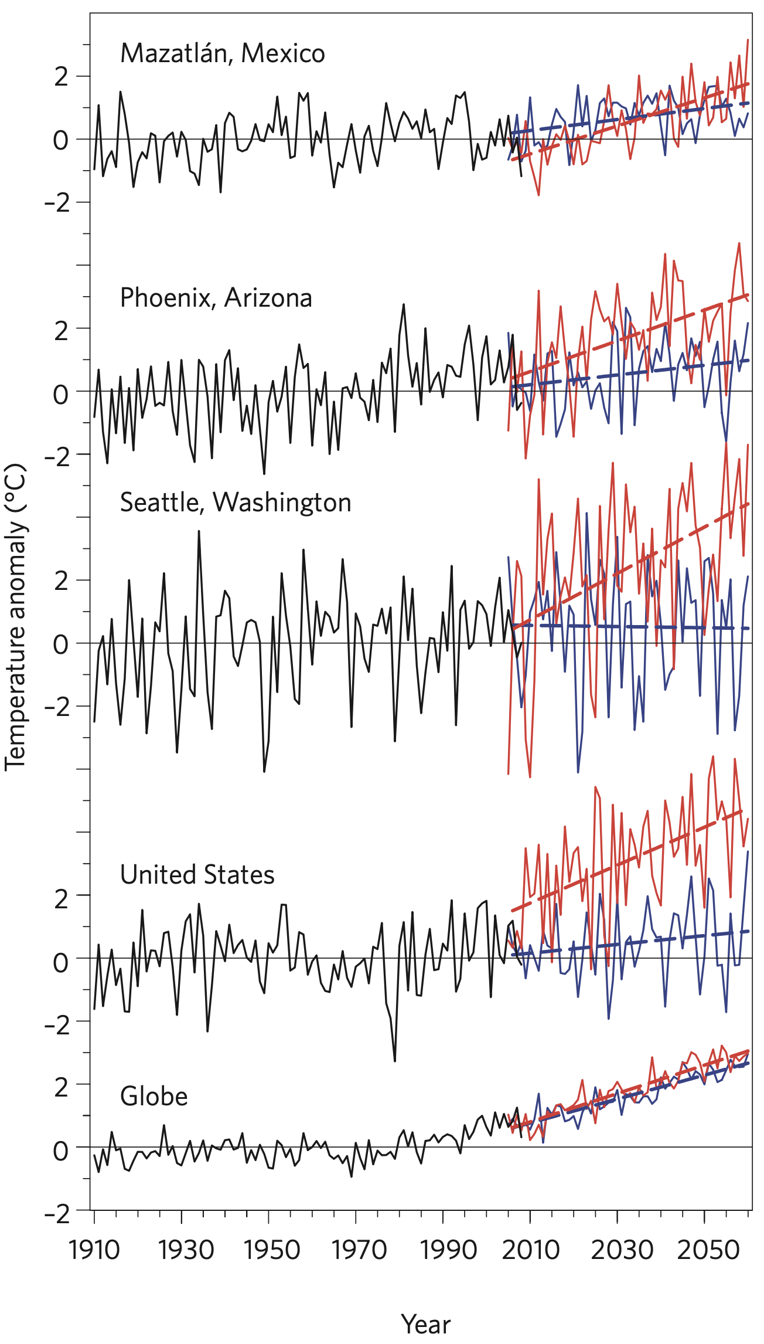
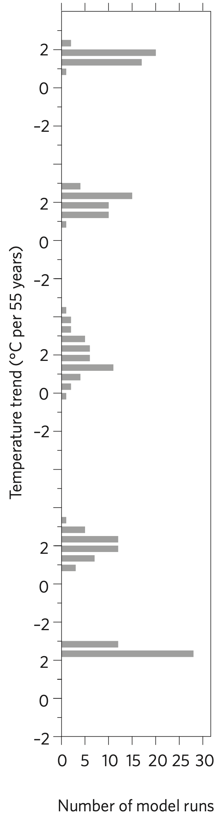
Impact of internal variability (DJF surface air temperature)
CCSM3
40 members
SRES A1B forcing
  Deser et al, 2012, Nature Climate Change, Fig. 1
Contiguous
Notes:
Figure 1 | Range of future climate outcomes. a, December–January–February (DJF) temperature trends during 2005–2060. Top panel shows the average
of the 40 model runs (all values are statistically significantly different from zero at the 5% confidence level); middle and bottom panels show the model
runs with the largest and smallest trends for the contiguous United States as a whole, respectively. b, DJF temperature anomaly time series for selected
cities (marked by open circles in the left panels), the contiguous United States and the globe (land areas only). Black curves show observed records from
1910 to 2008 (minus the long-term mean); red and blue curves show model projections for 2005–2060 from the realizations with the largest and smallest
future trends, respectively, for each location or region. Dashed red and blue lines show the best-fit linear trends to the red and blue curves, respectively. For
visual clarity, the model projections are matched to observations averaged over their common period of record 2005–2008. Thus, projected values at the
end of the simulation (2060) should be regarded in relative terms (see Supplementary Information). c, Distribution of projected DJF temperature trends
(2005–2060) across the 40 ensemble members at the locations shown in panel b.

Slide 17

Precipitation extremes from climate models

Slide 18
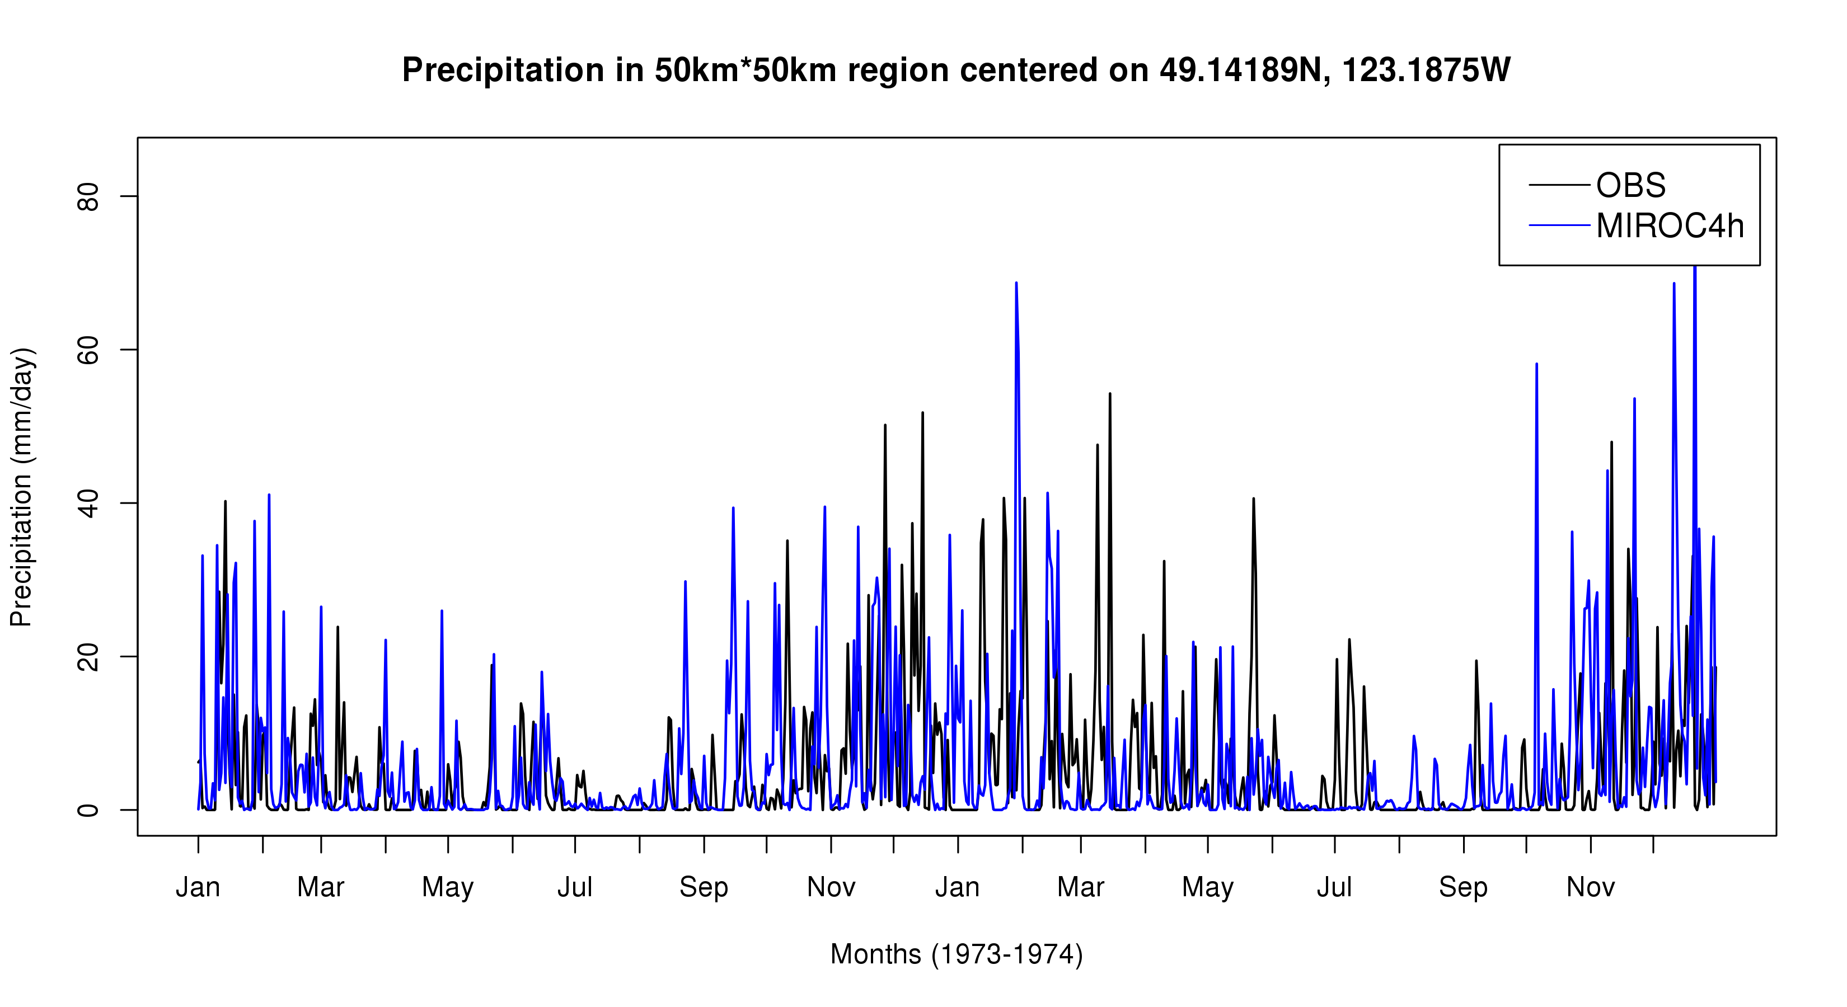
Can we plausibly consider precipitation extremes from climate models?
Mean daily precipitation in the MIROC4h
grid box centered on 49.1N, 123.2W (Vancouver)
40 stations reporting on average
?
1973
1974
Courtesy B. Veerman, PCIC

Slide 19
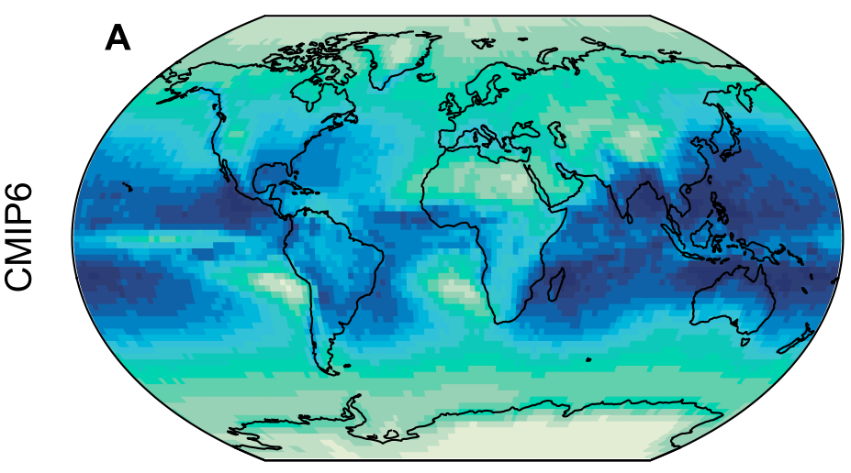
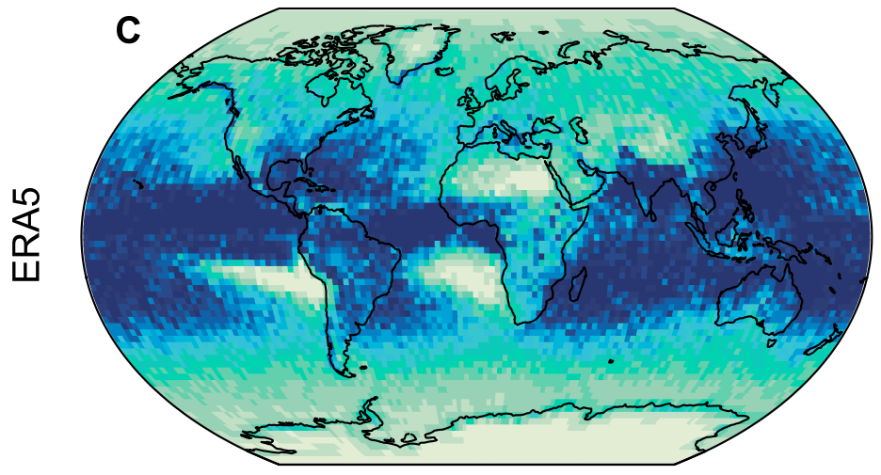
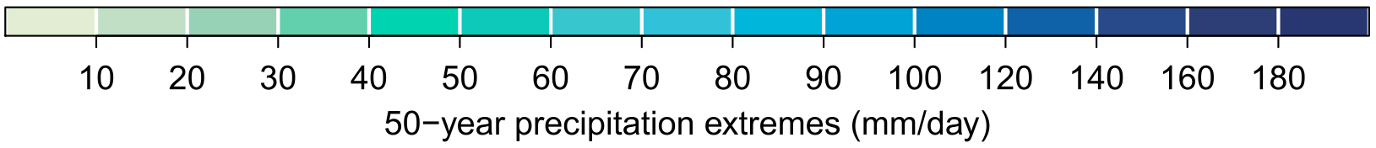
Can models simulate rare, intense, precipitation events?
  Li et al, 2021, J. Climate, Fig. 3
Notes:
FIG. 3. As in Fig. 2, but for Rx1day and Rx5day [units in (a)–(d) are mm day21 and in (e) and (f) are dimensionless]. Note that the differences between models and ERA5 are expressed as the ratios of the model estimates over the ERA5 estimates. (FIG. 2. Estimates of 50-yr return values of TXx and TNn (8C) in 1985–2014. (a)–(d) The CMIP6 multimodel median estimates of 50-yr return values of TXx and TNn in 1985–2014 and the corresponding estimates using ERA5 reanalysis. (e),(f) Differences between the CMIP6 multimodel median estimates of 50-yr return values of TXx and TNn in 1985–2014 and the corresponding ERA5 estimates. )

Slide 20
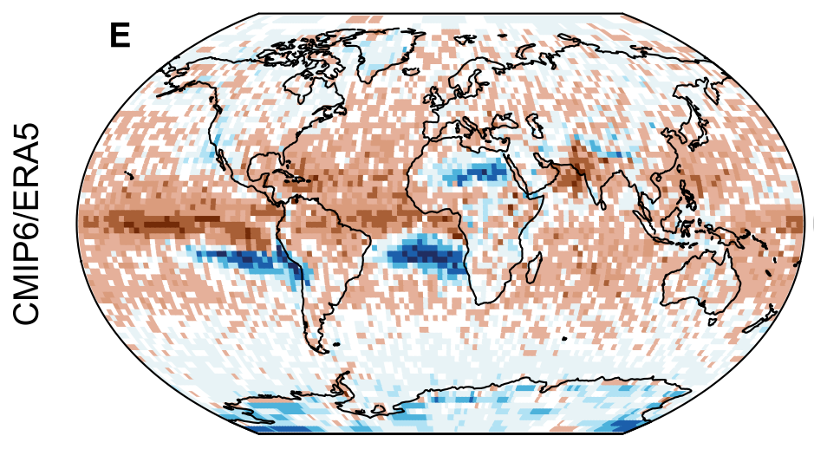
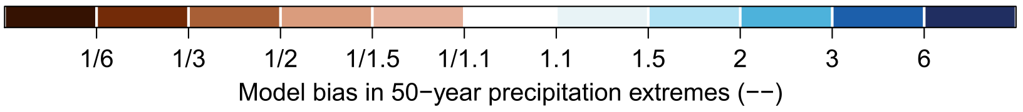
CMIP6/ERA5 comparison of estimated 50-year 1-day precipitation events
for the period 1985-2014
  Li et al, 2021, J. Climate, Fig. 3

Slide 21
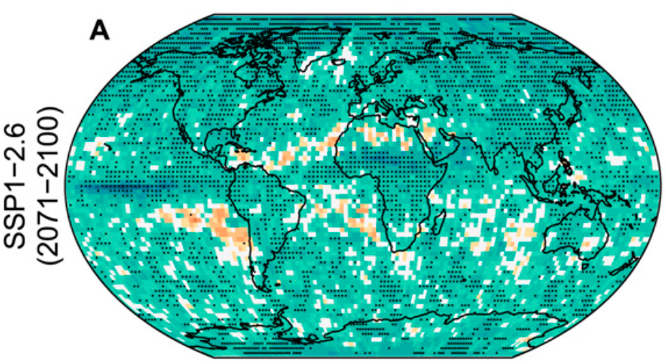
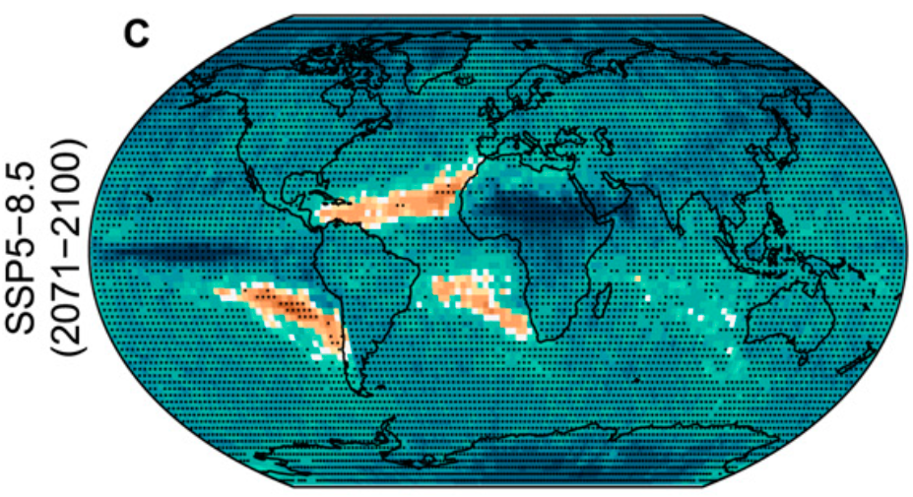
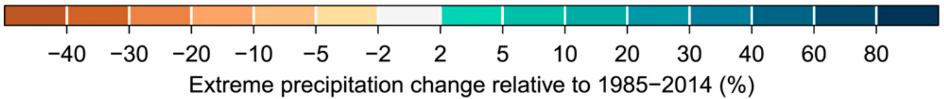
Projected relative changes in 50-year 1-day precipitation events
2071-2100 vs 1985-2014
  Li et al, 2021, J. Climate, Fig. 5
Notes:
FIG. 5. As in Fig. 4, but for Rx1day and Rx5day (%). (FIG. 4. Projected changes in 50-yr return values of TXx and TNn (8C). (a)–(d) The CMIP6 multimodel median changes in the 50-yr return values of TXx and TNn in 2071–2100 under the lower SSP1–2.6 and higher SSP5–8.5 scenarios relative to 1985–2014. (e),(f) The corresponding changes at 2.08 and 4.08C global warming above pre- industrial relative to the 1.08C global warming. Stippling marks grid cells where at least 80% of the available models or warming level windows agree on the sign of the corresponding ensemble median changes. )

Slide 22
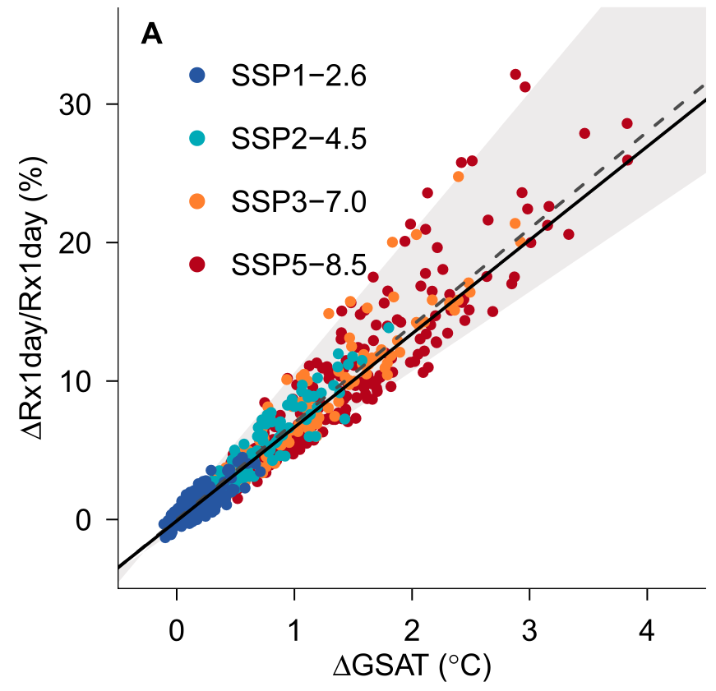
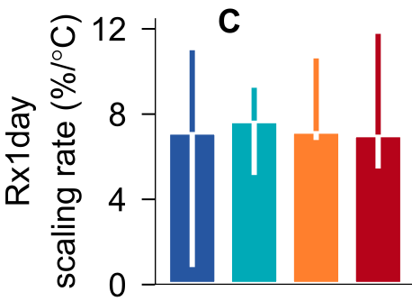
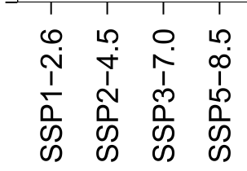
Global land median projected relative changes in 50-year 1-day precipitation events (2071-2100 vs 1985-2014) shown as a function of GSAT change (left) and expressed as a scaling rate (right)
  Li et al, 2021, J. Climate, Fig. 7
Notes:
FIG. 7. As in Fig. 6, but for Rx1day and Rx5day [changes in precipitation extremes and GSAT in (a) and (b) are in % and 8C, respectively; the scaling rate estimates for precipitation extremes in (c) and (d) are in % 8C21]. The dashed line in (a) and (b) shows the 7% 8C21 reference line.
FIG. 6. The scaling of the global land median increases in the 50-yr return values of TXx and TNn with global warming. (a),(b) Scatterplots of the global land median changes in the 50-yr return values of TXx and TNn vs changes in GSAT (8C) in the CMIP6 multimodel ensemble simulations under different forcing scenarios. Each dot represents the median change in the intensity of 50-yr events over the global land area between two 30-yr periods in a CMIP6 simulation under a given SSP scenario (colors). The black solid lines show the quantile regression lines for the median through the scatter of points and the gray envelopes are bounded the corresponding quantile regression lines for the 5th and 95th quantiles of the scatter of points. The dashed lines show the 1-to-1 reference line. (c),(d) Estimates of the corresponding scaling rates (8C 8C21) based on simulations under different forcing scenarios (color bars) and from different climate models (gray bars). Climate models from left to right exhibit increasing equilib- rium climate sensitivity (see Fig. 1b). For scaling rate estimates under a given forcing scenario, the whiskers indicate the 5%–95% uncertainty range of the estimates from individual models, while for scaling rate estimates from a given model, simulations under different forcing scenarios were pooled together. Scenario uncertainty is not shown for estimates from individual models because most models have simulations only under the SSP1–2.6 and SSP5–8.5 scenarios (Fig. 1a).

Slide 23
The rest of this talk …
Will focus on connecting climate change simulations with observations so as to constrain projections of future change
The projections we want to constrain are solutions to a boundary value problem rather than an initial conditions problem
Definitions
Detection and attribution (D&A) methods
Relationship between D&A and emergent constraints
Constrained projections of precipitation extremes
Discussion and Summary
Smokey summer sunset over the Strait of Juan de Fuca, Shirley, BC, Canada

Slide 24
Definitions
Detection¹ of change is defined as the process of demonstrating that climate or a system affected by climate has changed in some defined statistical sense without providing a reason for that change.
Attribution¹ is defined as the process of evaluating the relative contributions of multiple causal factors to a change or event with an assignment of statistical confidence.
Causal factors¹ usually refer to external influences on climate, which may be anthropogenic (GHGs, aerosols, ozone precursors, land use) and/or natural (volcanic eruptions, solar cycle modulations).
An emergent constraint² is the relationship between an uncertain aspect of future climate change and an observable feature of the Earth System, evident across an ensemble of models
¹IPCC Good Practice Guidance Paper on Detection and Attribution (2010), ²IPCC (2021)

Slide 25

D&A methods
  Linear regression based (often called “optimal fingerprinting”)
  Gaussian model based (sometimes called the “KCC” method)
Eleanor Lake, Blue River, BC, Canada

Slide 26
Assumptions
D&A methods
Involve simple statistical models
Complex implementation due to data volumes
The “D&A” problem is a small-sample problem that involves a lot of data
Key external forcings have been identified
Signals (expected responses to external forcing) are deterministic
Signals and noise are additive
Depending on the method, climate models may, or may not, be assumed to be indistinguishable from the truth

Slide 27
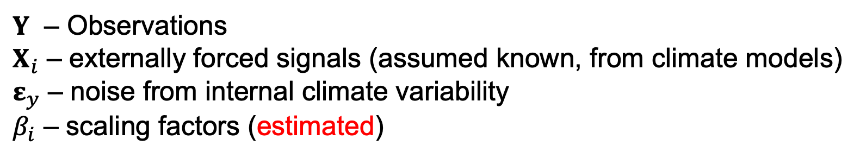
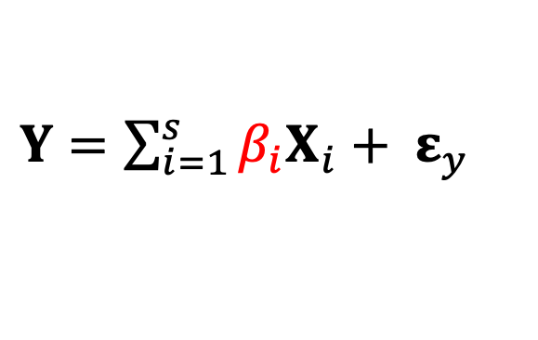
Primary methods
Early studies relied on linear models fitted via generalized least squares
Hasselmann (1979, 1993)
Bell (1982, 1986)
Hegerl et al (1996, 1997)
Tett et al (1999)
Santer et al (1995, 1996)
Bonfils et al (2020)
$Y=\sum_{i=1}^{s}{β_{i}X_{i}+ ε_{y} }$
$Y$ – Observations
$X_{i}$ – externally forced signals (assumed known, from climate models)
$ε_{y}$ – noise from internal climate variability
$β_{i}$ – scaling factors (estimated)
Notes:
Most studies use the Allan and Stott TLS method (ignores model uncertainty)
A few studies have discussed EIV approaches, but these are very difficult to apply

Slide 28

Observations (HadCRUT4)
Multi-model mean (ALL forcings)
1901-1910
1901-1910
1911-1920
1911-1920
1921-1930
1921-1930
1931-1940
1931-1940
1941-1950
1941-1950
1951-1960
1951-1960
1961-1970
1961-1970
1971-1980
1971-1980
1981-1990
1981-1990
1991-2000
1991-2000
2001-2010
2001-2010
11 decades (1901-1911 to 2001-2011)
Y
X
After Weaver and Zwiers (2000)
Evaluate
scaling factors
$$\hat{β}$$
Evaluate residuals

Slide 29
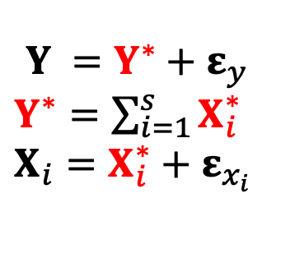
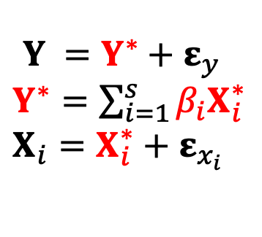
Primary methods
Most studies now treat the problem as an errors in variables problem
$Y =Y^{∗}+ε_{y}$
$Y^{∗}=\sum_{i=1}^{s}{{β_{i}X}_{i}^{∗}}$
$$X_{i}=X_{i}^{∗}+ε_{x_{i}}$$
Allan and Stott (2003)
Hegerl and Zwiers (2011)
Ribes et al (2013a, 2013b)
DelSole et al (2019)
Gillett et al (2021)
Ma et al (2023)
Chen et al (2024)
KCC (Kriging for Climate Change) recently proposed
$Y =Y^{∗}+ε_{y}$
$Y^{∗}=\sum_{i=1}^{s}{X_{i}^{∗}}$
$$X_{i}=X_{i}^{∗}+ε_{x_{i}}$$
Ribes et al (2017)
Notes:
Most studies use the Allan and Stott TLS method (ignores model uncertainty)
A few studies have discussed EIV approaches, but these are very difficult to apply

Slide 30
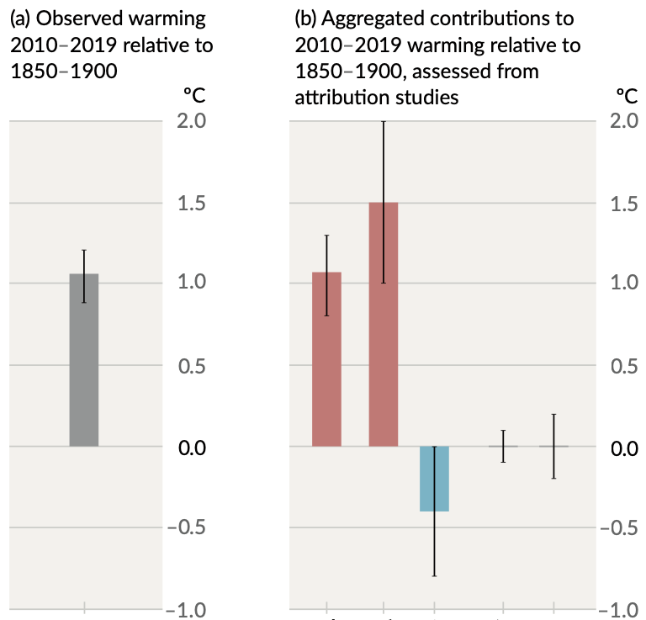
IPCC assessed attributed warming based on D&A studies
Application of D&A methods has also been extended to extreme precipitation and is also assessed by the IPCC.
Human influence is detected in observations of extreme precipitation at large scales, and attributable observed intensification is found to be consistent with theoretical expectations
IPCC AR6 WG1 (2021), Fig SPM.2
OANT
ANT
GHG
NAT
INT

Slide 31
D&A Summary
Concerned with long term change
Quantifies how the mean state (or some other statistic) has changed due to forcing
Statistically, this is a very small sample problem (there is only one observation on the left-hand side of the equations that describe the analysis approach)
Implicitly (or explicitly) assumes that the observation is multivariate Gaussian
Results support the IPCC conclusion that there is unequivocal evidence the observed warming is human caused
D&A methods used to attribute observed changes to individual forcing factors
Have been widely applied to surface temperature, precipitation, atmospheric thermal structure, oceanic thermal structure, atmospheric water vapor content, surface air pressure, extremes, etc …

Slide 32
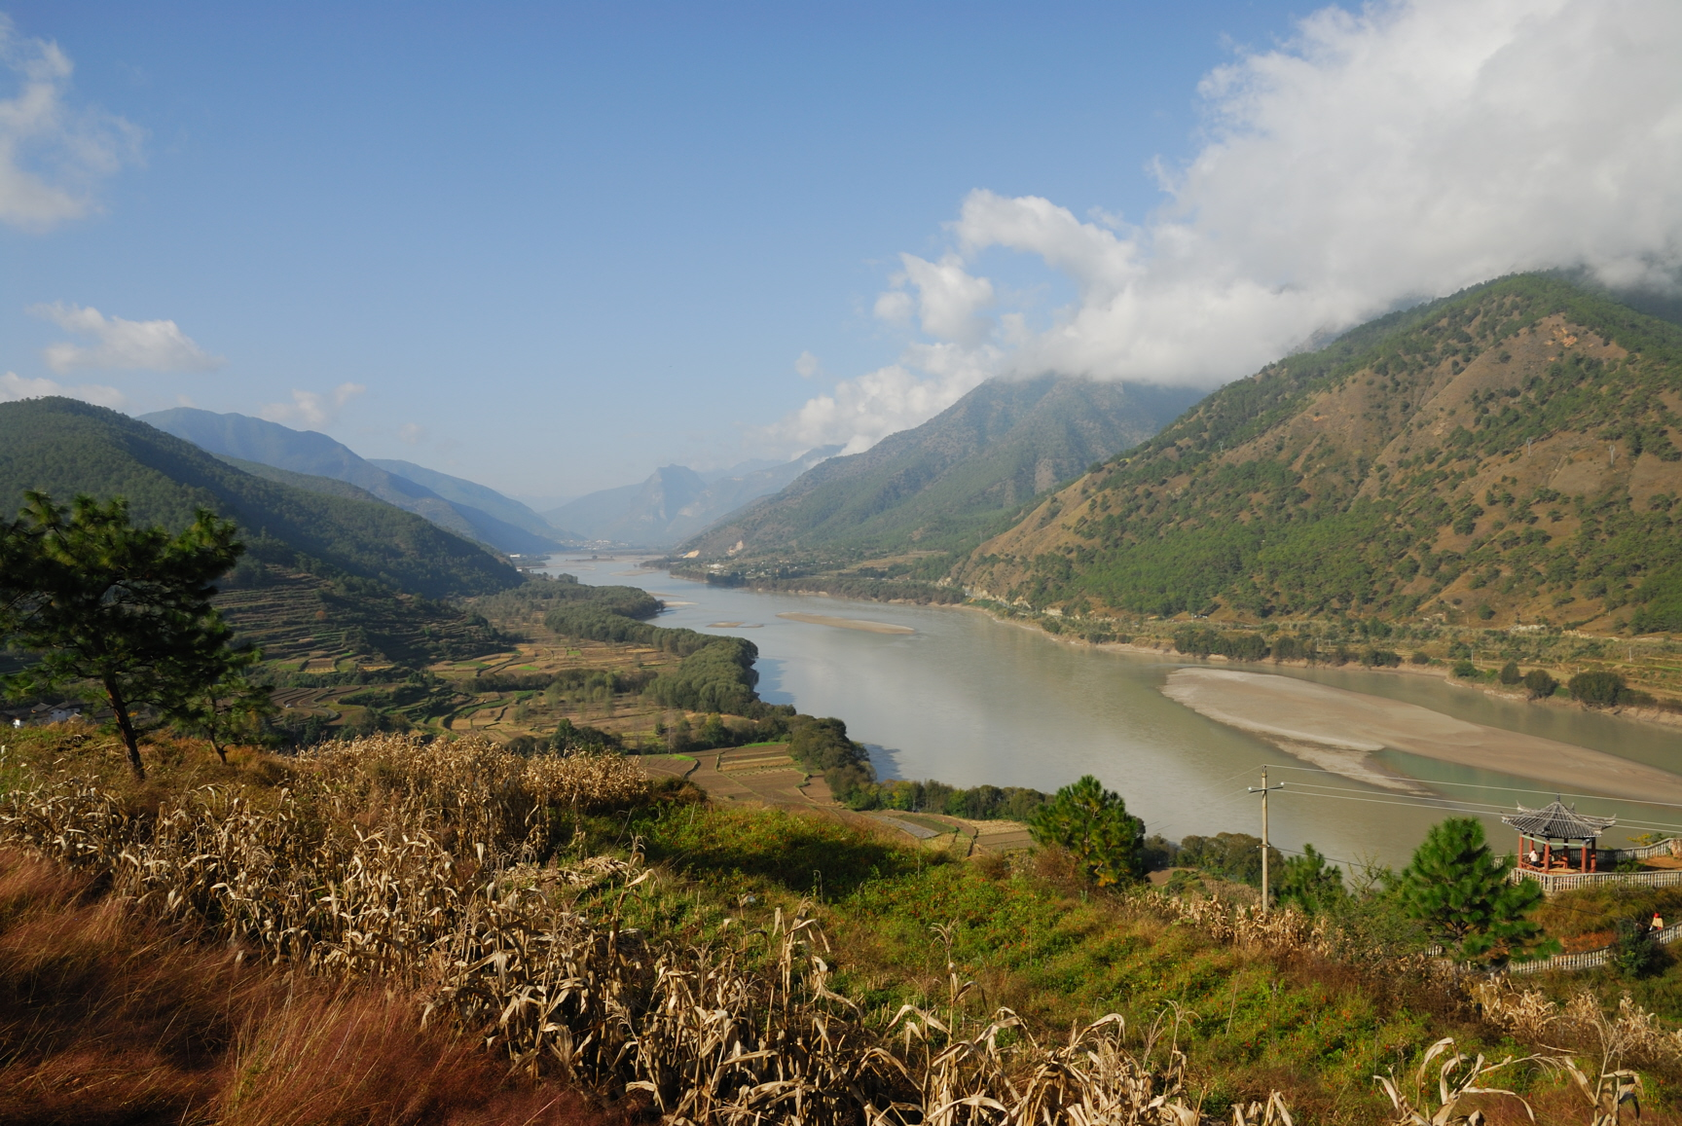
D&A’s relationship to emergent constraints
Photo: F. Zwiers (Yangtze River, China)

Slide 33
 | Observations | Models
Future | X | ✓
Past | ✓ | ✓
Predictand
Predictor
D&A uses the data in the bottom row of this matrix
The model that is fitted via D&A can be used to produce constrained projections of the future by substituting historical forced responses with future forced responses (sometimes called the “ASK” method after Allen, Stott and Kettleborough)
An example is Sun et al (2014), who considered changes in high temperature extremes in China

Slide 34
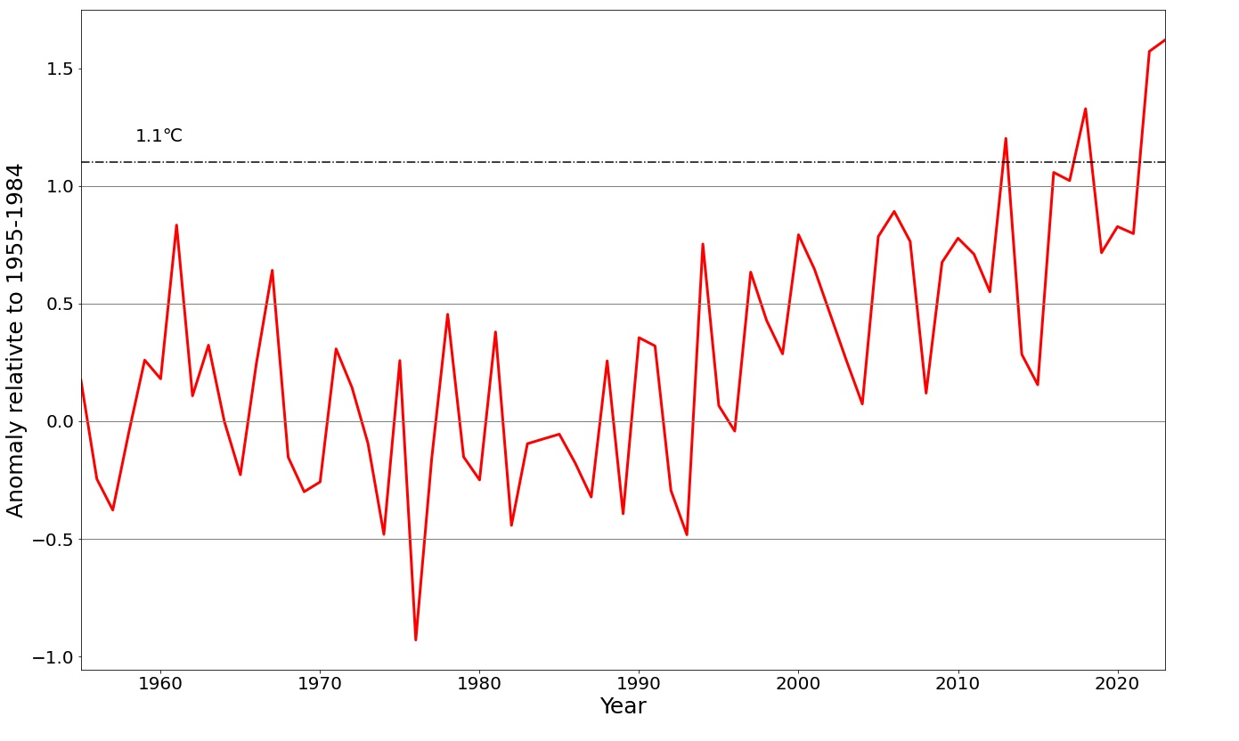
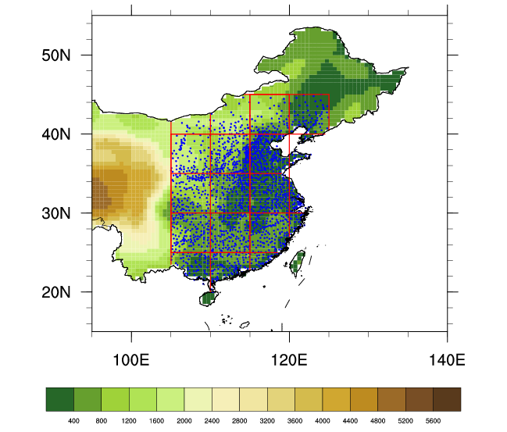
JJA mean temperature in Eastern China
°C
Updated from Sun et al, Nature Climate Change, 2014
1.1°C
2018, 2022 and 2023 are warmer than 2013
Anomaly relative to 1955-1984
Eastern China is densely observed
1749 stations (1955 onwards)
JJA mean temperature increased 0.82°C over 1955-2013
records were broken at more than 45% of stations in JJA 2013

Slide 35
Detection and attribution results for change JJA climate over 1955-2012
Sun et al, Nature Climate Change, 2014
ALL forcing → 0.82°C (0.57°C, 1.07°C)
NAT forcing → 0.03°C (-0.00°C, 0.07°C)
Urban warming may be responsible for part of the warming attributed to “ALL” → 0.21°C (0.16°C, 0.26°C)
Notes:
Note that large scale forcing and urban warming combined have a similar affect on risk of hot summers.

Slide 36
Projected event frequency
RCP4.5
RCP8.5
+ +
Frequency
× ×
Mean temp
23%, 4.3-yr
Expected 3-5 events during 2014-2023
Notes:
Figure 4 | Frequency of extreme hot summer recurrence. Time evolution of the frequency of summer temperature anomalies above 1.1 ◦ C, relative to the 1955–1984 mean, in the reconstructed observations (1955–2013) and in the observationally constrained projections (2014–2072) under RCP4.5 (plus) and RCP8.5 (cross) emission scenarios (left-hand scale). The solid smooth curves are LOESS (local regression) fitting. The dashed curves represent projected ensemble mean temperature changes under the relevant emission scenarios (right-hand scale) and are shown here for reference. Results for RCP4.5 and RCP8.5 are represented by red and green, respectively.

Slide 37
Relationship to Emergent Constraints
 | Observations | Models
Future | X | ✓
Past | ✓ | ✓
Predictand
Predictor
Emergent constraints, as first conceived, used a regression model to describe a relationship between the past and future as simulated by climate models
The observed historical change is then substituted for the modelled historical change to produce a constrained projection of future change
Support for such constraints is strengthened through the study of the physical mechanisms involved

Slide 38
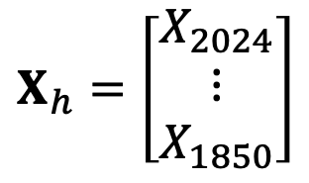
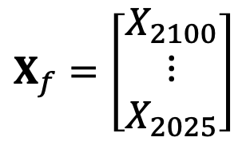
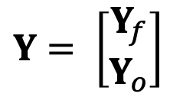
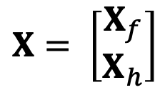
Neither D&A nor the original EC approach use all available data
KCC (Ribes et al, 2017, 2021) and HEC (Bowman et al, 2018) remedy this by treating the EC problem as a data imputation problem
$X_{f}=\left[\begin{matrix}X_{2100} \\ ⋮ \\ X_{2025}\end{matrix}\right]$
 | Observations | Models
Future | X | ✓
Past | ✓ | ✓
$$Y= \left[\begin{matrix}Y_{f} \\ Y_{o}\end{matrix}\right]$$
$$X= \left[\begin{matrix}X_{f} \\ X_{h}\end{matrix}\right]$$
$X_{h}=\left[\begin{matrix}X_{2024} \\ ⋮ \\ X_{1850}\end{matrix}\right]$
Note that $Y_{o}=HY$ where $H= \left[\begin{matrix}0 & I_{h}\end{matrix}\right]$

Slide 39
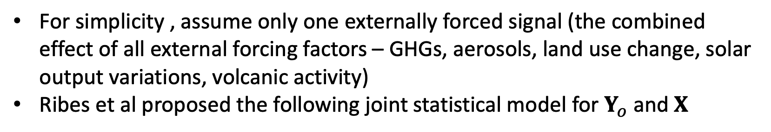
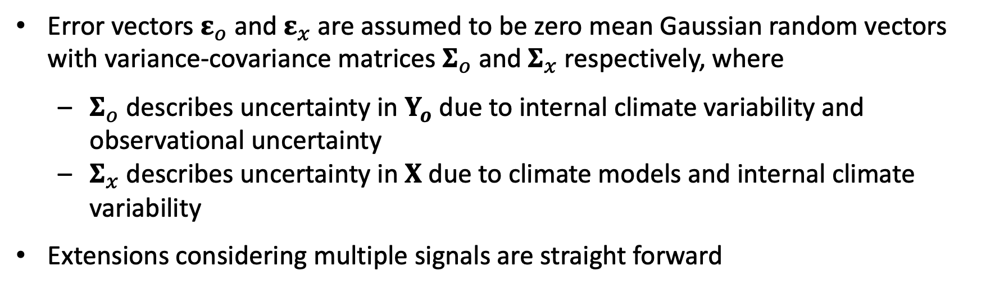
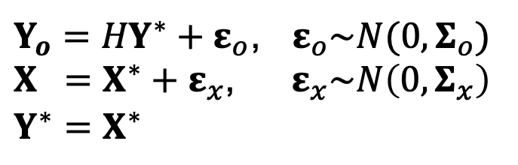
For simplicity , assume only one externally forced signal (the combined effect of all external forcing factors – GHGs, aerosols, land use change, solar output variations, volcanic activity)
Ribes et al proposed the following joint statistical model for $Y_{o}$ and $X$
Observations
$Y_{o}={HY}^{∗}+ε_{o}$, $ε_{o}\sim N(0,Σ_{o})$
$$X =X^{∗}+ε_{x}\text{, }{ ε}_{x}\sim N\left(0,Σ_{x}\right)$$
$Y^{∗}=X^{∗}$
Historical and future forced response in models
Past and future forced response in observations
Error vectors $ε_{o}$ and $ε_{x}$ are assumed to be zero mean Gaussian random vectors with variance-covariance matrices $Σ_{o}$ and $Σ_{x}$ respectively, where
  $Σ_{o}$ describes uncertainty in $Y_{o}$ due to internal climate variability and observational uncertainty
  $Σ_{x}$ describes uncertainty in $X$ due to climate models and internal climate variability
Extensions considering multiple signals are straight forward

Slide 40
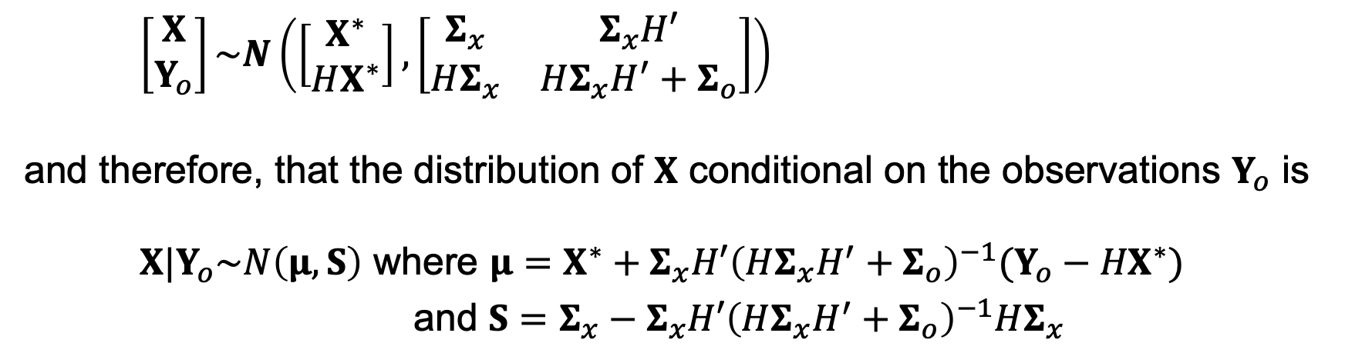

With this formulation, $X$ and $Y_{o}$ are jointly Gaussian
To see this, let $\left[\begin{matrix}X \\ Y_{o}\end{matrix}\right]=\left[\begin{matrix}I & 0 \\ 0 & H\end{matrix}\right]\left[\begin{matrix}X \\ Y^{∗}\end{matrix}\right]+\left[\begin{matrix}0 \\ ε_{o}\end{matrix}\right]$
It then follows from the assumptions above that
$\left[\begin{matrix}X \\ Y_{o}\end{matrix}\right]\sim N\left(\left[\begin{matrix}X^{∗} \\ HX^{∗}\end{matrix}\right],\left[\begin{matrix}Σ_{x} & Σ_{x}H′ \\ HΣ_{x} & HΣ_{x}H^{′}+Σ_{o}\end{matrix}\right]\right)$
and therefore, that the distribution of $X$ conditional on the observations $Y_{o}$ is
$X|Y_{o}\sim N\left(μ,S\right)$ where ${μ=X}^{∗}+Σ_{x}H′{\left(HΣ_{x}H^{′}+Σ_{o}\right)}^{−1}(Y_{o}−{HX}^{∗})$
and ${S=Σ}_{x}−Σ_{x}H′{\left(HΣ_{x}H^{′}+Σ_{o}\right)}^{−1}HΣ_{x}$

Slide 41
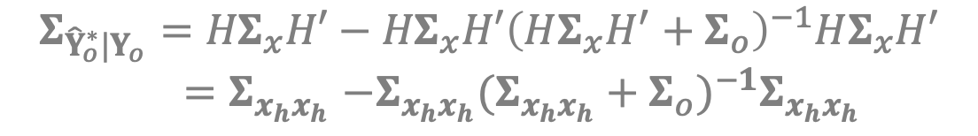

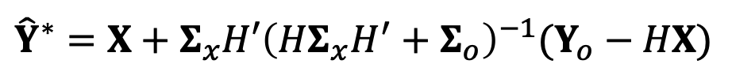
By replacing $X^{∗}$with our best estimate $X$ (i.e., set $X$ equal to the “multi-model” mean response to the prescribed forcing, and set ${\hat{ℇ}}_{x}=0$) we obtain
$${\hat{Y}}^{∗}=X+Σ_{x}H′{\left(HΣ_{x}H^{′}+Σ_{o}\right)}^{−1}(Y_{o}−HX)$$
with
$$Σ_{{\hat{Y}}^{∗}|Y_{o}}=Σ_{x}−Σ_{x}H′{\left(HΣ_{x}H^{′}+Σ_{o}\right)}^{−1}HΣ_{x}$$
We can see from this that detection and attribution with the KCC method does not benefit from the inclusion of future information in the model
Recall $Y_{o}=HY$ where $H= \left[\begin{matrix}0 & I_{h}\end{matrix}\right]$, and write $Σ_{x}=\left[\begin{matrix}Σ_{x_{f}x_{f}} & Σ_{x_{f}x_{h}} \\ Σ_{x_{h}x_{f}} & Σ_{x_{h}x_{h}}\end{matrix}\right]$. Then
$${\hat{Y}}_{o}^{∗}=HX+HΣ_{x}H′{\left(HΣ_{x}H^{′}+Σ_{o}\right)}^{−1}\left(Y_{o}−HX\right)$$
$={X_{h}+Σ}_{x_{h}x_{h}}{\left(Σ_{x_{h}x_{h}}+Σ_{o}\right)}^{−1}(Y_{o}−X_{h})$
$$Σ_{{\hat{Y}}_{o}^{∗}|Y_{o}}={HΣ}_{x}H′−{HΣ}_{x}H′{\left(HΣ_{x}H^{′}+Σ_{o}\right)}^{−1}HΣ_{x}H′$$
${=Σ}_{x_{h}x_{h}}−Σ_{x_{h}x_{h}}{(Σ_{x_{h}x_{h}}+Σ_{o})}^{−1}Σ_{x_{h}x_{h}}$

Slide 42
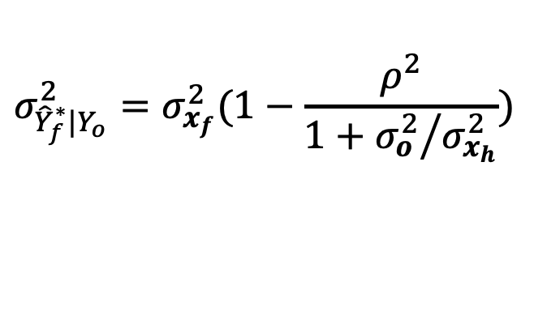

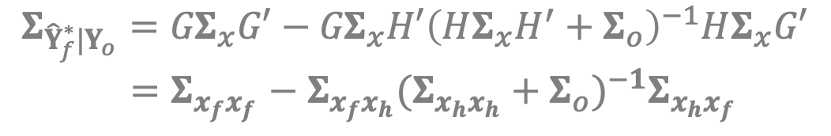
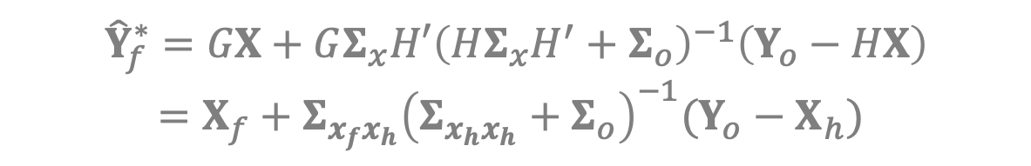
But projected change is constrained by the inclusion of historical information
Let $Y_{f}=GY$ where $G= \left[\begin{matrix}I_{f} & 0\end{matrix}\right]$. Then
$${\hat{Y}}_{f}^{∗}=GX+GΣ_{x}H′{\left(HΣ_{x}H^{′}+Σ_{o}\right)}^{−1}\left(Y_{o}−HX\right)$$
$={X_{f}+Σ}_{x_{f}x_{h}}{\left(Σ_{x_{h}x_{h}}+Σ_{o}\right)}^{−1}(Y_{o}−X_{h})$
$$Σ_{{\hat{Y}}_{f}^{∗}|Y_{o}}={GΣ}_{x}G′−{GΣ}_{x}H′{\left(HΣ_{x}H^{′}+Σ_{o}\right)}^{−1}HΣ_{x}G′$$
${=Σ}_{x_{f}x_{f}}−{ Σ}_{x_{f}x_{h}}{(Σ_{x_{h}x_{h}}+Σ_{o})}^{−1}Σ_{x_{h}x_{f}}$
Reduces to the typical HEC formulation when ${Y_{o}, Y}_{f},X_{h}$and $X_{f}$ are all scalars
$${\hat{Y}}_{f}^{∗}=X_{f}+ρ\frac{σ_{x_{f}}σ_{x_{h}}}{σ_{x_{h}}^{2}+σ_{o}^{2}}(Y_{o}−X_{h})$$
$$σ_{{\hat{Y}}_{f}^{∗}|Y_{o}}^{2}=σ_{x_{f}}^{2}(1−\frac{ρ^{2}}{1+{σ_{o}^{2}}/{σ_{x_{h}}^{2}}})$$
and

Slide 43
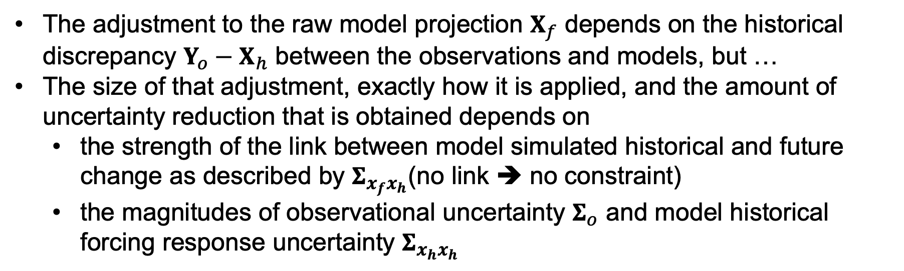
The role of climate models in the constraint
Observations and models both play a role
Recall
${\hat{Y}}_{f}^{∗}$ $={X_{f}+Σ}_{x_{f}x_{h}}{\left(Σ_{x_{h}x_{h}}+Σ_{o}\right)}^{−1}(Y_{o}−X_{h})$
The adjustment to the raw model projection $X_{f}$ depends on the historical discrepancy $Y_{o}−X_{h}$ between the observations and models, but …
The size of that adjustment, exactly how it is applied, and the amount of uncertainty reduction that is obtained depends on
  the strength of the link between model simulated historical and future change as described by $Σ_{x_{f}x_{h}}$(no link ➔ no constraint)
  the magnitudes of observational uncertainty $Σ_{o}$ and model historical forcing response uncertainty $Σ_{x_{h}x_{h}}$

Slide 44

Questions
Black tailed deer, Vancouver Island

Slide 45

Constraining future precipitation extremes
Photo: Francis Zwiers, Ogema, SK, Canada

Slide 46
  Want to constrain projections of rare, intense, 50-yr 1-day precipitation (Rx1d_50) in sub-continental scale “IPCC regions”
  In climate models, thermal processes are the dominant cause of future change over most of the global land area
  Suggests that observed global mean surface temperature (GMST) change may provide a usable observable for constraining projected extreme precipitation change
  We have evaluated this possibility using a hybrid constraint strategy that we have tested extensively via cross-validation, using individual withheld climate model simulations as future pseudo-observations
  We use HEC in this case (other studies underway using KCC)

Slide 47
Data
  33 CMIP6 models (SSP5-8.5), 18 CMIP5 models (RCP-8.5)
    Also considered SSP2-4.5 and RCP-4.5
  Consider projected change in Rx1d_50 between 1850-1900 and two future 30-yr time windows 2028-2057 (~2°C above 1850-1900) and 2050-2079 (~3°C)
  50-yr event intensity in each period estimated by fitting GEV distributions to Rx1day from individual model ensembles (pooled across 3x3 grid box areas)
  The observed 1981-2020 trend in GMST from HadCRUT5 is used to directly or indirectly constrain projected changes in Rx1d_50 using HEC (Bowman, et al., 2018)

Slide 48
Two kinds of constraints
Direct
  Constrain Rx1d_50 projections with observed GMST change via HEC
  Surprisingly, median Rx1d_50 change across large regions is very close to Gaussian!
Indirect
  Constrain GSAT projections using observed GMST change
  Then for each model, extract its projected Rx1d_50 change for the 30-year period when that model attains its constrained level of warming rather than for the fixed 2028-2057 or 2050-2089 periods
The indirect approach is used in regions where a statistically significant direct emergent constraint is not found

Slide 49

Results
    Photo: L’estive de Paloumère, France

Slide 50
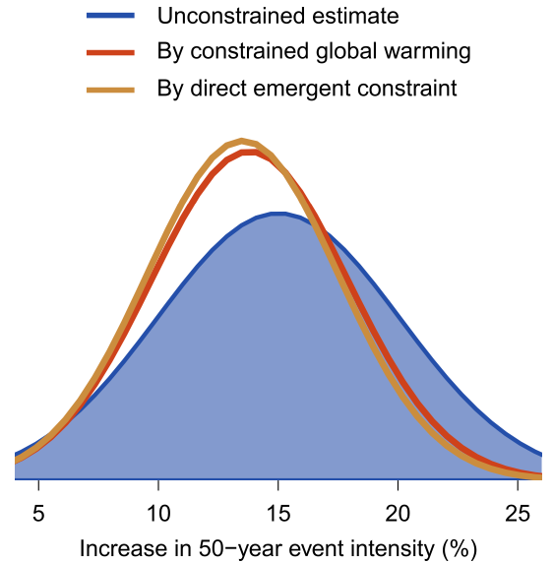
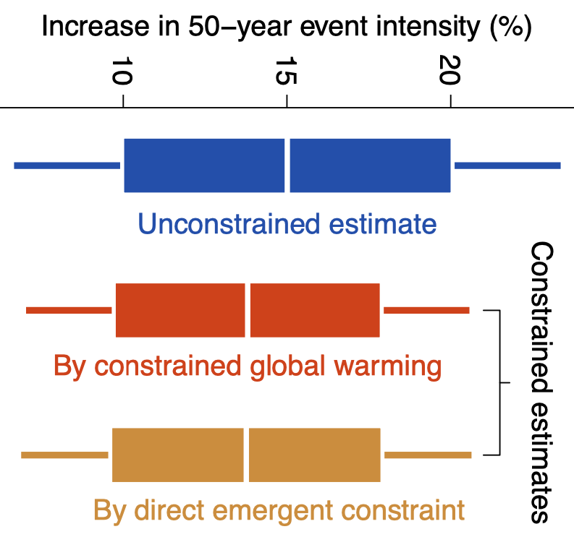
Comparison of indirect and direct constrained change in 50-year Rx1day projected for 2028-2057 for global land
  Li et al, 2024, GRL, Fig. 2
Notes:
Temperature constraint for the intensification of future rare precipitation events. (a) An illustration of constraining future rare precipitation events based on constrained global warming by the observed 1981-2020 global mean temperature trend with the emergent constraint method (left). The scatter points display global mean temperature changes in 2028-2057 relative to 1850-1900 in response to the 8.5 W/m² scenario versus the 1981-2020 global mean temperature trends in CMIP6 (solid points) and CMIP5 (empty points) models. The solid black line shows the emergent constraint regression line. The dashed vertical line and the gray shading mark the observed 1981-2020 global mean temperature trend and its central 90% uncertainty range estimated from HadCRUT5. Constrained precipitation can be obtained by integrating the projections for 30-year windows reaching the constrained warming levels in the climate models (right). Black curves show 30-year running mean global mean temperatures relative to 1850-1900 in the CMIP6/5 models, while horizonal lines depict the constrained plausible 2028-2057 warming levels in response to the 8.5 W/m² scenario. (b) The global land change in the intensity of 50-year daily precipitation event in 2028-2057 relative to 1850-1900 under the 8.5 W/m² scenario based on unconstrained (blue) and constrained estimates by the observed 1981-2020 global mean temperature trend via constrained global warming (orange) and direct emergent constraint on rare precipitation intensity (brown). (c) Model-based cross-validation of the temperature constraint. Panels show the coverage rates of the central 90% ranges in the estimated intensity changes of rare precipitation events containing the true reference values (left) and the relative biases (middle) and widths of 90% ranges (right) in the estimated changes. Colors of the boxplots distinguish different estimation methods as depicted in (b). The boxplots reflect regional variations, while black rectangles mark values for the global land change. All considered precipitation events during 2028-2057 under the 8.5 W/m² scenario are aggregated to compute these validation statistics.

Slide 51
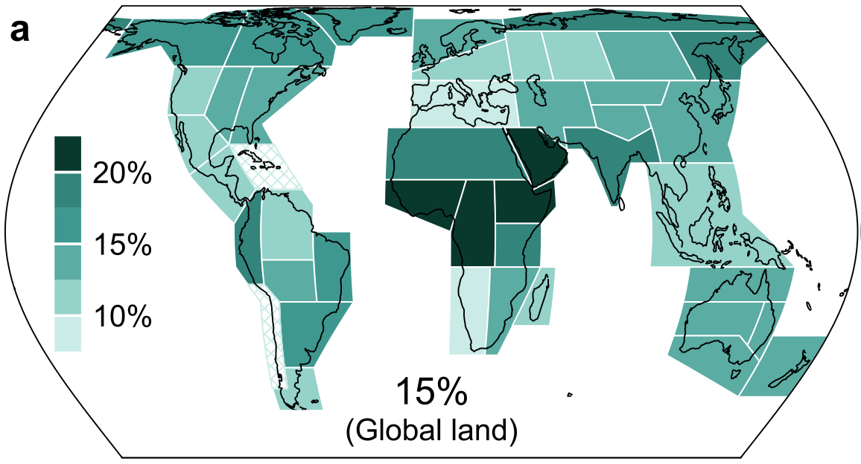
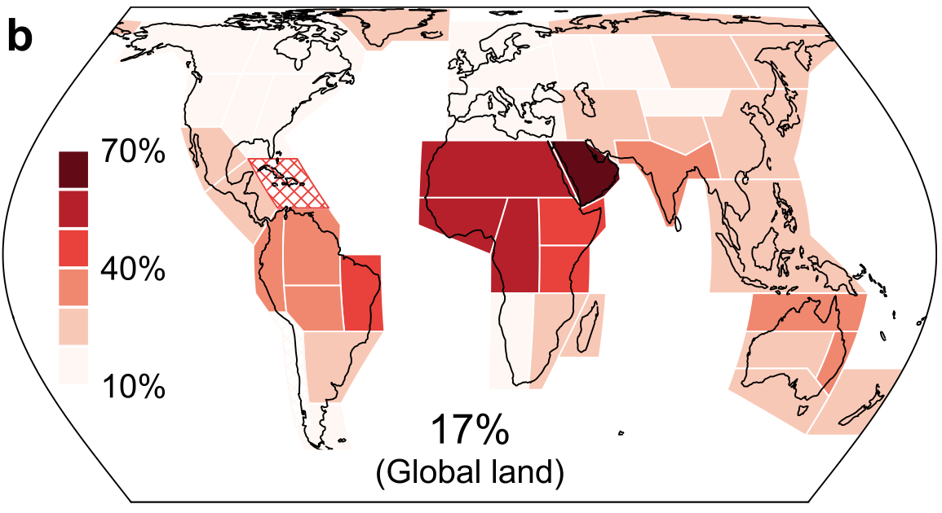
Unconstrained projections of relative change in Rx1d_50 at ~2°C
Width of central 90% uncertainty range as a proportion of the best estimate
Multi-model best estimate of relative change
  Li et al, 2024, GRL, Fig. 1

Slide 52
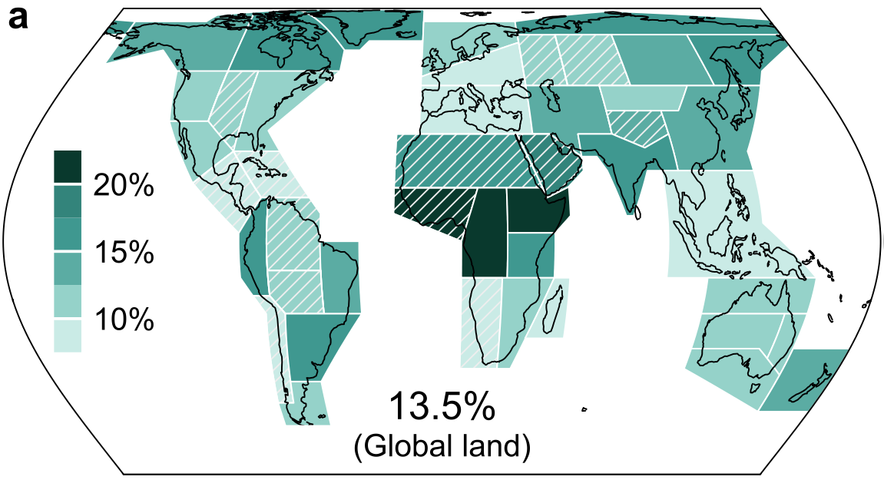

Constrained projections of relative change in Rx1d_50 at ~2°C
Multi-model best estimate of relative change
Width of central 90% uncertainty range
  Li et al, 2024, GRL, Fig. 3
The hybrid approach reduces projection uncertainty and projected intensity change in most regions
Upper uncertainty bounds are substantially reduced in many regions
Cross-validation demonstrates effective bias reductions when comparing raw multi-model projections with constrained projections across simulated climates with a wide range of climate sensitivities

Slide 53


Best estimates and upper uncertainty bounds reduced
  Li et al, 2024, GRL, Fig. 3
Notes:
Intensification of future 50-year daily precipitation events constrained by the past observed warming trend. (a-b) The best estimates (a) and widths of the central 90% ranges (b) of changes in the intensity of 50-year daily precipitation events in 2028-2057 relative to 1850-1900 in response to the 8.5 W/m² scenario constrained by the observed 1981-2020 global mean temperature trend. The bottom numbers show values for the global land change. (c-d) The percentage reductions in the constrained best estimates (c) and widths (d) and upper bounds (e) of the central 90% ranges relative to the corresponding values in unconstrained projections. Direct emergent constraint on precipitation is adopted for regions with significant emergent relationships at the 5% level for all considered rare precipitation events and projection periods (solid shading). Constrained future warming are used to constrain precipitation in other regions (hatched shading).

Slide 54


Projection uncertainty reduced substantially
  Li et al, 2024, GRL, Fig. 3
Notes:
Intensification of future 50-year daily precipitation events constrained by the past observed warming trend. (a-b) The best estimates (a) and widths of the central 90% ranges (b) of changes in the intensity of 50-year daily precipitation events in 2028-2057 relative to 1850-1900 in response to the 8.5 W/m² scenario constrained by the observed 1981-2020 global mean temperature trend. The bottom numbers show values for the global land change. (c-d) The percentage reductions in the constrained best estimates (c) and widths (d) and upper bounds (e) of the central 90% ranges relative to the corresponding values in unconstrained projections. Direct emergent constraint on precipitation is adopted for regions with significant emergent relationships at the 5% level for all considered rare precipitation events and projection periods (solid shading). Constrained future warming are used to constrain precipitation in other regions (hatched shading).

Slide 55

Not all uncertainty may be reducible …
The impact of warming uncertainty is large, but IS potentially reducible
Other sources of uncertainty may be much harder to reduce
The combination of direct and indirect constraints reduces the impact of warming uncertainty by more than 40% across most land regions for the projected change in 50-year Rx1day intensity when GSAT is 2°C warmer than pre-industrial
Proportion of projection uncertainty due to global warming uncertainty (%)
Reduction in projection uncertainty via constraint (%)
Notes:
Upper:Unconstrained intensification of future 50-year daily precipitation events. (a-b) The best estimates (a) and widths of central 90% ranges (b) of changes in the intensity of 50-year daily precipitation event in 2028-2057 (2 °C warmer) relative to 1850-1900 in response to the 8.5 W/m² scenario based on unconstrained projections in the CMIP6/5 models. The bottom numbers show values for the global land change. Cross-hatching marks regions where <80% of models project intensification. (c) The proportions of uncertainty in the projected 50-year event intensity changes due to uncertainty in the projected warming in the climate models, quantified by percentage differences between the widths of the central 90% ranges of the intensity changes for the 2028-2057 period and those calculated from individual model 30-year windows reaching the multi-model median warming in global mean surface air temperature projected for 2028-2057.
Lower: Intensification of future 50-year daily precipitation events constrained by the past observed warming trend. (a-b) The best estimates (a) and widths of the central 90% ranges (b) of changes in the intensity of 50-year daily precipitation events in 2028-2057 relative to 1850-1900 in response to the 8.5 W/m² scenario constrained by the observed 1981-2020 global mean temperature trend. The bottom numbers show values for the global land change. (c-d) The percentage reductions in the constrained best estimates (c) and widths (d) and upper bounds (e) of the central 90% ranges relative to the corresponding values in unconstrained projections. Direct emergent constraint on precipitation is adopted for regions with significant emergent relationships at the 5% level for all considered rare precipitation events and projection periods (solid shading). Constrained future warming are used to constrain precipitation in other regions (hatched shading).

Slide 56

Summary
Boar’s Head Lighthouse, Digby, NS

Slide 57
Summary
Physically based climate models simulate variability across a wide range of time and space scales, including extreme daily precipitation amounts
D&A and EC problems closely related
Can usefully constrain projected intensity change in extreme 1-day precipitation events over most land areas using observed GMST change as the observable constraint
Direct application of HEC is effective in regions where the forcing response is dominated by thermal processes
A constrained warming approach can be used in other regions
Can extend to individual grid boxes (Li, C. et al, 2024, in revision)
Extension to KCC using full historical record improves warming constraint over that possible with HEC (Li, T. et al, 2024, in prep)

Slide 58

Questions
https://www.pacificclimate.org/
fwzwiers@uvic.ca
Trout Creek #5 Bridge, Moores Mill, NB

