Slide 1
Dimensionality Reduction Techniques
David Woodruff
Carnegie Mellon University
Notes:
blah

Slide 2
Outline
Dimensionality Reduction for Regression and Low Rank Approximation
State of the Art Machine Learning Models

Slide 3
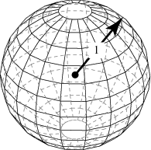
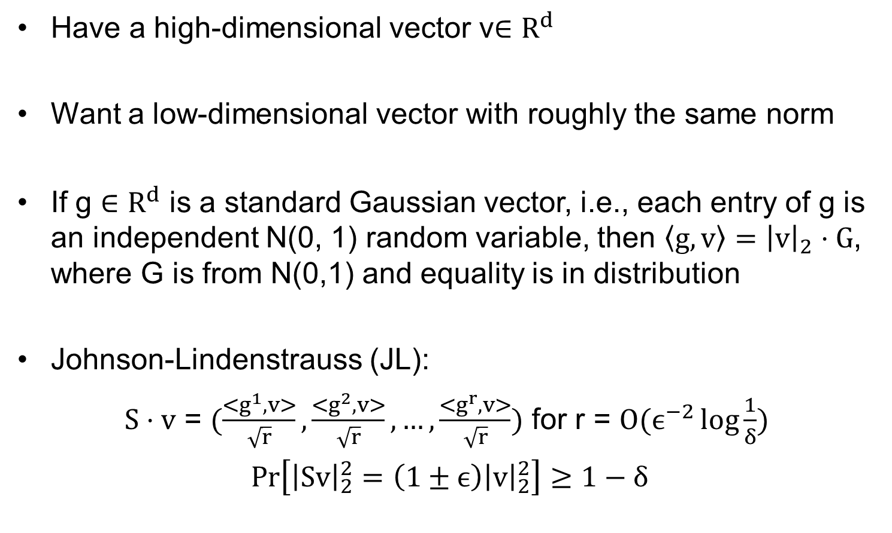
Preserving the Norm of a Vector
Have a high-dimensional vector v$∈R^{d}$
Want a low-dimensional vector with roughly the same norm
If g $∈R^{d}$ is a standard Gaussian vector, i.e., each entry of g is an independent N(0, 1) random variable, then $\left\langle g, v\right\rangle ={\left|v\right|}_{2}⋅G$, where G is from N(0,1) and equality is in distribution
Johnson-Lindenstrauss (JL):
$S⋅v$ = $(\frac{<g^{1}, v>}{\sqrt{r}},\frac{<g^{2}, v>}{\sqrt{r}}, …,\frac{<g^{r}, v>}{\sqrt{r}})$ for r = $O(ϵ^{−2}\log{\frac{1}{δ})}$
$\operatorname{Pr}\left[{\left|Sv\right|}_{2}^{2}=\left(1±ϵ\right){\left|v\right|}_{2}^{2}\right]≥1−δ$

Slide 4
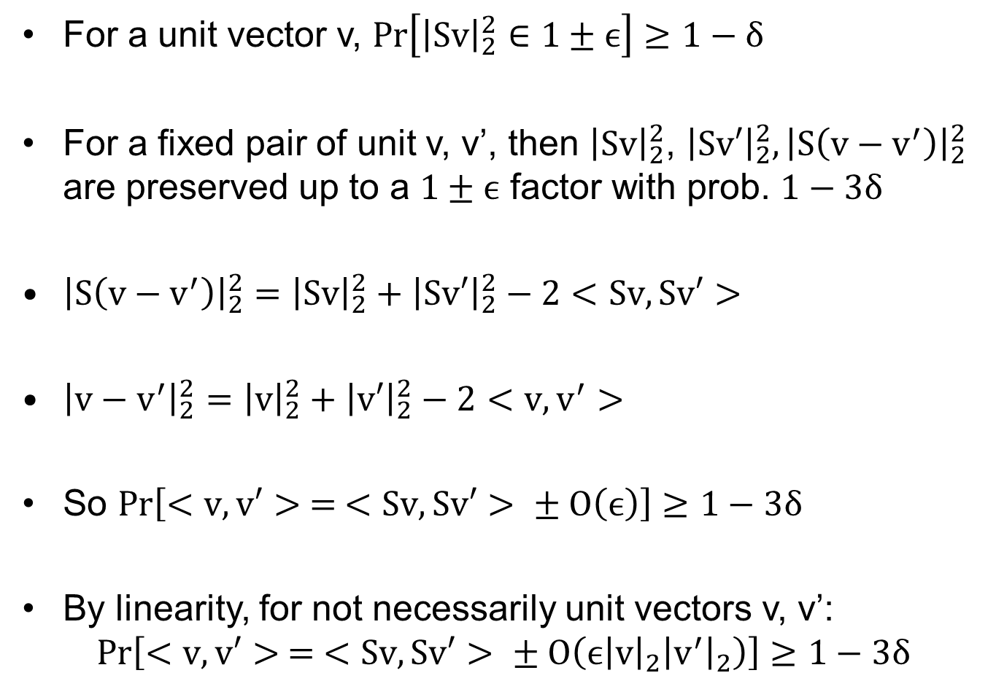
Preserving a Dot Product
For a unit vector v, $\operatorname{Pr}\left[{\left|Sv\right|}_{2}^{2}∈1±ϵ\right]≥1−δ$
For a fixed pair of unit v, v’, then ${\left|Sv\right|}_{2}^{2}$, ${\left|Sv′\right|}_{2}^{2}, {\left|S\left(v−v^{′}\right)\right|}_{2}^{2}$ are preserved up to a $1±ϵ$ factor with prob. $1−3δ$
${\left|S\left(v−v^{′}\right)\right|}_{2}^{2}={\left|Sv\right|}_{2}^{2}+{\left|Sv′\right|}_{2}^{2}−2<Sv, Sv′>$
${\left|v−v^{′}\right|}_{2}^{2}={\left|v\right|}_{2}^{2}+{\left|v′\right|}_{2}^{2}−2<v, v^{′}>$
So $Pr\left[<v, v′> = <Sv, Sv′> ± O\left(ϵ\right)\right]≥1−3δ$
By linearity, for not necessarily unit vectors v, v’:
$$Pr\left[<v, v′> = <Sv, Sv′> ± O\left(ϵ{\left|v\right|}_{2}{\left|v^{′}\right|}_{2}\right)\right]≥1−3δ$$

Slide 5
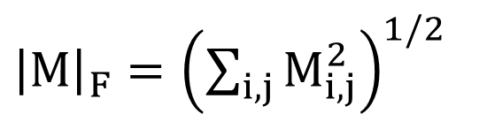
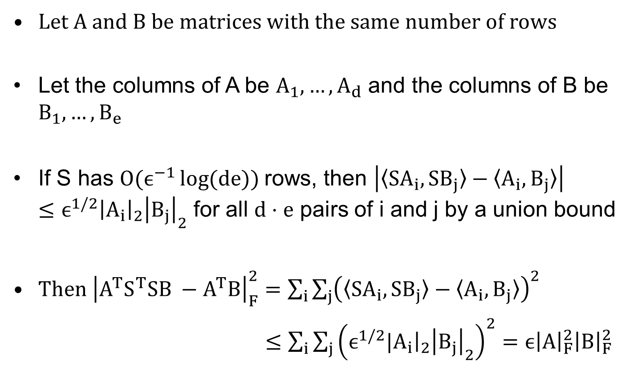
Preserving a Matrix Product
Let A and B be matrices with the same number of rows
Let the columns of A be $A_{1},…, A_{d}$ and the columns of B be $B_{1},…, B_{e}$
If S has $O(ϵ^{−1}\log{(de)) }$rows, then $\left|〈SA_{i}, SB_{j}〉−〈A_{i}, B_{j}〉\right|≤ϵ^{1/2}{\left|A_{i}\right|}_{2}{\left|B_{j}\right|}_{2}$ for all $d⋅e$ pairs of i and j by a union bound
Then ${\left|A^{T}S^{T}SB −A^{T}B\right|}_{F}^{2}=\sum_{i}{\sum_{j}{{\left(〈SA_{i}, SB_{j}〉−〈A_{i}, B_{j}〉\right)}^{2}}}$
$≤\sum_{i}{\sum_{j}{{\left(ϵ^{1/2}|A_{i}{\left.​\right|}_{2}{\left|B_{j}\right|}_{2}\right)}^{2}=ϵ{\left|A\right|}_{F}^{2}{\left|B\right|}_{F}^{2} }}$
${\left|M\right|}_{F}={\left(\sum_{i,j}{M_{i,j}^{2}}\right)}^{1/2}$

Slide 6
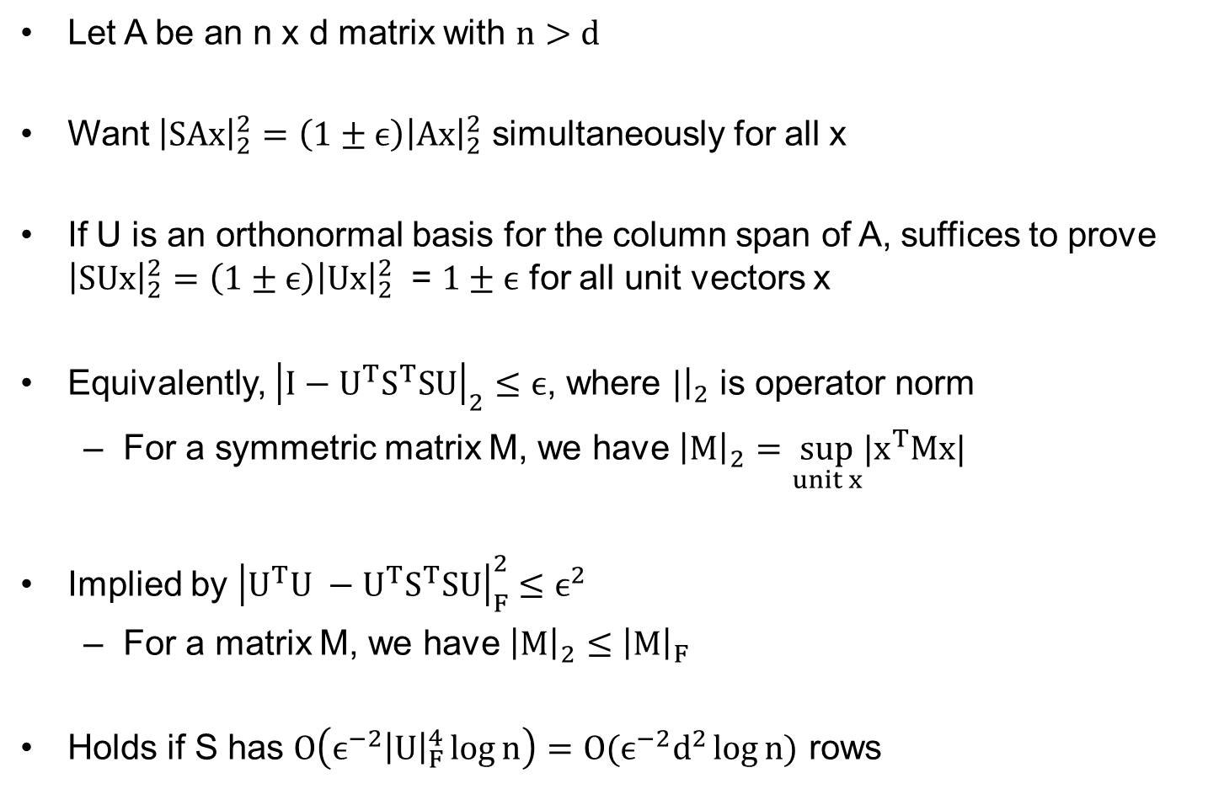
Preserving a Subspace
Let A be an n x d matrix with $n>d$
Want ${\left|SAx\right|}_{2}^{2}=\left(1±ϵ\right){\left|Ax\right|}_{2}^{2}$ simultaneously for all x
If U is an orthonormal basis for the column span of A, suffices to prove ${\left|SUx\right|}_{2}^{2}=\left(1±ϵ\right){\left|Ux\right|}_{2}^{2}$ = $1±ϵ$ for all unit vectors x
Equivalently, ${\left|I−U^{T}S^{T}SU\right|}_{2}≤ϵ$, where $|{\left.​\right|}_{2}$ is operator norm
  For a symmetric matrix M, we have ${\left|M\right|}_{2}=\sup_{unit x}{|x}^{T}Mx|$
Implied by ${\left|U^{T}U −U^{T}S^{T}SU\right|}_{F}^{2}≤ϵ^{2}$
  For a matrix M, we have ${\left|M\right|}_{2}≤{\left|M\right|}_{F}$
Holds if S has $O\left(ϵ^{−2}{\left|U\right|}_{F}^{4}\log{n}\right)=O(ϵ^{−2}d^{2}\log{n)}$ rows

Slide 7
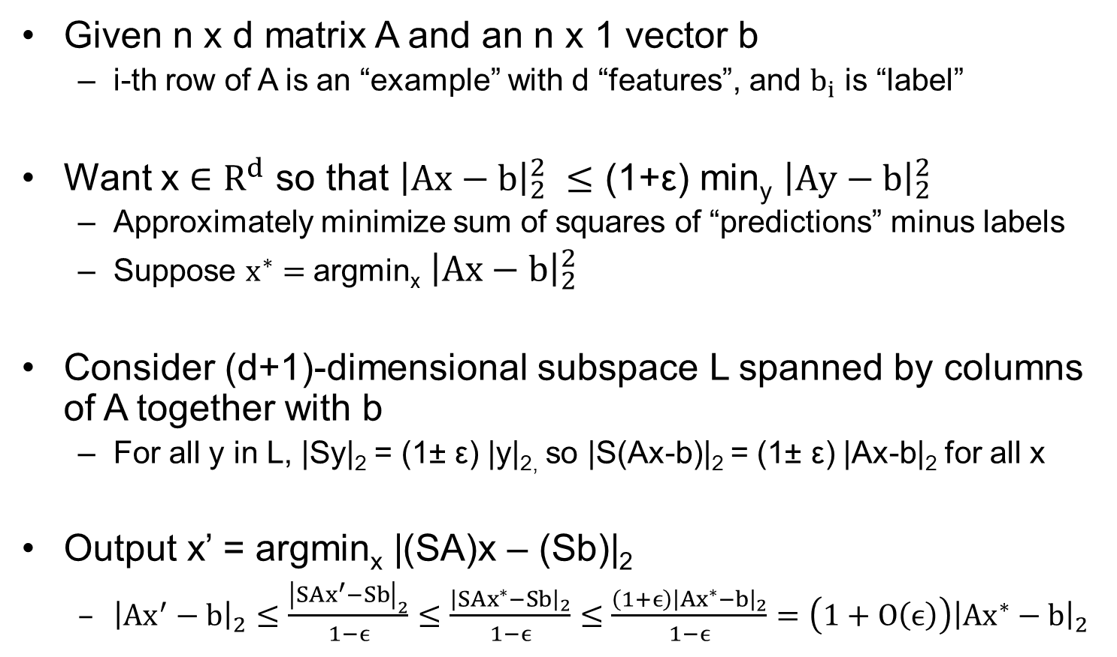
Solving Regression
Given n x d matrix A and an n x 1 vector b
  i-th row of A is an “example” with d “features”, and $b_{i}$ is “label”
Want x $∈R^{d}$ so that ${\left|Ax−b\right|}_{2}^{2}$ $≤$ (1+ε) min_{y} ${\left|Ay−b\right|}_{2}^{2}$
  Approximately minimize sum of squares of “predictions” minus labels
  Suppose $x^{∗}=$argmin_{x} ${\left|Ax−b\right|}_{2}^{2}$
Consider (d+1)-dimensional subspace L spanned by columns of A together with b
  For all y in L, |Sy|₂ = (1± ε) |y|_{2,} so |S(Ax-b)|₂ = (1± ε) |Ax-b|₂ for all x
Output x’ = argmin_{x} |(SA)x – (Sb)|₂
  ${\left|Ax^{′}−b\right|}_{2}≤\frac{{\left|SAx^{′}−Sb\right|}_{2}}{1−ϵ}≤\frac{{\left|SAx^{∗}−Sb\right|}_{2}}{1−ϵ}≤\frac{\left(1+ϵ\right){\left|Ax^{∗}−b\right|}_{2}}{1−ϵ}=\left(1+O\left(ϵ\right)\right){\left|Ax^{∗}−b\right|}_{2}$

Slide 8
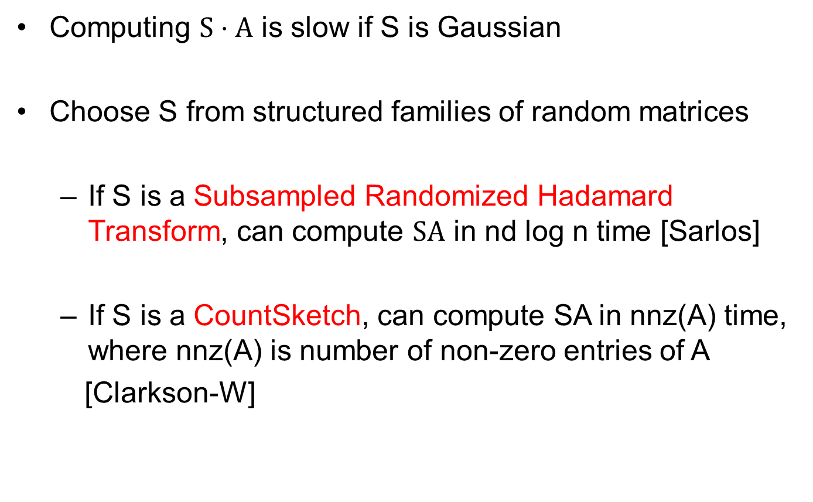
Efficiency
Computing $S⋅A$ is slow if S is Gaussian
Choose S from structured families of random matrices
  If S is a Subsampled Randomized Hadamard Transform, can compute $SA$ in nd log n time [Sarlos]
  If S is a CountSketch, can compute SA in nnz(A) time, where nnz(A) is number of non-zero entries of A
  [Clarkson-W]

Slide 9
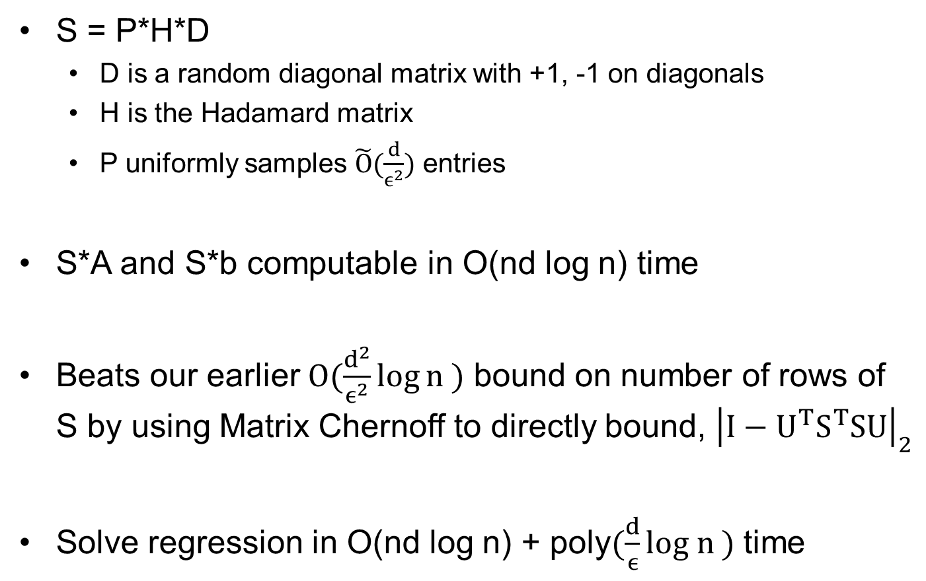
Randomized Hadamard Transform
S = P*H*D
  D is a random diagonal matrix with +1, -1 on diagonals
  H is the Hadamard matrix
  P uniformly samples $\tilde{O}(\frac{d}{ϵ^{2}})$ entries
S*A and S*b computable in O(nd log n) time
Beats our earlier $O(\frac{d^{2}}{ϵ^{2}}\log{n })$ bound on number of rows of S by using Matrix Chernoff to directly bound, ${\left|I−U^{T}S^{T}SU\right|}_{2}$
Solve regression in O(nd log n) + poly$(\frac{d}{ϵ}log n )$ time

Slide 10
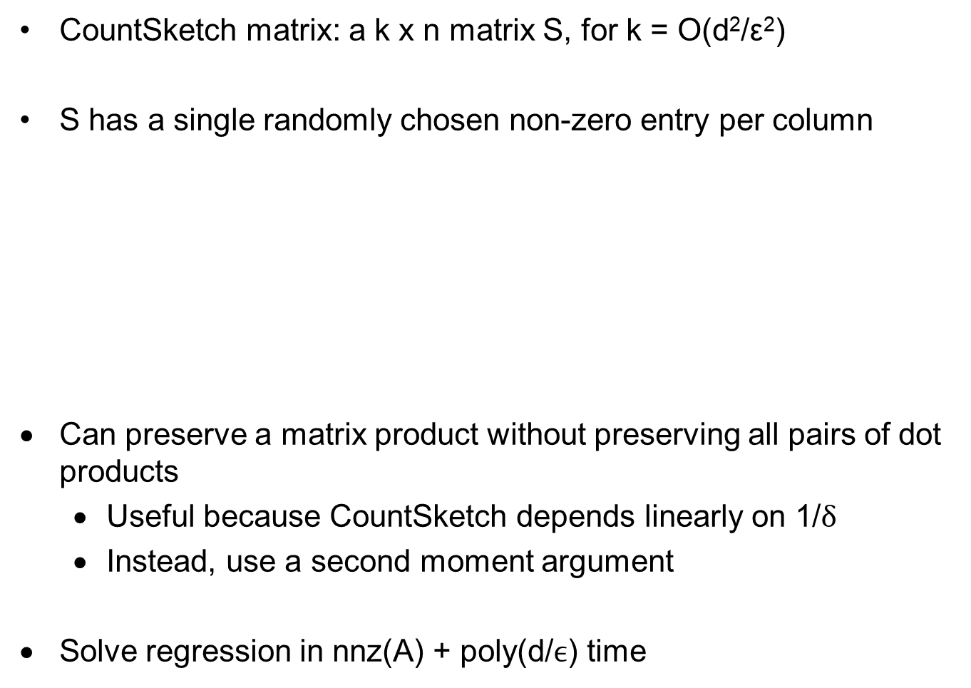
CountSketch
CountSketch matrix: a k x n matrix S, for k = O(d²/ε²)
S has a single randomly chosen non-zero entry per column
Can preserve a matrix product without preserving all pairs of dot products
  Useful because CountSketch depends linearly on 1/δ
  Instead, use a second moment argument
Solve regression in nnz(A) + poly(d/$ϵ$) time
[
[
0 0 1 0 0 1 0 0
1 0 0 0 0 0 0 0
0 0 0 -1 1 0 -1 0
0-1 0 0 0 0 0 1
Compute
SA in nnz(A)
time!
Hashes rows into k
buckets

Slide 11
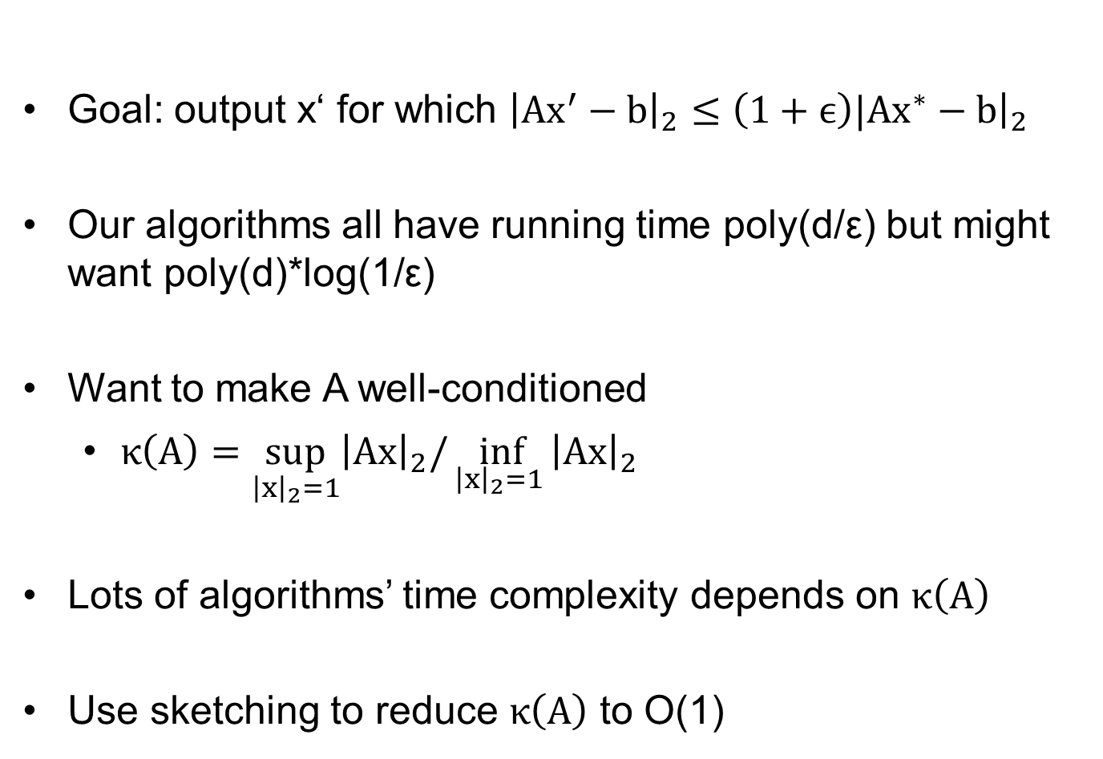
Other Ways to Use Sketching
Goal: output x‘ for which ${\left|Ax^{′}−b\right|}_{2}≤\left(1+ϵ\right)|Ax^{∗}−b{\left.​\right|}_{2}$
Our algorithms all have running time poly(d/ε) but might want poly(d)*log(1/ε)
Want to make A well-conditioned
  $κ\left(A\right)=\sup_{{\left|x\right|}_{2}=1}{{\left|Ax\right|}_{2}/\inf_{{\left|x\right|}_{2}=1 }{{\left|Ax\right|}_{2} }}$
Lots of algorithms’ time complexity depends on $κ\left(A\right)$
Use sketching to reduce $κ\left(A\right)$ to O(1)

Slide 12
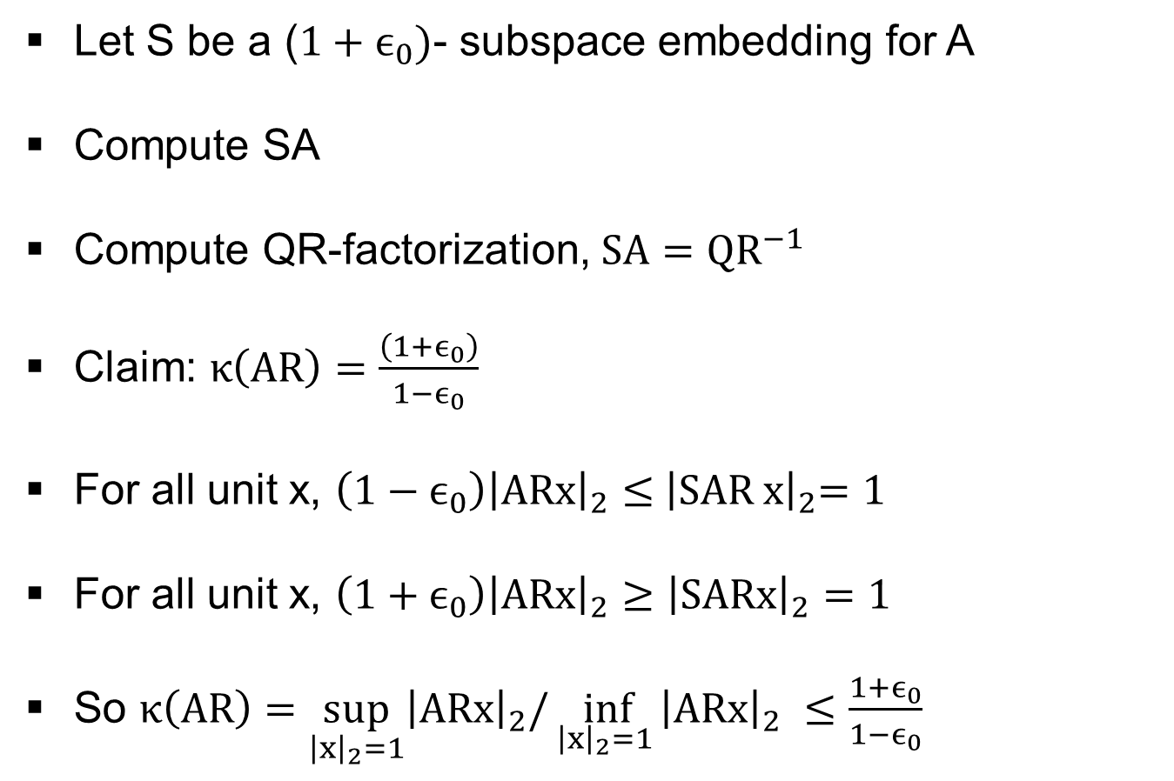
Small QR Decomposition
Let S be a ($1+ϵ_{0})$- subspace embedding for A
Compute SA
Compute QR-factorization, $SA=QR^{−1}$
Claim: $κ\left(AR\right)=\frac{\left(1+ϵ_{0}\right)}{1−ϵ_{0}}$
For all unit x, $\left(1−ϵ_{0}\right){\left|ARx\right|}_{2}≤{ \left|SAR^{ }x\right|}_{2}=1$
For all unit x, ${\left(1+ϵ_{0}\right)\left|ARx\right|}_{2}≥{\left|SARx\right|}_{2}=1$
So $κ\left(AR\right)=\sup_{{\left|x\right|}_{2}=1}{{\left|ARx\right|}_{2}/\inf_{{\left|x\right|}_{2}=1 }{{\left|ARx\right|}_{2} }}≤\frac{1+ϵ_{0}}{1−ϵ_{0}}$

Slide 13
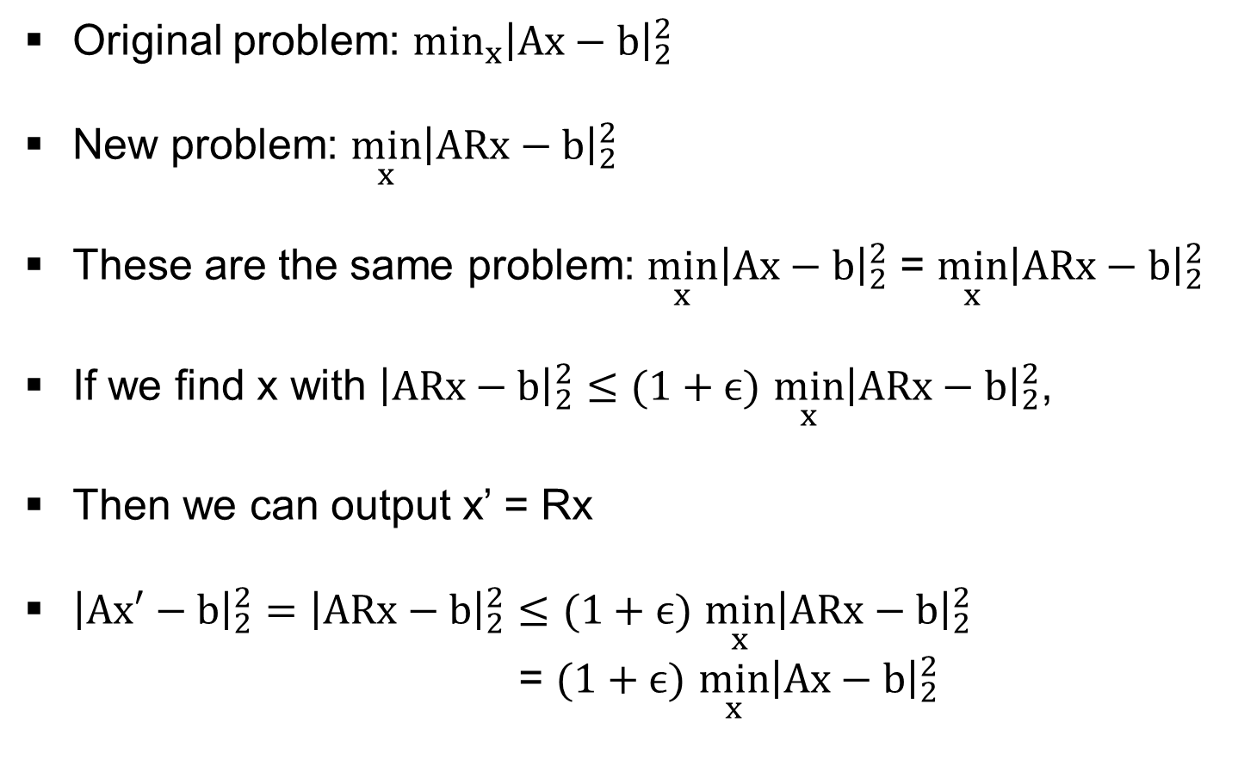
Change of Variables
Original problem: $\min_{x}{{\left|Ax−b\right|}_{2}^{2}}$
New problem: $\min_{x}{{\left|ARx−b\right|}_{2}^{2}}$
These are the same problem: $\min_{x}{{\left|Ax−b\right|}_{2}^{2}}$ = $\min_{x}{{\left|ARx−b\right|}_{2}^{2}}$
If we find x with ${\left|ARx−b\right|}_{2}^{2}≤(1+ϵ)$ $\min_{x}{{\left|ARx−b\right|}_{2}^{2}}$,
Then we can output x’ = Rx
${\left|Ax′−b\right|}_{2}^{2}=$ ${\left|ARx−b\right|}_{2}^{2}≤(1+ϵ)$ $\min_{x}{{\left|ARx−b\right|}_{2}^{2}}$
  = $(1+ϵ)$ $\min_{x}{{\left|Ax−b\right|}_{2}^{2}}$

Slide 14
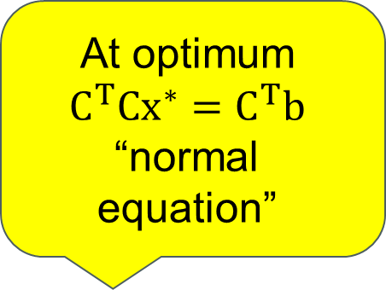
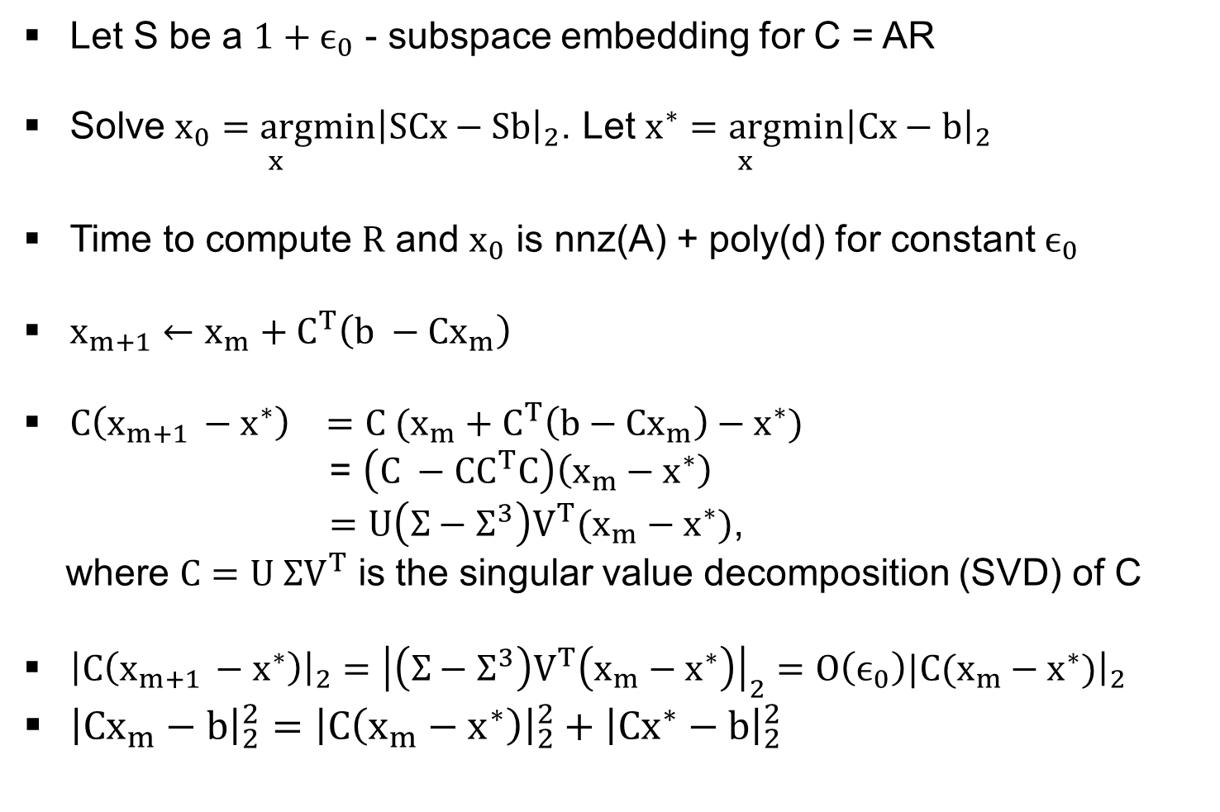
Gradient Descent
Let S be a $1+ϵ_{0}$ - subspace embedding for C = AR
Solve $\underset{x}{x_{0}=argmin}{{\left|SCx−Sb\right|}_{2}}$. Let $\underset{x}{x^{∗}=argmin}{{\left|Cx−b\right|}_{2}}$
Time to compute $R$ and $x_{0}$ is nnz(A) + poly(d) for constant $ϵ_{0}$
$x_{m+1}←x_{m}+C^{T}\left(b −Cx_{m}\right)$
$C\left(x_{m+1 }−x^{∗}\right) =C (x_{m}+C^{T}\left(b−Cx_{m}\right)−x^{∗})$
= $\left(C −CC^{T}C\right)\left(x_{m}−x^{∗}\right)$
$=U\left(Σ−Σ^{3}\right)V^{T}(x_{m}^{}−x^{∗})$,
where $C=U ΣV^{T}$ is the singular value decomposition (SVD) of C
${\left|C\left(x_{m+1 }−x^{∗}\right)\right|}_{2}={\left|\left(Σ−Σ^{3}\right)V^{T}\left(x_{m}^{}−x^{∗}\right)\right|}_{2}=O\left(ϵ_{0}\right)|C(x_{m}−x^{∗}){\left.​\right|}_{2}$
${\left|{Cx}_{m}−b\right|}_{2}^{2}={\left|C\left(x_{m}−x^{∗}\right)\right|}_{2}^{2}+{\left|Cx^{∗}−b\right|}_{2}^{2}$
At optimum
$$C^{T}Cx^{∗}=C^{T}b$$
“normal equation”

Slide 15
Outline
Tutorial on Sketching for Matrices
Applications

Slide 16
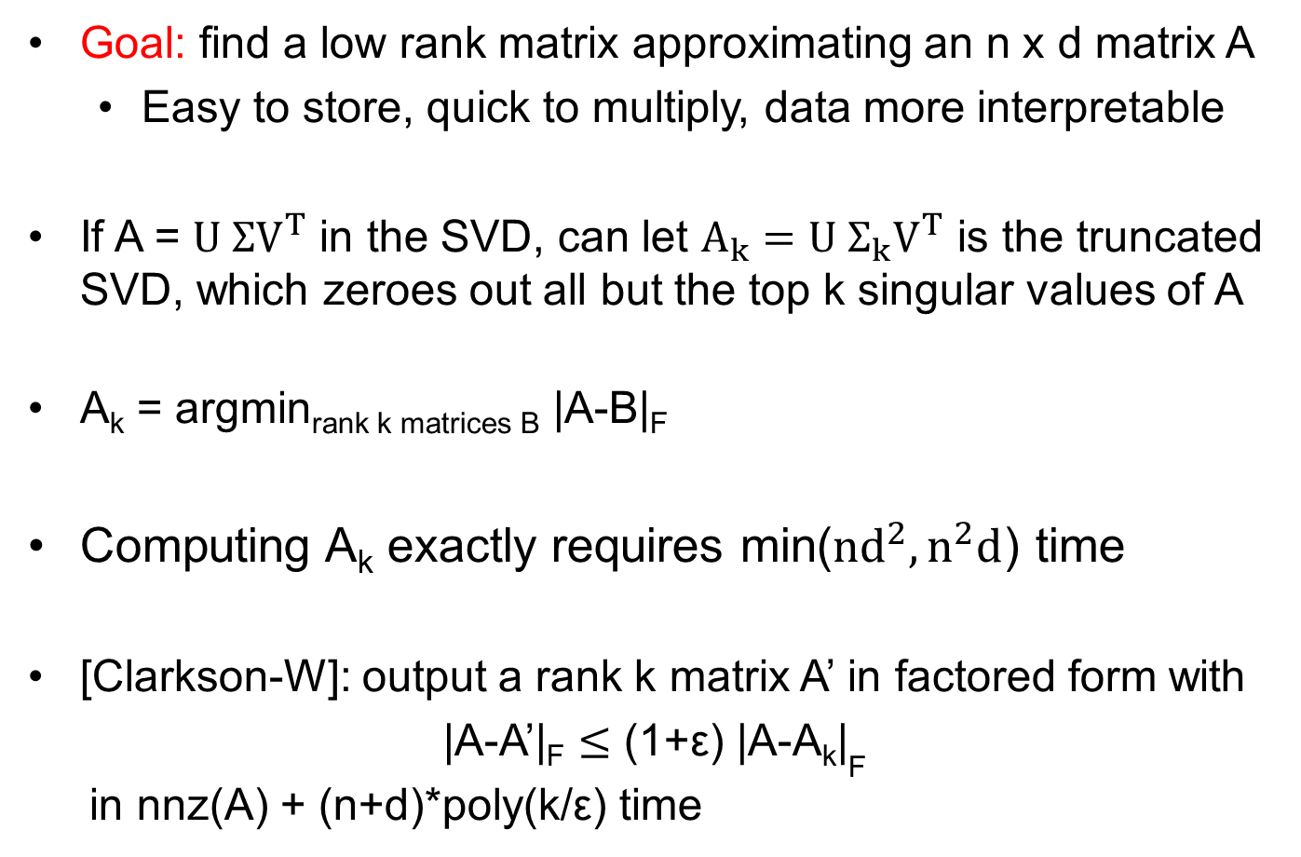
Low Rank Approximation
Goal: find a low rank matrix approximating an n x d matrix A
  Easy to store, quick to multiply, data more interpretable
If A = $U ΣV^{T}$ in the SVD, can let $A_{k}=U Σ_{k}V^{T}$ is the truncated SVD, which zeroes out all but the top k singular values of A
A_{k} = argmin_{rank k matrices B} |A-B|_{F}
Computing A_{k} exactly requires min($nd^{2}, n^{2}d$) time
[Clarkson-W]: output a rank k matrix A’ in factored form with
|A-A’|_{F} $≤$ (1+ε) |A-A_{k}|_{F}
in nnz(A) + (n+d)*poly(k/ε) time

Slide 17


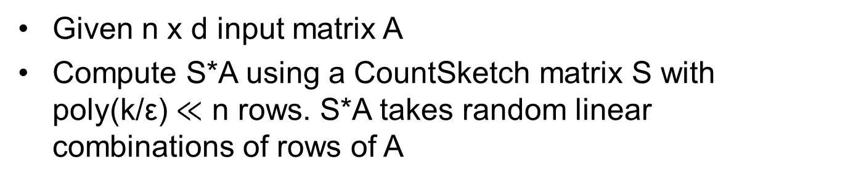



Solution to Low-Rank Approximation
Given n x d input matrix A
Compute S*A using a CountSketch matrix S with poly(k/ε) $≪$ n rows. S*A takes random linear combinations of rows of A
$$A_{3}$$
$$A_{2}$$
$$A_{1}$$
$$R^{d}$$
$$A_{4}$$
SA
Project rows of A onto SA, then find best rank-k approximation to points inside of SA

Slide 18
General Function Low Rank Approximation
Chierichetti, Gollapudi, Kumar, Lattanzi,
Mahankali, Panigrahy, Song, W, Yasuda, Zhong

Slide 19
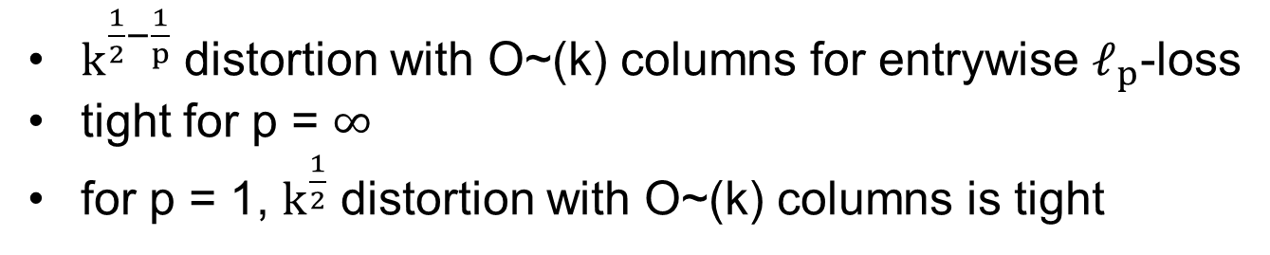
Column Subset Selection
U is an actual subset of columns
$k^{\frac{1}{2}−\frac{1}{p}}$ distortion with O~(k) columns for entrywise $ℓ_{p}$-loss
tight for p = $∞$
for p = 1, $k^{\frac{1}{2}}$ distortion with O~(k) columns is tight

Slide 20
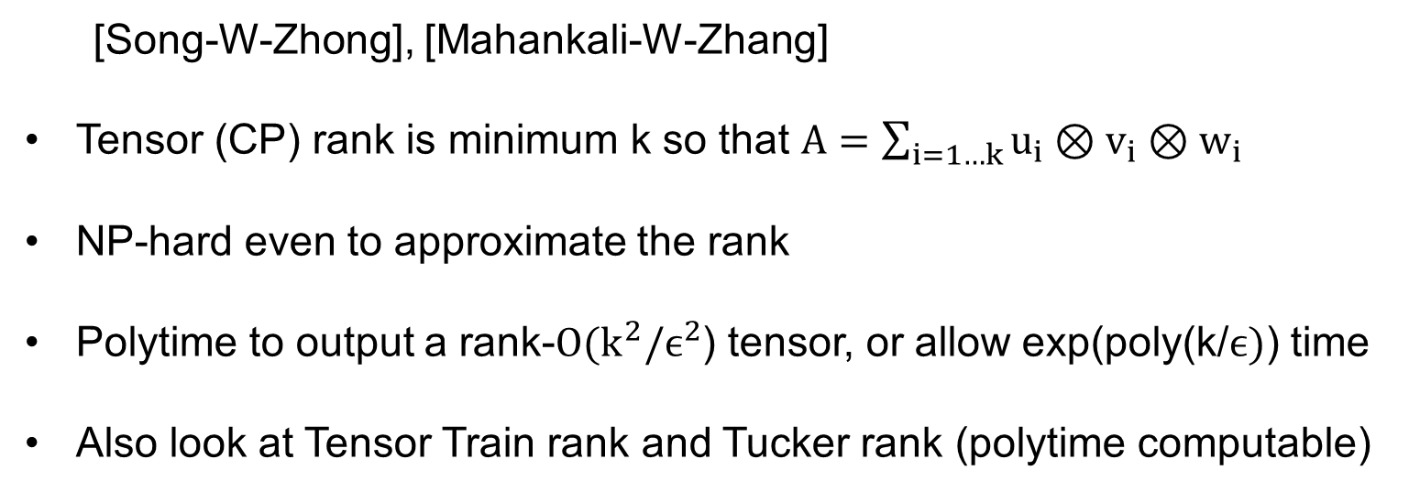
Tensor Low Rank Approximation
  [Song-W-Zhong], [Mahankali-W-Zhang]
Tensor (CP) rank is minimum k so that $A=\sum_{i=1…k}{u_{i}⊗v_{i}⊗w_{i}}$
NP-hard even to approximate the rank
Polytime to output a rank-$O(k^{2}/ϵ^{2}$) tensor, or allow exp(poly(k/$ϵ)$) time
Also look at Tensor Train rank and Tucker rank (polytime computable)

Slide 21

Ridge Regression
Output x* that minimizes |Ax-b|₂² + $λ{\left|x\right|}_{2}^{2}$
Sketching useful both when n $≫$ d and when d $≫$ n
Statistical dimension $sd_{λ}\left(A\right)=\sum_{i}{\frac{σ_{i}^{2}}{λ+σ_{i}^{2}}}$
[Avron-Clarkson-W, Kacham-W, Chowdhury-Yang-Drineas]:
  n >> d: sketch to |SAx-Sb|₂² + $λ{\left|x\right|}_{2}^{2}$, where S has $sd_{λ}\left(A\right)$/$ϵ$ rows
  d >> n: solve using sketching in $poly(sd_{λ}\left(A\right)σ_{1}\left(A\right)$/$ϵλ)$ time
[Chepurko-Clarkson, Horesh, W]: quantum-inspired methods

Slide 22
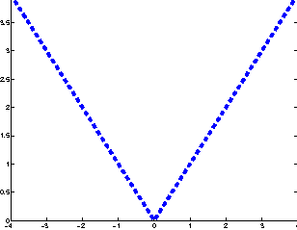
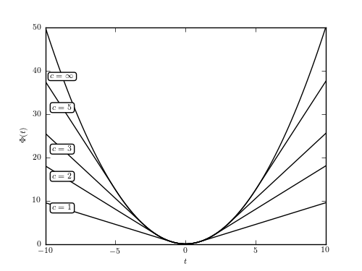
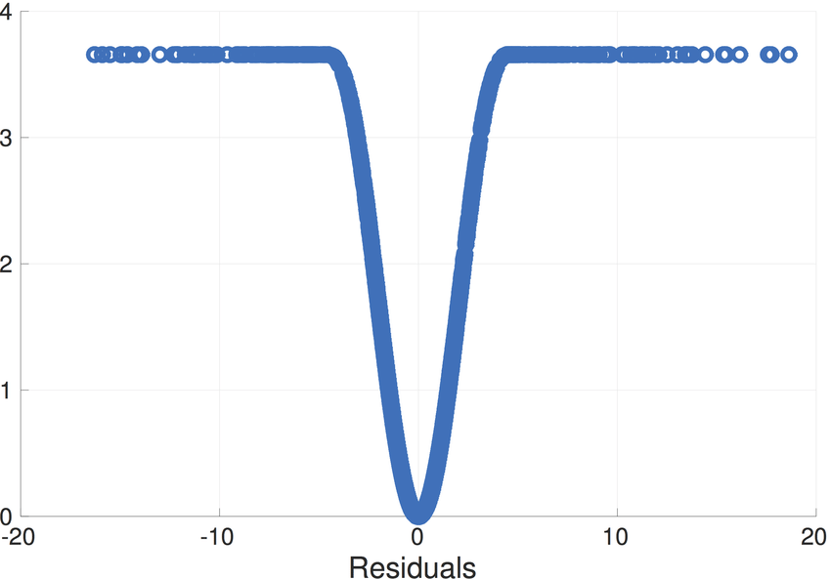

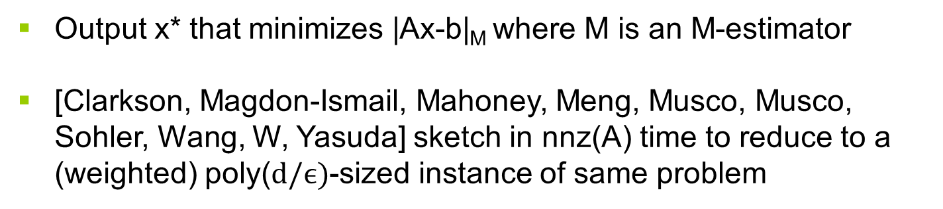
Robust Regression
Other loss functions than least squares sometimes more robust
$$ℓ_{1}$$
Huber
Tukey
Output x* that minimizes |Ax-b|_{M} where M is an M-estimator
[Clarkson, Magdon-Ismail, Mahoney, Meng, Musco, Musco, Sohler, Wang, W, Yasuda] sketch in nnz(A) time to reduce to a (weighted) poly($d/ϵ)$-sized instance of same problem

Slide 23
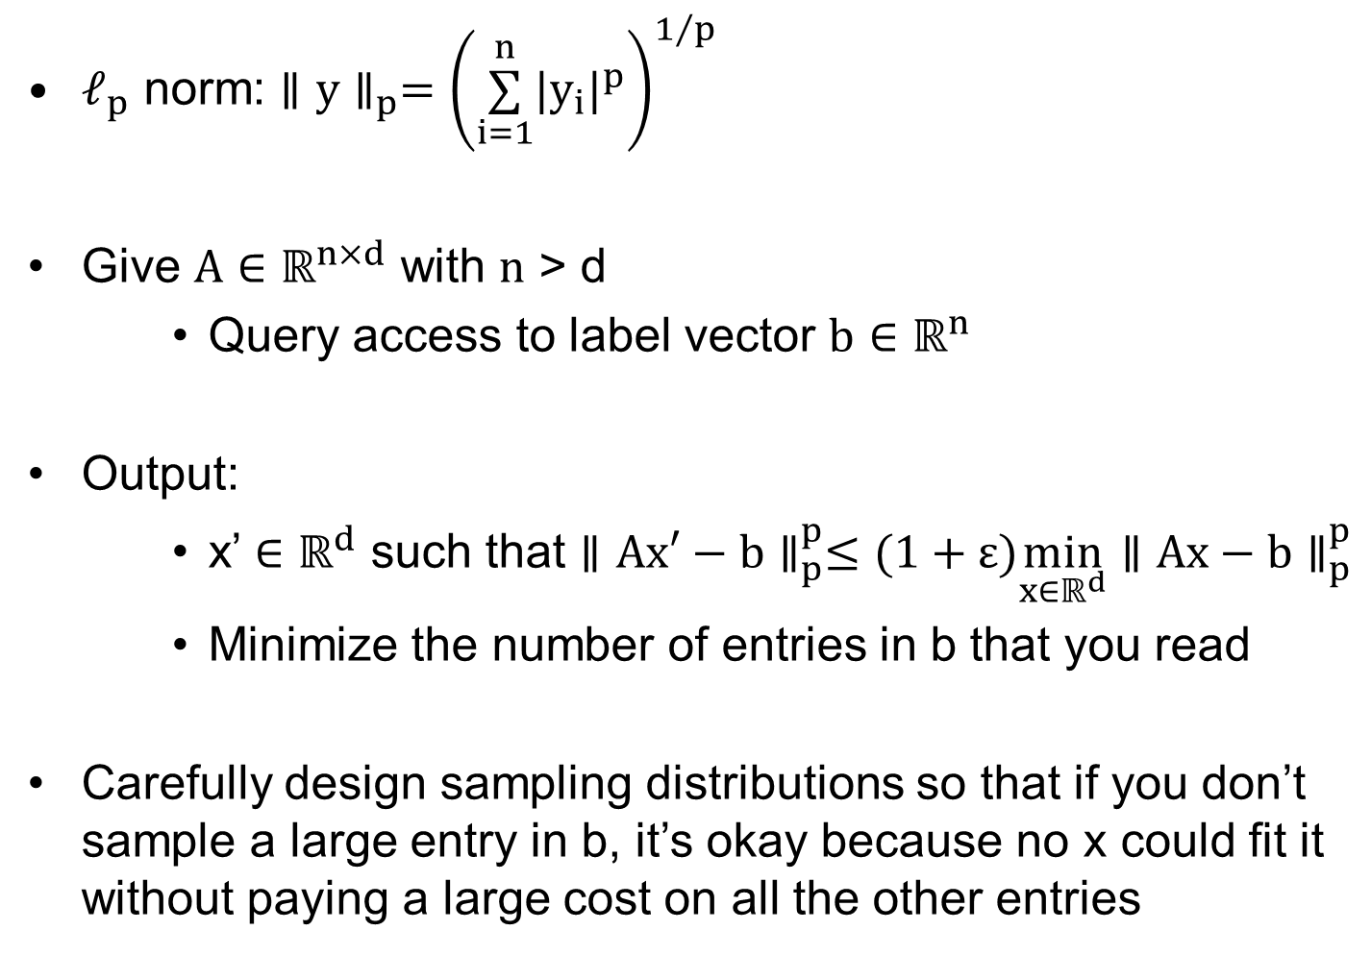

Active $ℓ_{p}$ Linear Regression
$ℓ_{p}$ norm: $∥y∥_{p}={\left(\overset{n}{\underset{i=1}{∑}}|y_{i}|^{p}\right)}^{1/p}$
Give $A∈ℝ^{n×d}$ with $n$ > d
    Query access to label vector $b∈ℝ^{n}$
Output:
    x’ $∈ℝ^{d}$ such that $∥Ax′−b∥_{p}^{p}≤(1+ε)\min_{x∈ℝ^{d}}∥Ax−b∥_{p}^{p}$
    Minimize the number of entries in b that you read
Carefully design sampling distributions so that if you don’t sample a large entry in b, it’s okay because no x could fit it without paying a large cost on all the other entries

Slide 24













Active $ℓ_{p}$ Linear Regression
 | Query Complexity | Work
 |  | [Chen, Price 2019]
 |  | [Chen, Derezinski 2021] [Parulekar, Parulekar, Price 2021]
 |  | [Chen, Derezinski 2021]
 |  | [Musco, Musco, Woodruff, Y 2022]
 |  | [Woodruff, Y 2023] (improving earlier [Musco, Musco, Woodruff, Y 2022] )
 |  | [Musco, Musco, Woodruff, Y 2022]
$$Θ\left(\frac{d}{ε}\right)$$
$$p=2$$
$$\overset{˜}{Θ}\left(\frac{d}{ε^{2}}\right)$$
$$p=1$$
$$\overset{˜}{O}\left(\frac{d^{2}}{ε^{2}}\right)$$
$$1<p<2$$
$$\overset{˜}{Θ}\left(\frac{d}{ε}\right)$$
$$1<p<2$$
$$\overset{˜}{Θ}\left(\frac{d^{p/2}}{ε^{p−1}}\right)$$
$$p>2$$
$$0<p<1$$
$$\overset{˜}{Θ}\left(\frac{d}{ε^{2}}\right)$$

Slide 25
Weighted Low Rank Approximation
[Razenshteyn-Song-W], [Song-W-Zhong]
  [Razenshteyn-Song-W], [Ban-W-Zhang], [Musco- Musco-W],
  [W-Yasuda], [Bhaskara-Ruwanpathirana-Wijewardena]
  Generalizes matrix completion, NP-hard even with relaxations
  Can look at additive error
  For relative error, look at structured weight matrices that occur in practice. Allow for outputting rank larger than k, or exponential time in certain parameters describing W

Slide 26

Structure-Preserving Low Rank Approximation
  [Clarkson-W], [Musco-W] [Bakshi-Chepurko-W],
  [Clarkson-W], [Musco-W] [Bakshi-Chepurko-W], [Indyk-Vakilian-Wagner-W], [Bakshi-W]
If A is PSD, its diagonal encodes a lot of information
Can find a U achieving (1+$ϵ$)-approximation by reading only O(nk/$ϵ)$ entries of A

Slide 27
Wrapping Up
Sketching also useful for
  Regularized regression
  Active regression
  Column subset selection and CUR decompositions
  Tensor and weighted low rank approximation
  Robust regression and low rank approximation
  Kernel regression and low rank approximation
  Distributed, sliding window, and streaming computation
  Speeding up first and second order optimization. Linear programming, cutting plane methods, etc.
  PSD low rank approximation
  Trace estimation
  Eigenvalue estimation
  Large language models

