Slide 1

Uncertainty Quantification Summer School
GAME THEORY
Part II: APPLICATIONS

Slide 2
Mechanism Design

Slide 3
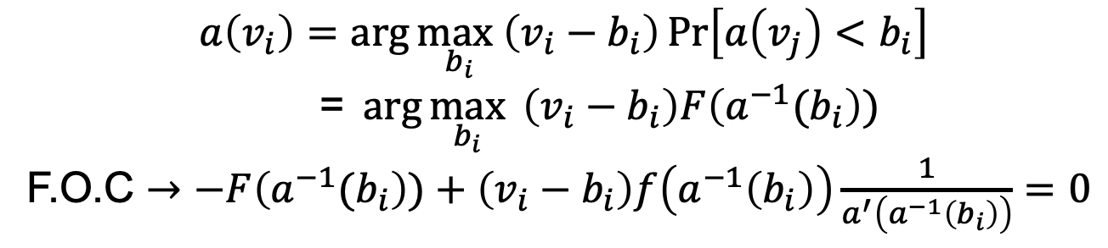
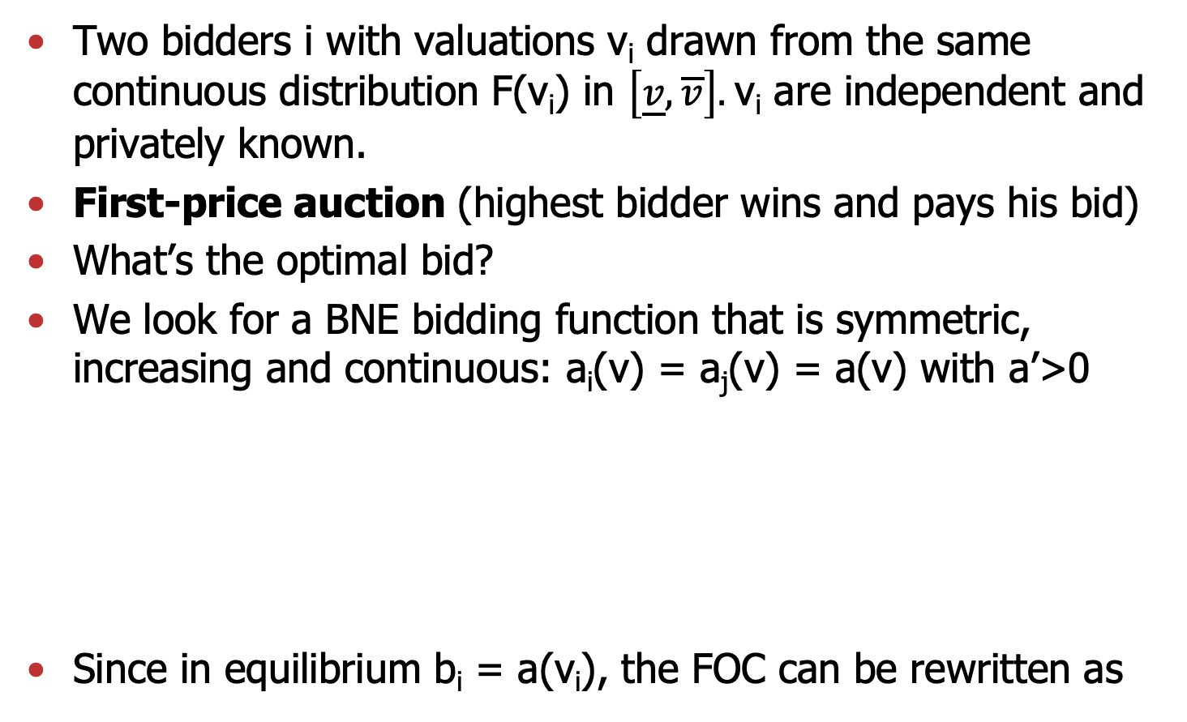
First price auction
Two bidders i with valuations v_{i} drawn from the same continuous distribution F(v_{i}) in $\left[\underline{v},\overline{v}\right].$v_{i} are independent and privately known.
First-price auction (highest bidder wins and pays his bid)
What’s the optimal bid?
We look for a BNE bidding function that is symmetric, increasing and continuous: a_{i}(v) = a_{j}(v) = a(v) with a’>0
Since in equilibrium b_{i} = a(v_{i}), the FOC can be rewritten as
$$a\left(v_{i}\right)=\arg{\max_{b_{i}}\left(v_{i}−b_{i}\right)\operatorname{Pr}\left[a\left(v_{j}\right)<b_{i}\right]}$$
=$\arg{\max_{b_{i}}{ \left(v_{i}−b_{i}\right)F\left(a^{−1}(b_{i}\right))}}$
F.O.C $→−F\left(a^{−1}(b_{i}\right))+\left(v_{i}−b_{i}\right)f\left(a^{−1}\left(b_{i}\right)\right)\frac{1}{a^{′}\left(a_{ }^{−1}\left(b_{i}\right)\right)}=0$

Slide 4
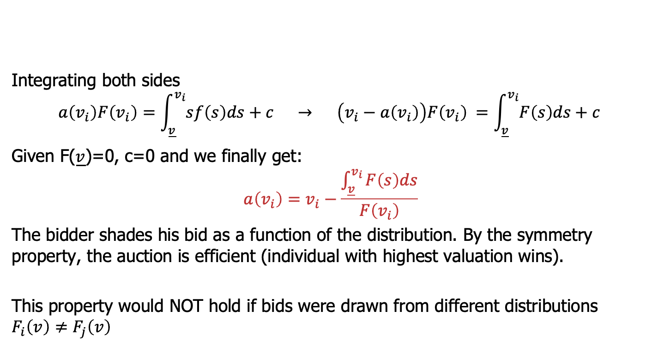
First price auction
$$−F\left(v_{i}\right)+\left(v_{i}−a\left(v_{i}\right)\right)f\left(v_{i}\right)\frac{1}{a^{′}\left(v_{i}\right)}=0 OR{ a}^{′}\left(v_{i}\right)F\left(v_{i}\right)+a\left(v_{i}\right)f\left(v_{i}\right)=v_{i}f\left(v_{i}\right)$$
Integrating both sides
$$a\left(v_{i}\right)F\left(v_{i}\right)={\int_{\underline{v}}^{v_{i}}{sf\left(s\right)ds+c} → \left(v_{i}−a\left(v_{i}\right)\right)F\left(v_{i}\right)}_{ }={\int_{\underline{v}}^{v_{i}}{F\left(s\right)ds+c}}_{ }$$
Given F($\underline{v}$)=0, c=0 and we finally get:
$$a\left(v_{i}\right)=v_{i}−\frac{\int_{\underline{v}}^{v_{i}}{F\left(s\right)ds}}{F\left(v_{i}\right)}$$
The bidder shades his bid as a function of the distribution. By the symmetry property, the auction is efficient (individual with highest valuation wins).
This property would NOT hold if bids were drawn from different distributions
$$F_{i}\left(v\right)≠F_{j}\left(v\right)$$

Slide 5
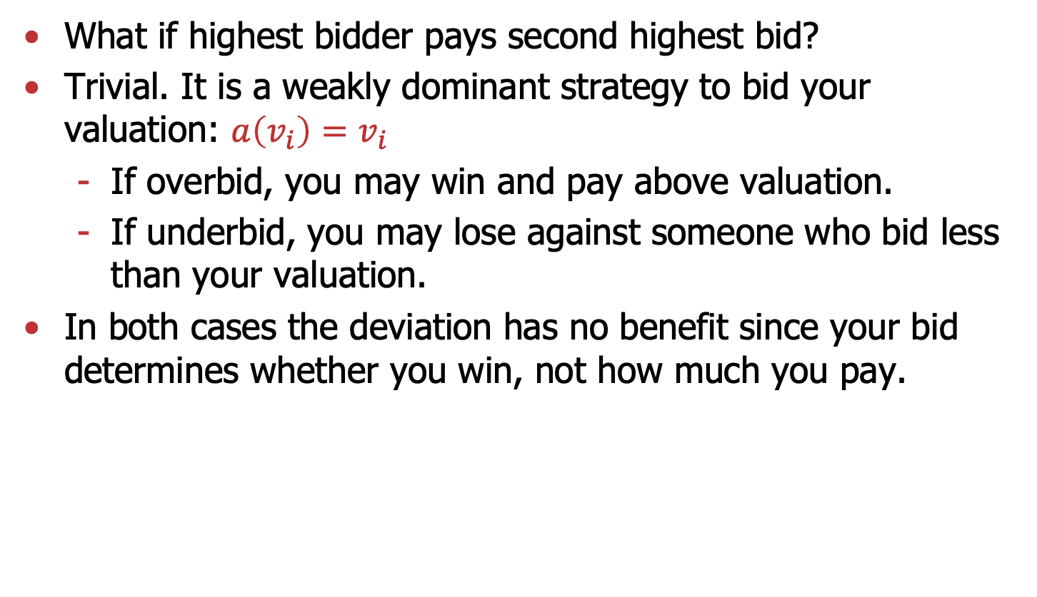
Second-price auction
What if highest bidder pays second highest bid?
Trivial. It is a weakly dominant strategy to bid your valuation: $a\left(v_{i}\right)=v_{i}$
  If overbid, you may win and pay above valuation.
  If underbid, you may lose against someone who bid less than your valuation.
In both cases the deviation has no benefit since your bid determines whether you win, not how much you pay.

Slide 6
Optimal auction design
Million-dollar question. What is better for the seller:
First price? Second price? English auction? Dutch auction?
Answer (beautiful): under certain assumptions
Private value goods
and
Risk-neutral bidders
It doesn’t matter
[Revenue Equivalence Theorem (Myerson)]

Slide 7
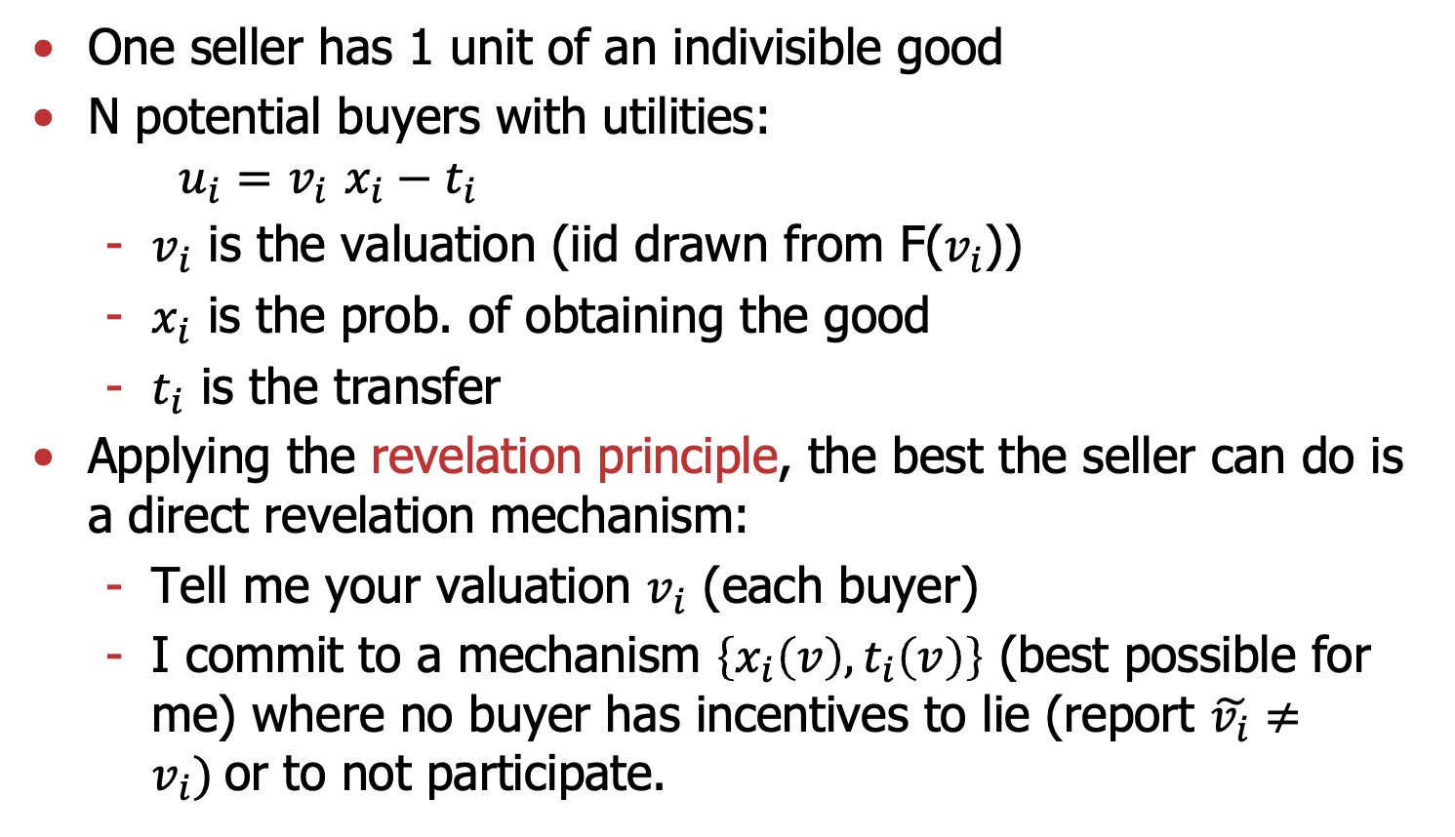
Optimal auction
One seller has 1 unit of an indivisible good
N potential buyers with utilities:
$u_{i}=$ $v_{i}$ $x_{i}−t_{i}$
  $v_{i}$ is the valuation (iid drawn from F($v_{i}$))
  $x_{i}$ is the prob. of obtaining the good
  $t_{i}$ is the transfer
Applying the revelation principle, the best the seller can do is a direct revelation mechanism:
  Tell me your valuation $v_{i}$ (each buyer)
  I commit to a mechanism $\left\{x_{i}\left(v\right),t_{i}\left(v\right)\right\}$ (best possible for me) where no buyer has incentives to lie (report $\tilde{v_{i}}≠v_{i})$or to not participate.

Slide 8
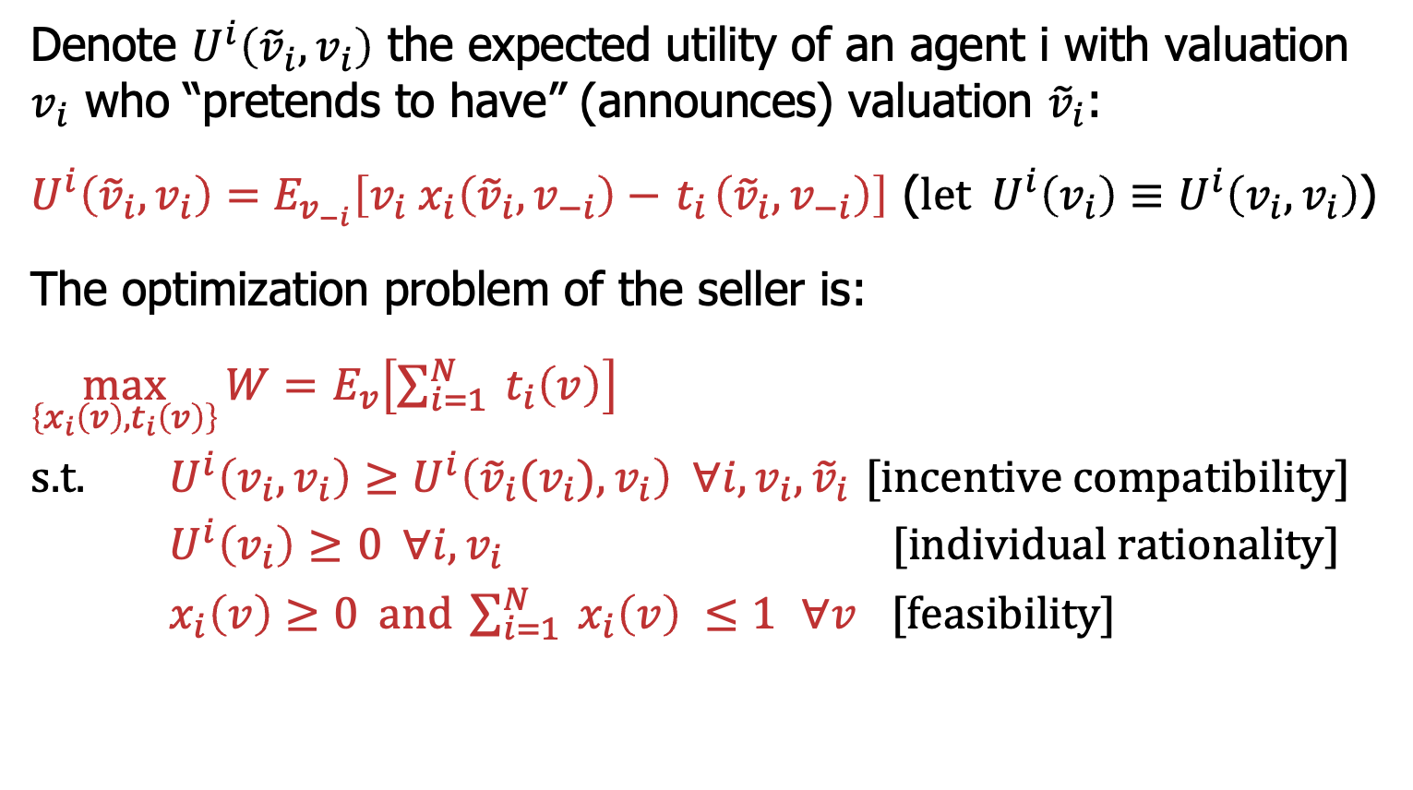
Optimal auction
Denote $U^{i}\left({\tilde{v}}_{i},v_{i}\right)$ the expected utility of an agent i with valuation $v_{i}$ who “pretends to have” (announces) valuation ${\tilde{v}}_{i}$:
$U^{i}\left({\tilde{v}}_{i},v_{i}\right)=E_{v_{−i}}\left[v_{i}{ x}_{i}\left({\tilde{v}}_{i},v_{−i}\right)−{ t}_{i}\left({\tilde{v}}_{i},v_{−i}\right)\right]$ ($let{ U}^{i}\left(v_{i}\right)≡U^{i}\left(v_{i}, v_{i}\right)$)
The optimization problem of the seller is:
$\max_{\left\{x_{i}\left(v\right),t_{i}\left(v\right)\right\}}{W=}$ $E_{v}\left[\sum_{i=1}^{N}{{ t}_{i}\left(v\right)}\right]$
s.t. $U^{i}\left(v_{i},v_{i}\right)≥U^{i}\left({\tilde{v}}_{i}(v_{i}), v_{i}\right) ∀i, v_{i},{\tilde{v}}_{i}$ [incentive compatibility]
$U^{i}\left(v_{i}\right)≥$ $0 ∀i, v_{i}$ [individual rationality]
$x_{i}\left(v\right)≥0 \text{and} \sum_{i=1}^{N}{{ x}_{i}\left(v\right) ≤1 }$ $∀v$ [feasibility]

Slide 9
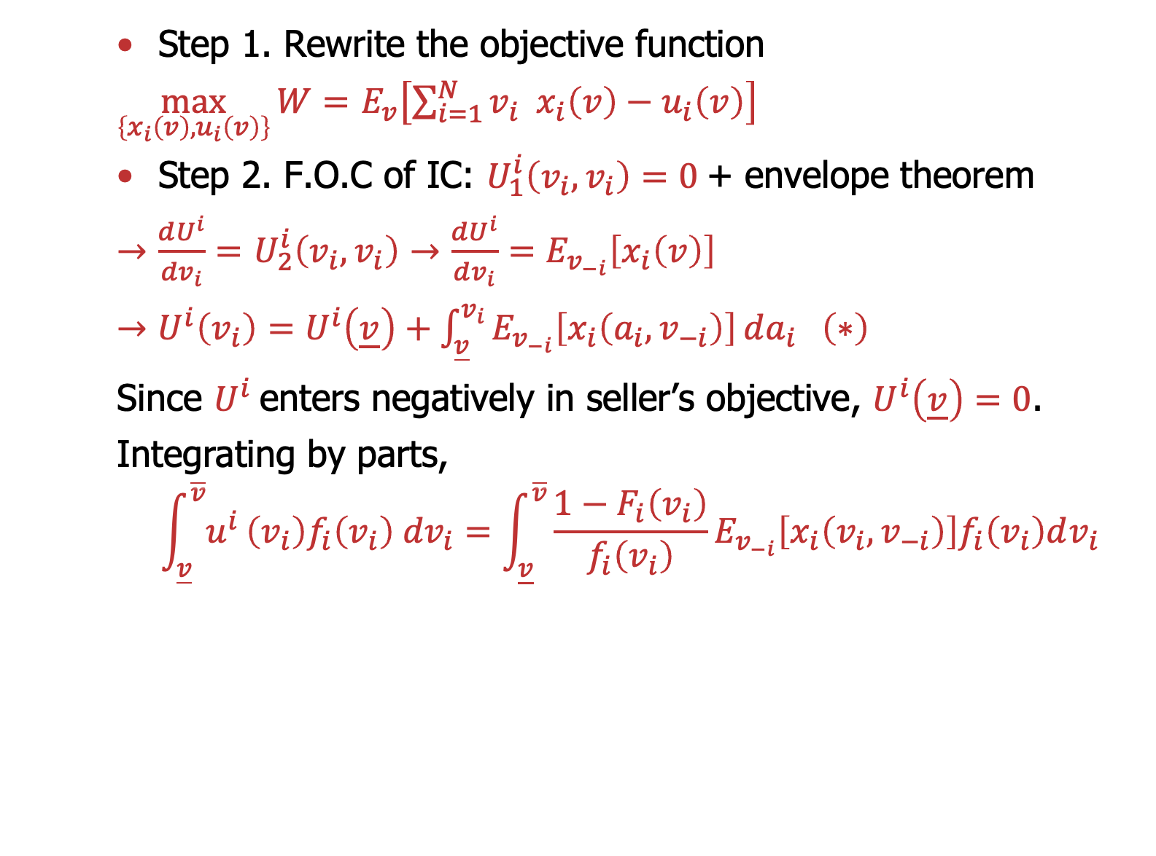
Optimal auction
Step 1. Rewrite the objective function
$\max_{\left\{x_{i}\left(v\right),u_{i}\left(v\right)\right\}}{W=}$ $E_{v}\left[\sum_{i=1}^{N}{{v_{i} { x}_{i}\left(v\right)−u}_{i}\left(v\right)}\right]$
Step 2. F.O.C of IC: $U_{1}^{i}\left(v_{i},v_{i}\right)=0$+ envelope theorem
$→\frac{dU^{i}}{dv_{i}}=$ $U_{2}^{i}\left(v_{i},v_{i}\right)→\frac{dU^{i}}{dv_{i}}=E_{v_{−i}}\left[x_{i}\left(v\right)\right]$
$→U^{i}\left(v_{i}\right)=U^{i}\left(\underline{v}\right)+\int_{\underline{v}}^{v_{i}}{E_{v_{−i}}\left[x_{i}\left(a_{i},v_{−i}\right)\right]}da_{i} \left(∗\right)$
Since $U^{i}$enters negatively in seller’s objective, $U^{i}\left(\underline{v}\right)=0$.
Integrating by parts,
$$\int_{\underline{v}}^{\overline{v}}{u^{i}}\left(v_{i}\right)f_{i}\left(v_{i}\right) {dv}_{i}=\int_{\underline{v}}^{\overline{v}}{{\frac{1−F_{i}\left(v_{i}\right)}{f_{i}\left(v_{i}\right)}E}_{v_{−i}}\left[x_{i}\left(v_{i},v_{−i}\right)\right]f_{i}\left(v_{i}\right)dv_{i}}$$

Slide 10
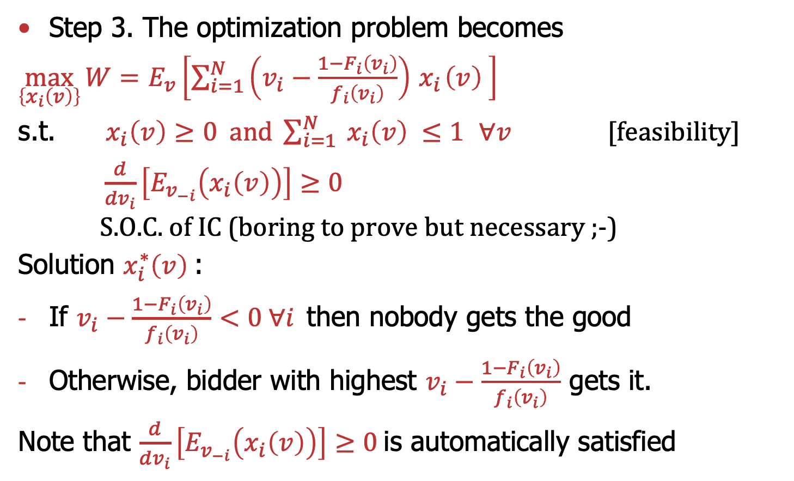
Optimal auction
Step 3. The optimization problem becomes
$\max_{\left\{x_{i}\left(v\right)\right\}}{W=}$ $E_{v}\left[\sum_{i=1}^{N}{{\left(v_{i}−\frac{1−F_{i}\left(v_{i}\right)}{f_{i}\left(v_{i}\right)}\right){ x}_{i}\left(v\right)}_{ }}\right]$
s.t. ${ x}_{i}\left(v\right)≥0 \text{and} \sum_{i=1}^{N}{{ x}_{i}\left(v\right) ≤1 }$ $∀v$ [feasibility]
$\frac{d}{dv_{i}}\left[E_{v_{−i}}\left(x_{i}\left(v\right)\right)\right]≥0$
S.O.C. of IC (boring to prove but necessary ;-)
Solution $x_{i}^{∗}\left(v\right)$:
If $v_{i}−\frac{1−F_{i}\left(v_{i}\right)}{f_{i}\left(v_{i}\right)}<0 ∀i$then nobody gets the good
Otherwise, bidder with highest $v_{i}−\frac{1−F_{i}\left(v_{i}\right)}{f_{i}\left(v_{i}\right)}$ gets it.
Note that $\frac{d}{dv_{i}}\left[E_{v_{−i}}\left(x_{i}\left(v\right)\right)\right]≥0$ is automatically satisfied

Slide 11
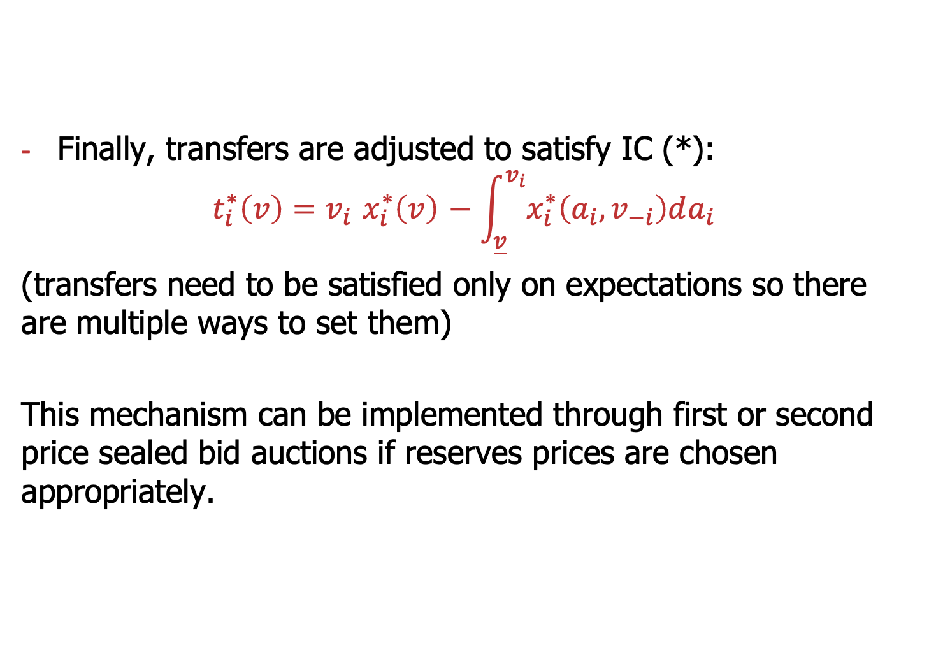
Optimal auction
Finally, transfers are adjusted to satisfy IC (*):
$$t_{i}^{∗}\left(v\right)=v_{i}{ x_{i}^{∗}\left(v\right)}_{ }−\int_{\underline{v}}^{v_{i}}{{x_{i}^{∗}\left(a_{i},v_{−i}\right)da_{i}}_{ }}$$
(transfers need to be satisfied only on expectations so there are multiple ways to set them)
This mechanism can be implemented through first or second price sealed bid auctions if reserves prices are chosen appropriately.

Slide 12
Incorporating
Choice uncertainty

Slide 13
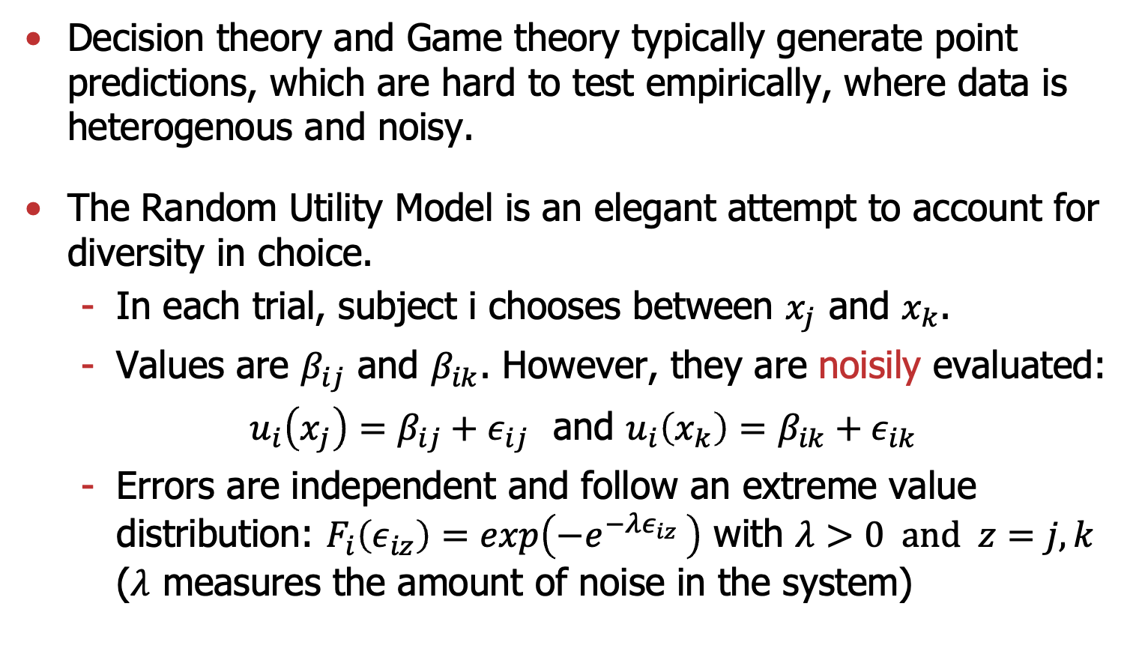
Random Utility Model (RUM)
Decision theory and Game theory typically generate point predictions, which are hard to test empirically, where data is heterogenous and noisy.
The Random Utility Model is an elegant attempt to account for diversity in choice.
  In each trial, subject i chooses between $x_{j}$ and $x_{k}$.
  Values are $β_{ij}$ and $β_{ik}$. However, they are noisily evaluated:
  $u_{i}\left(x_{j}\right)=β_{ij}+ε_{ij}$ and $u_{i}\left(x_{k}\right)=β_{ik}+ε_{ik}$
  Errors are independent and follow an extreme value distribution: $F_{i}\left(ε_{iz}\right)=exp\left(−e^{{−λε_{iz}}_{ }}\right)$ with $λ>0 \text{and} z=j,k$
  ($λ$ measures the amount of noise in the system)

Slide 14
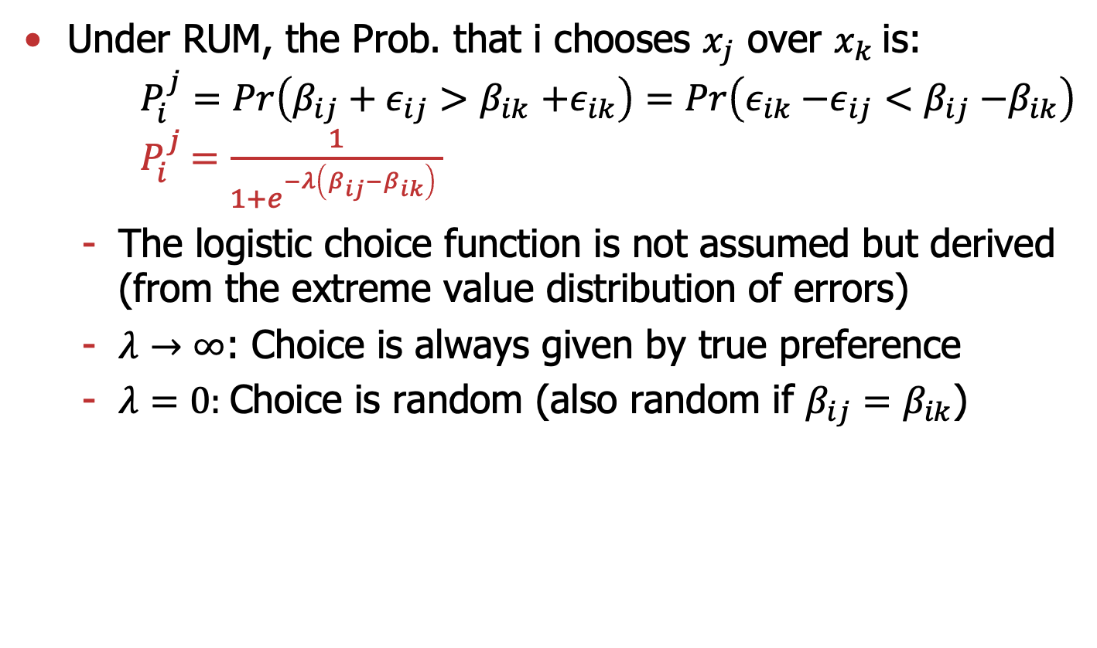
Random Utility Model (RUM)
Under RUM, the Prob. that i chooses $x_{j}$ over $x_{k}$is:
$P_{i}^{j}=Pr\left(β_{ij}+ε_{ij}{>β}_{ik}+ε_{ik}\right)=Pr\left(ε_{ik}{−ε_{ij}<β}_{ij}−β_{ik}\right)$
$P_{i}^{j}$ $=\frac{1}{1+e^{{−λ\left(β_{ij}−β_{ik}\right)}_{ }}}$
  The logistic choice function is not assumed but derived (from the extreme value distribution of errors)
  $λ→∞$: Choice is always given by true preference
  $λ=0:$Choice is random (also random if $β_{ij}=β_{ik}$)

Slide 15
Quantal Response Equilibrium (QRE)
Theory: Modify Nash equilibrium to incorporate realistic limitations to rational choice (uncertainty in choice)
Methodological: Provide a statistical framework to analyze game theoretic data:
Structural econometric approach
Testing comparative static predictions
Similar spirit as RUM but for multi-person strategic settings

Slide 16
Quantal Response Equilibrium (QRE)
Generalization of Nash equilibrium (not “replacement”).
  It is still an equilibrium model
  Agents “better respond’’ instead of “best respond”.
Introduces mistakes in play that are inversely related to the payoff (errors generating high costs are unlikely).
At the limit, (small errors), the model approximates Nash equilibrium.
Any strategy can be played with non-zero probability. It is consistent with experimental data and can fit data better.
Unlike other behavioral theories, it retains rationality: probabilistic behavior of all actors are, in equilibrium, correct.

Slide 17
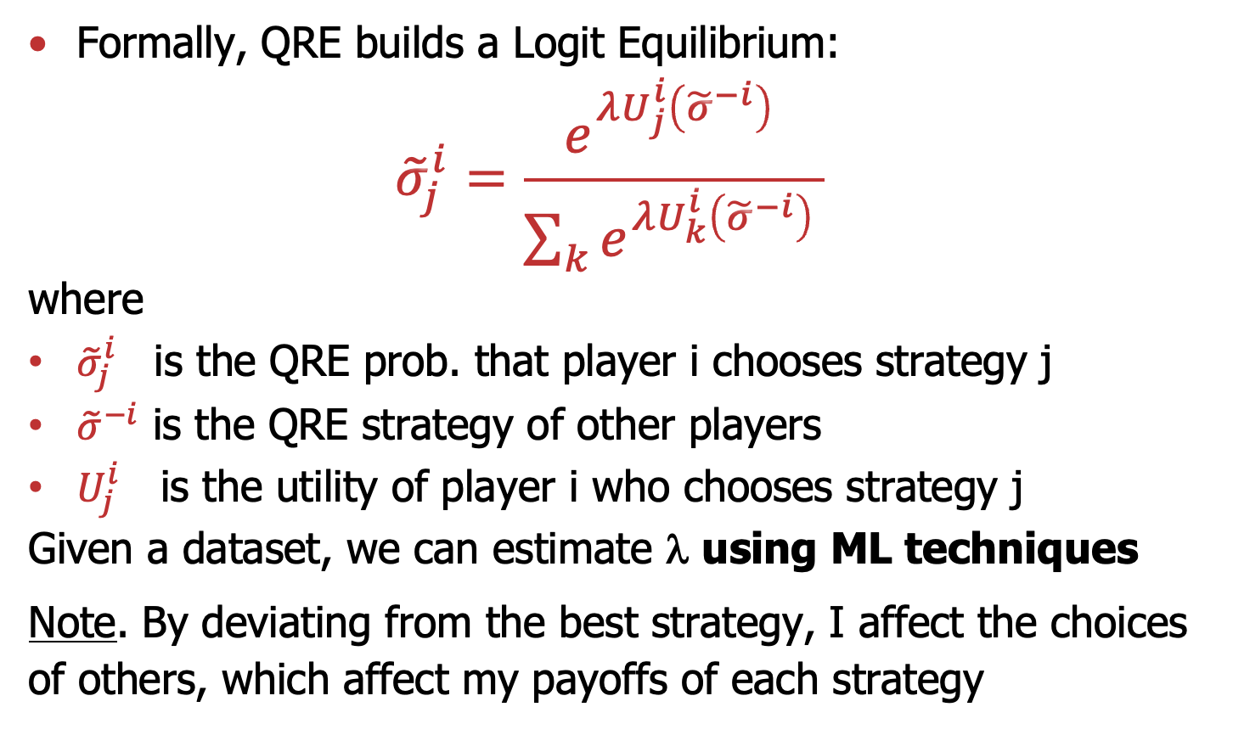
Quantal Response Equilibrium (QRE)
Formally, QRE builds a Logit Equilibrium:
$${\tilde{σ}}_{j}^{i}=\frac{e^{{λU_{j}^{i}\left({\tilde{σ}}_{ }^{−i}\right)}_{ }}}{\sum_{k}{e^{{λU_{k}^{i}\left({\tilde{σ}}_{ }^{−i}\right)}_{ }}}}$$
where
${\tilde{σ}}_{j}^{i}$is the QRE prob. that player i chooses strategy j
${\tilde{σ}}_{ }^{−i}$ is the QRE strategy of other players
$U_{j}^{i}$ is the utility of player i who chooses strategy j
Given a dataset, we can estimate λ using ML techniques
Note. By deviating from the best strategy, I affect the choices
of others, which affect my payoffs of each strategy

Slide 18
QRE illustration
 |  | seeker
 |  | A_{S} | B_{S}
hider | A_{H} | 5,1 | 1,2
 | B_{H} | 1,2 | 2,1
Best response correspondences of NE
A_{H}
Nash
Equilibrium
Pr(A_{H})=1/2
Pr(A_{S})=1/5
A_{S}

Slide 19

QRE illustration
QRE given a fixed $λ$
Best response functions of QRE
QRE

Slide 20

QRE illustration
QRE as a function of$λ$

Slide 21
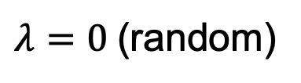
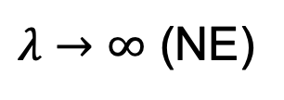
QRE illustration
QRE as a function of$λ$
$λ→∞$ (NE)
$λ=0$(random)

Slide 22
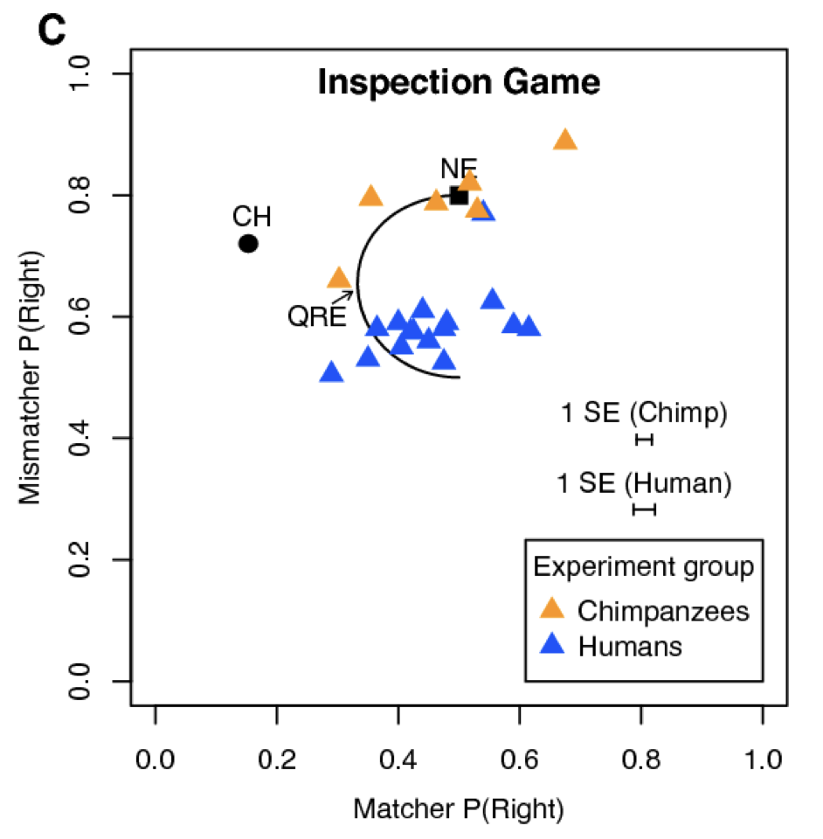
Humans or chimpanzees?
Chimpanzees are closer to NE
Humans are closer to random / QRE
“Chimpanzee choice rates in competitive games match equilibrium game theory predictions”, Martin et al, Scientific Reports (2014)

