Slide 1
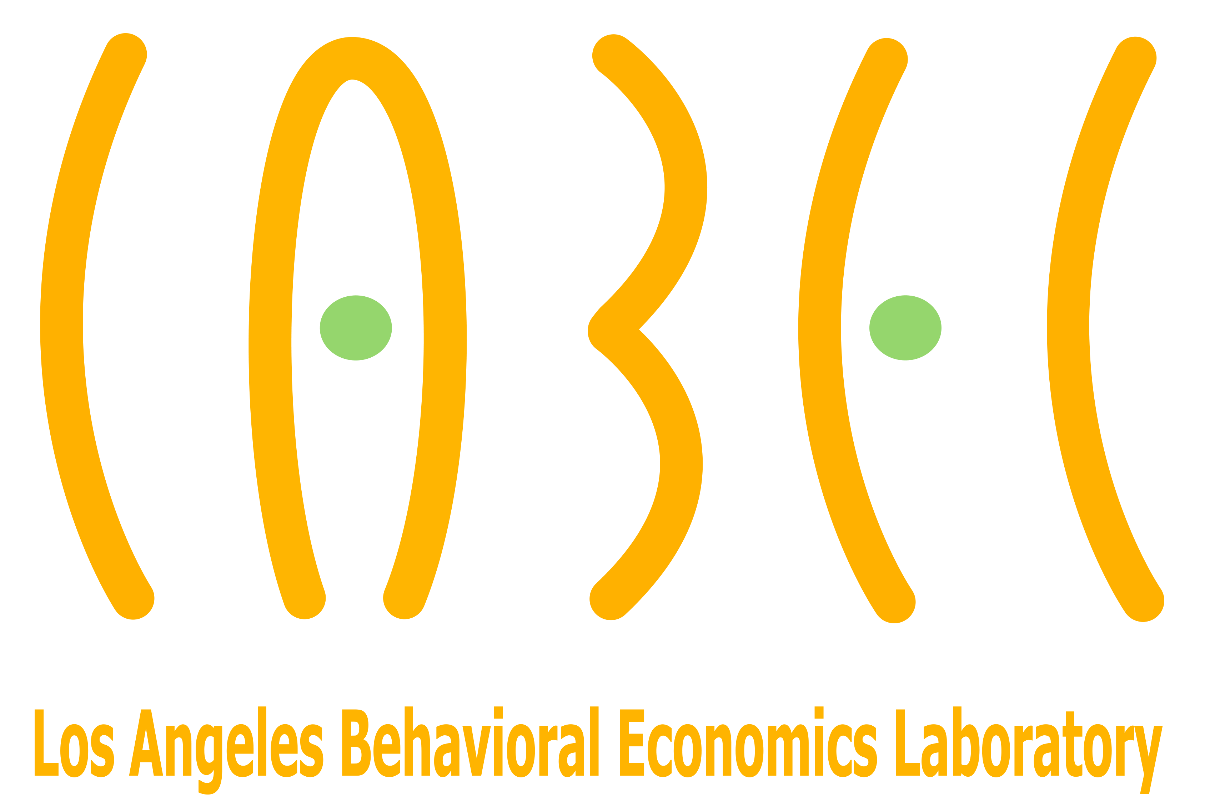
Uncertainty Quantification Summer School
GAME THEORY
Part I: INTRODUCTION

Slide 2
Game Theory – Basic objective
Predict decision making:
  By actors with well defined goals (preferences)
  In strategic settings (payoff interdependence)
  With more than one but a limited number of players

Slide 3
Game Theory – Basic assumptions
Common knowledge of rationality
  Everyone knows each other’s goals
  Everyone takes the action that maximizes their own goals
Common knowledge of structure of the game
(I know which elements I don’t know; others know which elements I don’t know; I know which elements others don’t know, etc.)

Slide 4
Taxonomy of games
Static (everyone moves once and at the same time)
v.
Dynamic
Complete information (no agent knows something about the game that at least one other agent does not).
v.
Incomplete Information
Note: knowledge about the game, not about what others will do!

Slide 5
Ingredients of a game
Players. Set of players: N={1,...,n}.
Actions.
  Set of actions or action space: a_{i} ∈ A_{i}. Note. Action can be stochastic (a_{i}¹ w.p. p and a_{i}² w.p. 1-p)
  Outcome a = (a₁,a₂,...,a_{n}) = (a_{i},a_{-i}) is a combination of actions, one for each player
  Outcome space:
  A = A₁ × … × A_{n} = {(a₁,...,a_{n}): a_{i} ∈ A_{i}, i = 1, ...,n}
  all the possible outcomes of the game.

Slide 6
Strategies. An action for every possible contingency, i.e. every time that the player may be called to play.
Payoffs.
u_{i}: A  R
For every outcome (a_{i}, a_{-i}) there is an associated payoff (e.g., the profit as a function of the prices)
Summary. Representation of game is:
G = (N; A₁, ... , A_{n} ; u₁, ... ,u_{n})

Slide 7
Equilibrium concept
Ingredients of a game
Nash Equilibrium (and its variants Bayesian Nash Equilibrium, Subgame Perfect Equilibrium, Perfect Bayesian Equilibrium)
Intuition 1.
Choose my optimal action knowing that others will choose their optimal action. Warning! their optimal action depends on my action (recursive thinking)
Intuition 2.
Each agent plays optimally conditional on beliefs about what others will do in the game
In equilibrium, beliefs about the others are correct (in a deterministic or stochastic sense)

Slide 8
Equilibrium concept
Formally… just a fixed point (as Von Neumann famously told Nash)
Definition 1. Outcome (a₁*, a₂*,…, a_{n}*) is a NE iff:
u_{i}(a_{i}*, a_{-i}*) ≥ u_{i}(a_{i}, a_{-i}*) for all a_{i} ∈ A_{i} and for all i
Definition 2. Let player i’s Best Response correspondence
be:
Outcome (a₁*, a₂*,…, a_{n}*) is a NE iff:

Slide 9
Games with complete information
Despite its simplicity, predictions are not always straightforward and/or empirically accurate
Example 1. Everyone in the room chooses a number. Whoever is closest to 1/2 the average wins (if tie, we split) (Keynes view of stock market: people price shares not based on belief of fundamental value, but rather on what they think everyone else believes the value is).
What do you think is the Nash Equilibrium?
What would you do if you were to play?
Example 2. Two randomly chosen persons. Same rules.
What do you think is the equilibrium?
What would you do if you were to play?

Slide 10
Simple examples
Example 3: play many times “hide and seek”
Pr(A_{H})=1/2
Pr(A_{S})=1/2
Example 4: what if
Pr(A_{H})=1/2
Pr(A_{S})=1/5
 |  | seeker
 |  | A_{S} | B_{S}
hider | A_{H} | 2,1 | 1,2
 | B_{H} | 1,2 | 2,1
 |  | seeker
 |  | A_{S} | B_{S}
hider | A_{H} | 5,1 | 1,2
 | B_{H} | 1,2 | 2,1

Slide 11
Games with incomplete information
(some) players have private information about some aspect of the game (their cost, their benefit, the weather, the ability of Apple’s CEO)
Nash equilibrium is extended: action of each player depends on their private information or “type” t_{i}:
Others have a belief p_{j} about one’s type
Bayesian Nash Equilibrium (BNE)
(a₁*(t₁), a₂*(t₂), …, a_{n}*(t_{n})) form a BNE iff:
Often counterintuitive: I need to determine what I would do if my type was something I know it isn’t

Slide 12
Example 5: The Betting Game
Two players, 1 and 2, choose “bet” or “no bet”
If at least one chooses “no bet”: nothing happens, both get 0
If both choose “bet”, payoffs are:
Pl1 learns state is “bad” or “not bad” (good + medium)
Pl2 learns state is “good” or “not good” (medium + bad)
Meant to capture trading or betting for informational reasons with people having different abilities to interpret information
 | good | medium | bad
Payoff of player 1 | 10 | -5 | 10
Payoff of player 2 | -5 | 10 | -5
Not bet: 0

Slide 13
The Betting Game
Should you bet if you are Pl1 and state is “not bad”?
→ No! because if state is “good” Pl2 will not bet anyway
… But I guess some people will average 10 and -5 and bet
 | good | medium | bad
Payoff of player 1 | 10 | -5 | 10
Payoff of player 2 | -5 | 10 | -5
Not bet: 0

Slide 14
The Betting Game
Should you bet if you are Pl2 and state is “not good”?
→ Again no! because a rational Pl1 will not bet if “not bad” and will bet if “bad”
 | good | medium | bad
Payoff of player 1 | 10 | -5 | 10
Payoff of player 2 | -5 | 10 | -5
Not bet: 0

Slide 15
The Betting Game
Should you bet if you are Pl2 and state is “not good”?
→ Again no! because a rational Pl1 will not bet if “not bad” and will bet if “bad”
Remarks:
Impossible counterfactual. Pl2 needs to know what they would do if state was “good” to unravel the argument
 | good | medium | bad
Payoff of player 1 | 10 | -5 | 10
Payoff of player 2 | -5 | 10 | -5
Not bet: 0

Slide 16
The Betting Game
Should you bet if you are Pl2 and state is “not good”?
→ Again no! because a rational Pl1 will not bet if “not bad” and will bet if “bad”
Remarks:
Impossible counterfactual. Pl2 needs to know what they would do if state was “good” to unravel the argument
Uncertainty quantification. If payoff of Pl1 under “good” is 100, maybe enough Pl1 will “mistakenly bet” under “not bad”. This will make betting for Pl2 optimal.
 | good | medium | bad
Payoff of player 1 | 100 | -5 | 10
Payoff of player 2 | -5 | 10 | -5
Not bet: 0

Slide 17
Example 6: Jar of Pennies Auction
You all make a bid (zero or positive) for this jar of pennies
Highest bidder wins: pay his bid (first-price auction) and get the cash equivalent of the content of the jar
All other bidders: get nothing and pay nothing
You just want to make as much money as possible
Captures auction of goods that have the same value to everyone, but no one knows exactly what the value is (oil drilling rights, timber rights, items for investment or resale)

Slide 18
Jar of Pennies Auction
“Winner’s curse”: winning the auction conveys information
Some estimates are too high, some too low
The winner made the highest bid, which generally implies that his estimate of profitability was among the highest ones
If you win, it is quite likely that you overestimated the value
If you bid close to your estimate of profitability and you win, then you are likely to lose money

Slide 19
Jar of Pennies Auction
The best advice:
bid something but shade the bid a “ton”
Uncertainty principle: generally, shade more if more uncertainty and if more bidders
If you suspect a lot of “crazy over-bidders”, it’s better that you don’t win.
  “If one wins a tract against two or three others he may feel fine about his good fortune. But how should he feel if he won against 50 others? Ill.” Competitive bidding in high risk situations (Cappen, Clapp and Campbell)
  By the way, the amount of money in the jar was $7.11

Slide 20
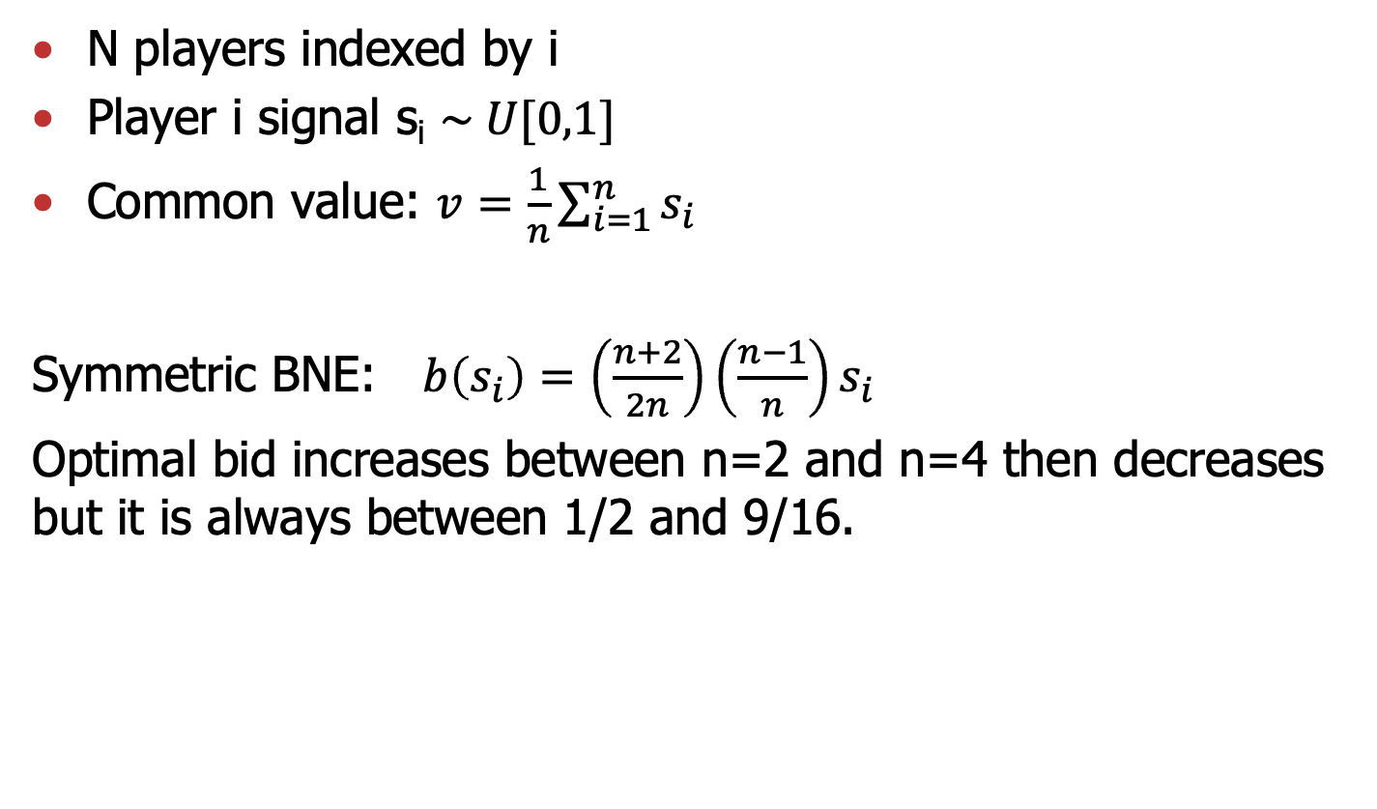
Numerical example
N players indexed by i
Player i signal s_{i} $\sim U[0,1]$
Common value: $v=\frac{1}{n}\sum_{i=1}^{n}{s_{i}}$
Symmetric BNE: $b\left(s_{i}\right)=\left(\frac{n+2}{2n}\right)\left(\frac{n−1}{n}\right)s_{i}$
Optimal bid increases between n=2 and n=4 then decreases but it is always between 1/2 and 9/16.

Slide 21
Example 7: Adverse Selection
A owns a firm. B knows how to run it better.
If the value is x for A, then it is 3x/2 for B.
→ There is gain from trade p ∈ [x, 1.5x]
Let’s make the problem interesting
A knows x but B does not. B only knows that x ∼ U[a,b] (owner knows better the value of the firm)
Timing
  B proposes a price p for the firm.
  A accepts or refuses and the game ends (no counter-offer, no repeated interaction, etc.)
How much should B offer?

Slide 22
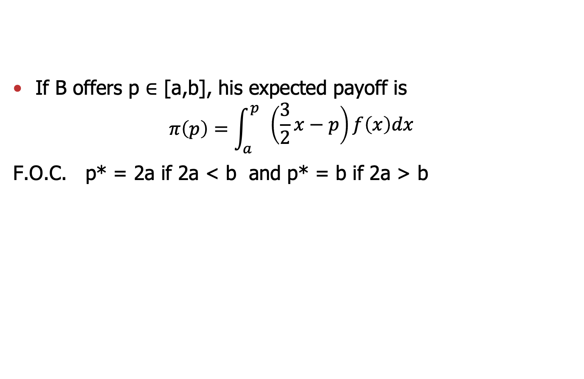
Adverse Selection
If B offers p ∈ [a,b], his expected payoff is
$$π\left(p\right)=\int_{a}^{p}{\begin{aligned}\left(\frac{3}{2}x−p\right)f\left(x\right)dx \\ \end{aligned}}$$
F.O.C. p* = 2a if 2a < b and p* = b if 2a > b

Slide 23
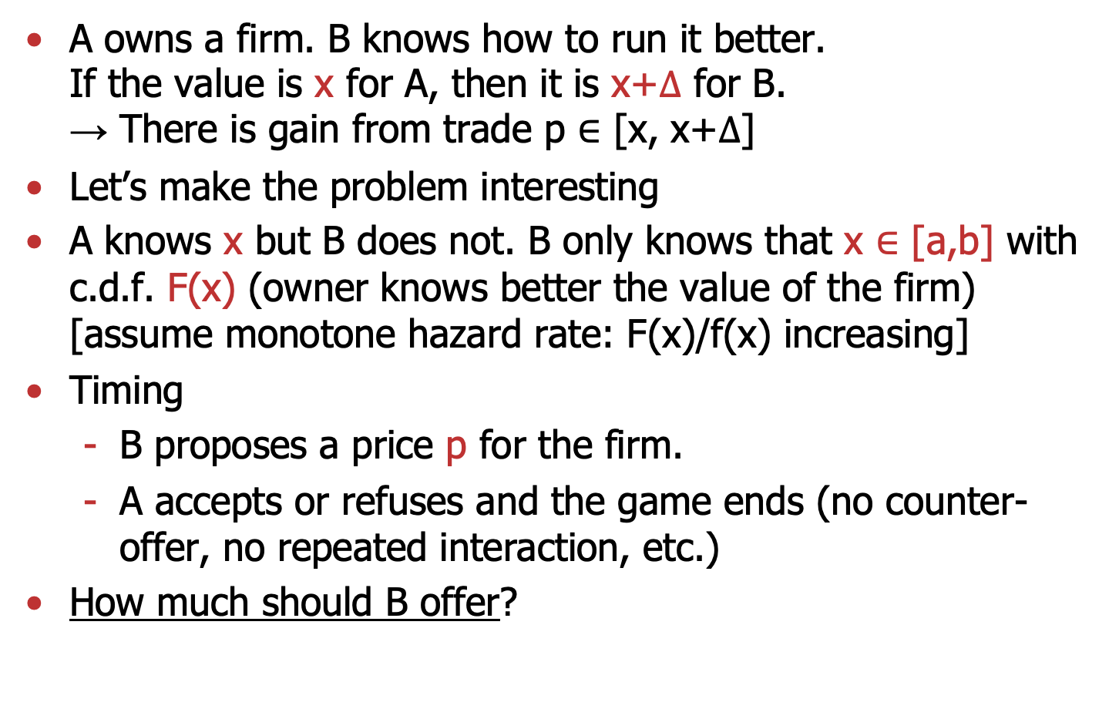
Example 7: Adverse Selection
A owns a firm. B knows how to run it better.
If the value is x for A, then it is x+$Δ$ for B.
→ There is gain from trade p ∈ [x, x+$Δ$]
Let’s make the problem interesting
A knows x but B does not. B only knows that x $∈$ [a,b] with c.d.f. F(x) (owner knows better the value of the firm)
[assume monotone hazard rate: F(x)/f(x) increasing]
Timing
  B proposes a price p for the firm.
  A accepts or refuses and the game ends (no counter-offer, no repeated interaction, etc.)
How much should B offer?

Slide 24
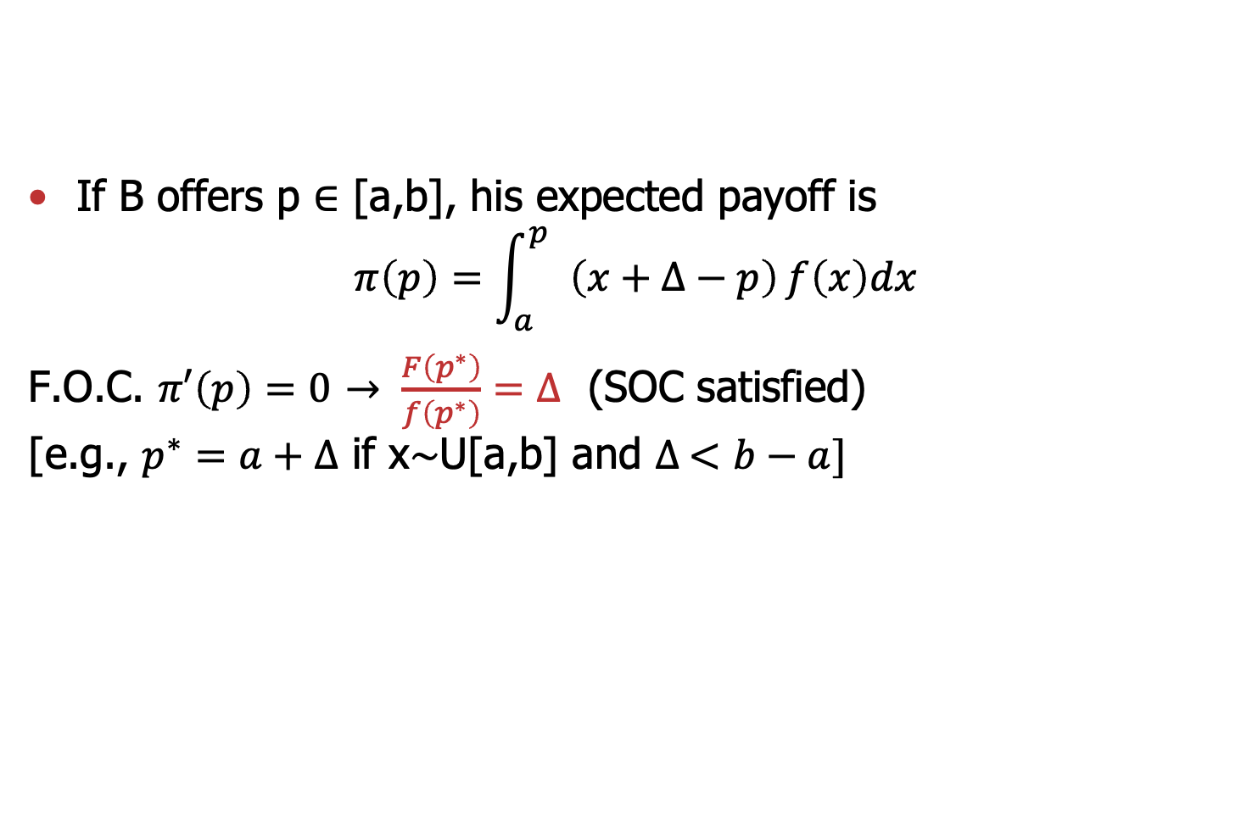
Adverse Selection
If B offers p ∈ [a,b], his expected payoff is
$$π\left(p\right)=\int_{a}^{p}{\begin{aligned} \\ \end{aligned}}\left(x+∆−p\right)f\left(x\right)dx$$
F.O.C. $π′\left(p\right)=0$ $→ \frac{F\left(p^{∗}\right)}{f\left(p^{∗}\right)}=∆$ (SOC satisfied)
[e.g., $p^{∗}=a+∆$ if x∼U[a,b] and $∆ <b−a]$

Slide 25
Adverse Selection
Conclusion
Adverse selection. When info. is asymmetric
  Low productivity workers most likely to accept offer
  Low quality cars most likely to be sold
  Worst health agents most attracted by insurance, etc.
This may lead to market unraveling but not always. It depends on the gains from trade, magnitude of uncertainty distribution of types, etc.
What would happen if seller could certify quality, that is, show unambiguous proof of x (but only if he wants to)?

